Slide 1

Unlocking Student Strengths with the DESSA System
Notes:
Hello and welcome to Unlocking Student Strengths with the DESSA System! In this session we’ll highlight best practices for using the DESSA to support students with disabilities or those receiving special education services.

Slide 2
Goals for Today’s Session
By the end of today’s session, you will be able to:
Understand how social and emotional assessments can support students receiving special education services.
Use students’ DESSA data as a guide when writing present level of performance statement(s) and individualized education plan goal(s).
Choose strategies and resources based on DESSA data to promote skill building.
Notes:
The overall goal of this mini session is to help you to gain an understanding of how to identify the strengths of students with exceptionalities in a way that will guide how you may provide skill building support.
By the end of today’s session, you will be able to:
Understand how social and emotional assessments can support students receiving special education services.
Use students’ DESSA data as a guide when writing present level of performance statement(s) and individualized education plan goal(s).
Choose strategies and resources based on DESSA data to promote skill building.

Slide 3

Opening Activity
What strengths do you recognize in your students receiving special education services?
Notes:
As an opening activity, let’s ground ourselves with a strengths-based mindset. Although some of our students may present some challenges, what strengths do you recognize in your students?

Slide 4
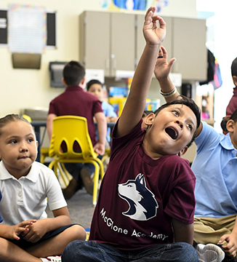
Social Emotional Competence and Special Education
Notes:
Thank you for sharing. It’s time to explore our first topic, social emotional competence and Special Education.

Slide 5
Social Emotional Competence and Special Education
Positive Student Growth and Outcomes
Identify Student
Strengths Using Research-based Assessments
Social Emotional Assessments:
DESSA 2 mini
DESSA 2
Know Student
Strengths
Complex Needs
Personal,
Behavioral
Social,
and Emotional
Academic
Communication
Notes:
All students can benefit from ongoing social and emotional competence building and instruction; yet, as special education teachers know, students with disabilities often need additional support to build their social and emotional competence.
Students receiving special education services often have complex needs across several domains including – social and emotional, academic, and communication. We know however, that rather than approach a student's individualized programming only through a deficit lens – it is more beneficial to adopt a strength-based approach, in which a student's strengths are leveraged to develop their areas of need.
Regardless of the setting and context in which students receive services, assessment data can help you design intentional, proactive intervention to better meet the unique needs of the students you serve. Using assessment data will position you to meet the goals of positive student growth and outcomes.

Slide 6
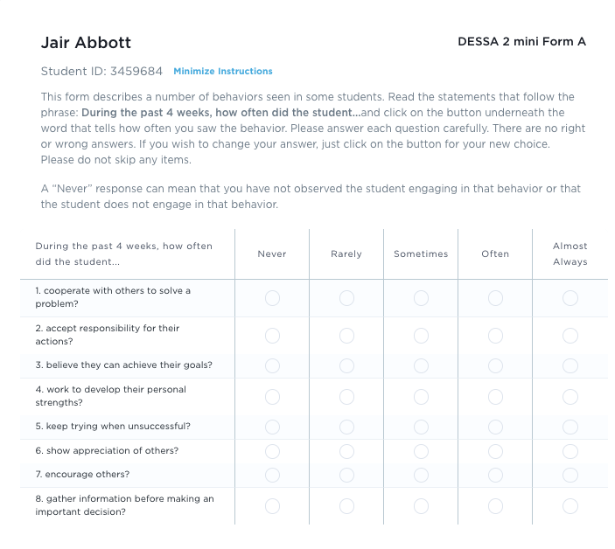
The DESSA
What is it and how can it support students receiving special education services?
Notes:
Now that we know how social and emotional competency assessment can support students with exceptionalities, let’s talk more specifically about the DESSA.

Slide 7
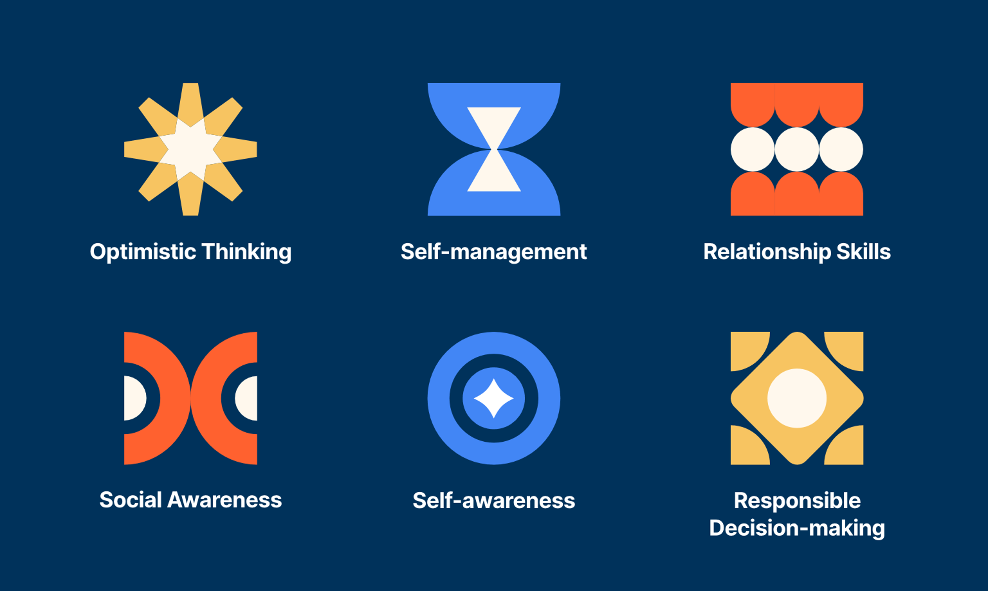
Defining the DESSA
The DESSA is an evidence-based social and emotional competency assessment to support student growth.
Notes:
As a reminder, the DESSA is an evidence-based social and emotional competency assessment to support student growth.
The data from the DESSA shares where a student has strengths within 6 skill areas as well as where teachers have an opportunity to provide further instruction. With DESSA data, educators can design individualized instruction to better meet the unique needs of the students they serve.
The 6 skill areas are self-awareness, optimistic thinking, self-awareness, self-management, responsible decision making, social awareness, and relationship skills.

Slide 8


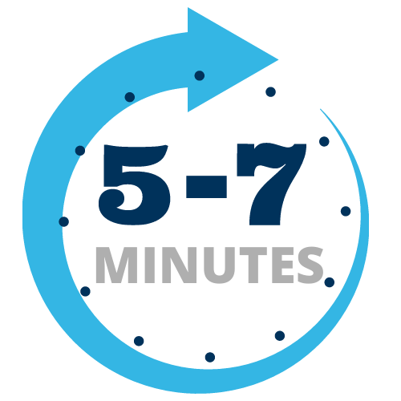
Fast Facts about the DESSA
Standardized
Norm-Referenced
Strength-Based
K-12th Educators Complete
DESSA-mini Universal Screener
DESSA Assessment
Notes:
On the bottom portion of this slide, the different DESSA assessments are noted, which we will expand on in just a moment.
First, let’s take a look at the development and standardization properties of the DESSA assessments.
(Click) All the DESSA assessments are standardized; there are established procedures for administering, scoring, and interpreting the results.​ The standardization sample was representative of the population across the United States and a bias analysis was completed for each question item.
(Click) They are norm-referenced scores and are based on a national sample of students. Students’ social and emotional competence can be compared or benchmarked to other students. ​The assessments are classified as Behavior Rating Scales which are one of the most common forms of assessment used in the educational field.
(Click)Most uniquely, the DESSA assessments are strength-based. Every question on the DESSA is a positively worded, desirable behavior, such as “get along with others”, rather than maladaptive ones, like “annoys others”. There are many advantages to this approach of promoting social and emotional competencies, a main benefit is that these social-emotional competencies contribute to a student’s resilience in the face of adversity. By highlighting students’ strengths, educators can help students leverage their strengths in areas of growth.

Slide 9
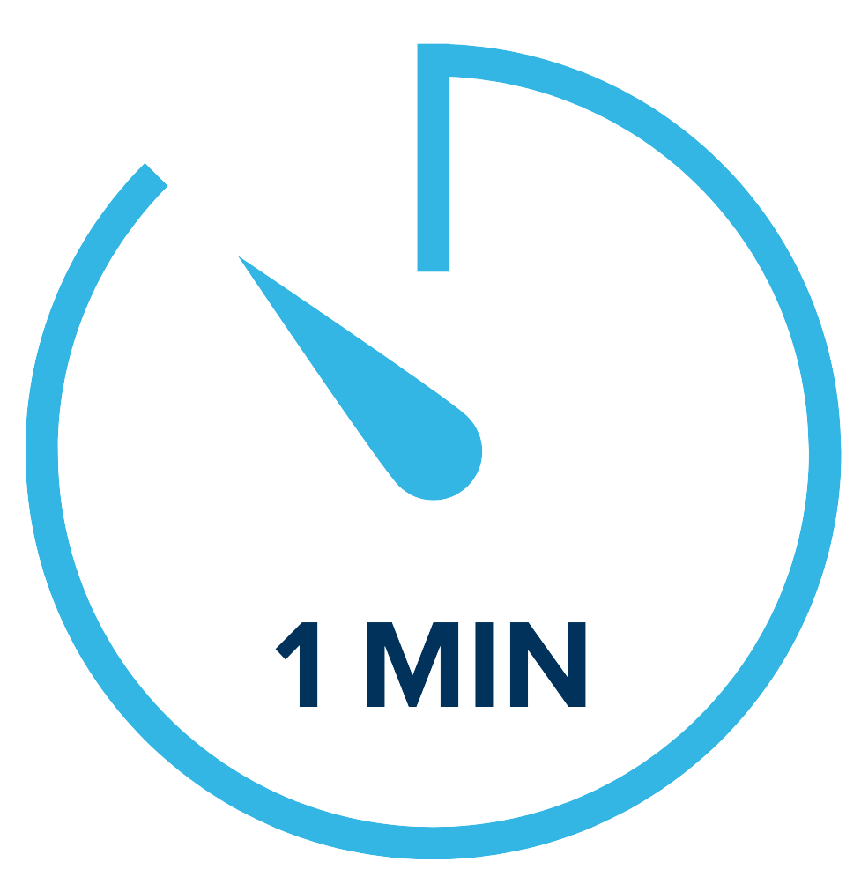
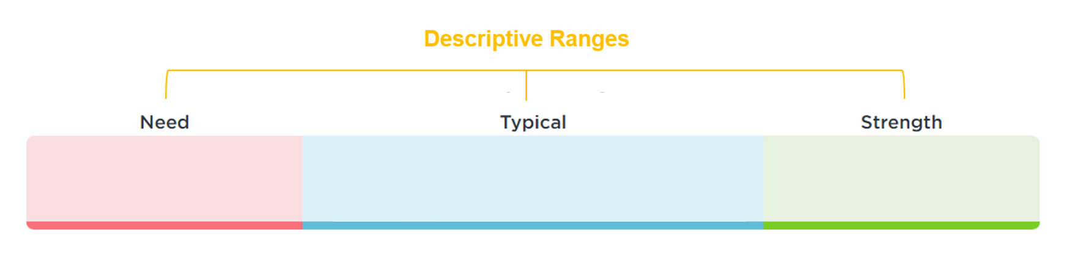
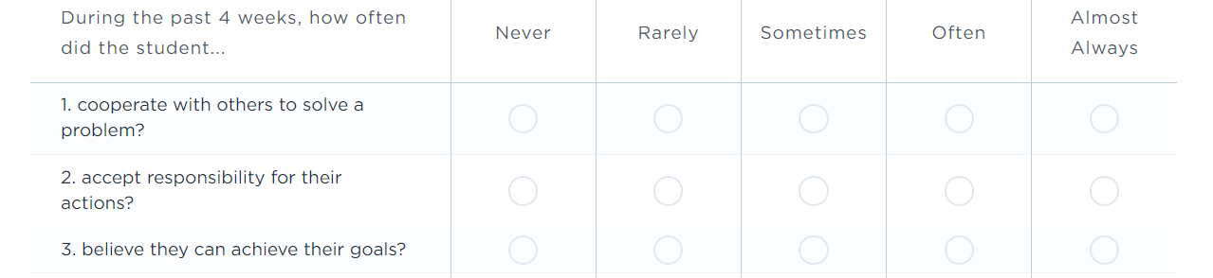
DESSA 2 mini (K-8)
Universal Screener
4 Forms
Score:
Social-Emotional Total (SET)
Educators Complete
Notes:
The DESSA 2-mini is a universal screener of social and emotional competence designed for all students. It has 8 questions and takes about 1 minute per student for an educator (or rater) to complete.
The primary purpose of the “mini” screener is to quickly and accurately identify which students may be at risk of academic and behavioral difficulties based on their social and emotional development.
The screener is completed online after at least 4 weeks, or a cumulative of 24 hours over a 4-week period of interaction and observation of the student. There are 4 different forms that can be utilized for progress monitoring throughout the school year.
(Click) The results from the DESSA 2-mini produce a Social-Emotional Total (SET) score that provides an indication of a student’s overall social and emotional competence at the time of assessment.
This data can help educators plan how best to strengthen, readjust, or add universal supports. This screener can also help to identify students that may benefit from additional assessment.
A few examples of questions that are on the DESSA 2-mini are listed here, with the answer options that can be selected based on the frequency in which the educator has observed the student to utilize a specific skill.
[Click] The student’s results will populate on this spectrum provided.

Slide 10
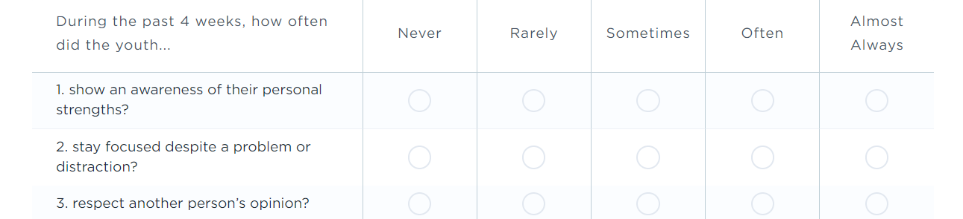
DESSA High School Edition (HSE) Mini (9-12)
Universal Screener
4 Forms
Score:
Social-Emotional Total (SET)
Educators Complete
Notes:
For the high school setting, educators complete a version of the screener called the High School Edition, or the DESSA-HSE mini.
Similar to the screener used for grades Kindergarten through 8th grade, educators complete the screening, which also results in one score, the Social and Emotional Total (SET).
(Click) There are differences in the language used on the high school edition (the HSE), including “youth” instead of child, and the frequency scale options for the educator to select from when answering the questions. The skills assessed on the HSE screener also reflect that of students within the 9th-12th grade range.

Slide 11
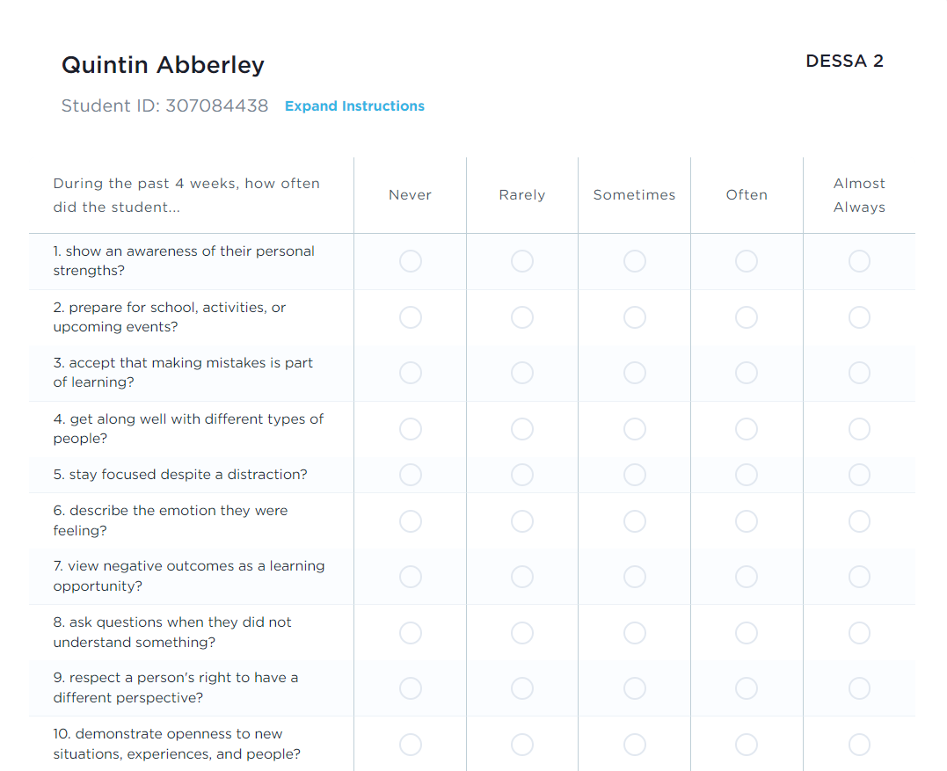
DESSA 2
K-8
Assessment of 6 competency areas
Educators Complete
Scores:
Social and Emotional Composite (SEC)
6 competency areas
Notes:
The DESSA 2 is a full assessment of students' social and emotional competencies. It takes about 5 minutes for an educator to complete, and it is typically completed as a follow-up assessment after the DESSA-mini for certain students, if needed. We will look at that conditional process in just a moment.
The results of the DESSA produce one total score, the Social and Emotional Composite (“SEC”) score, and a score for each of eight social and emotional competencies per student.
Similar to the DESSA-mini, each question on the DESSA is a positively worded, desirable behavior and offers the educator (or rater) the same Likert frequency scale to select their answer.
The DESSA data provides an indication of student strengths and needs across multiple competencies, it can help educators plan how best to strengthen, readjust, or add universal and tiered supports in specific areas.

Slide 12
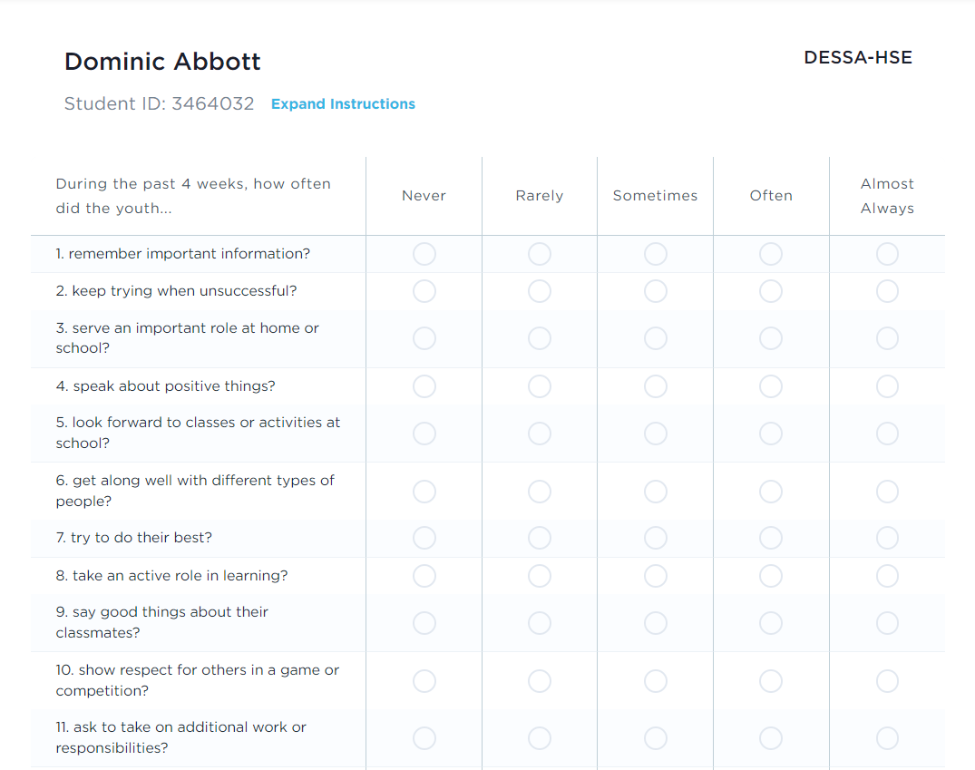
DESSA High School Edition (HSE)
9th-12th
Assessment of 8 competency areas
Educators Complete
Scores:
Social and Emotional Composite (SEC)
8 competency areas
Notes:
The high school version of the DESSA assessment mirrors that of the HSE screening tool, with the differences in language used to identify the student (“youth”) and the frequency scale options, as well as the skills measured for in 9th-12th grades, which we can see here in the examples on screen.
Just like the K-8 version, this follow-up assessment allows for educators to have a deeper insight into the strengths of an individual student, with t-score results in each of the 8 competency areas.

Slide 13

Think-Pair-Share:
How might a strength-based approach improve conversations about students’ IEP goals and performance?
Notes:
We’ve talked a lot about a strength-based approach and how DESSA can support that mindset.
In a few moments, I will invite you to pair up and discuss how a strength-based approach can improve conversations about students’ IEP goals and performance?.
Take a moment to jot down some thoughts and then we’ll pair up and share.

Slide 14

The DESSA and the IEP Process
Notes:
So, we know all about the DESSA, right?
Now let’s venture into how we can access and use DESSA data to support the IEP process.

Slide 15
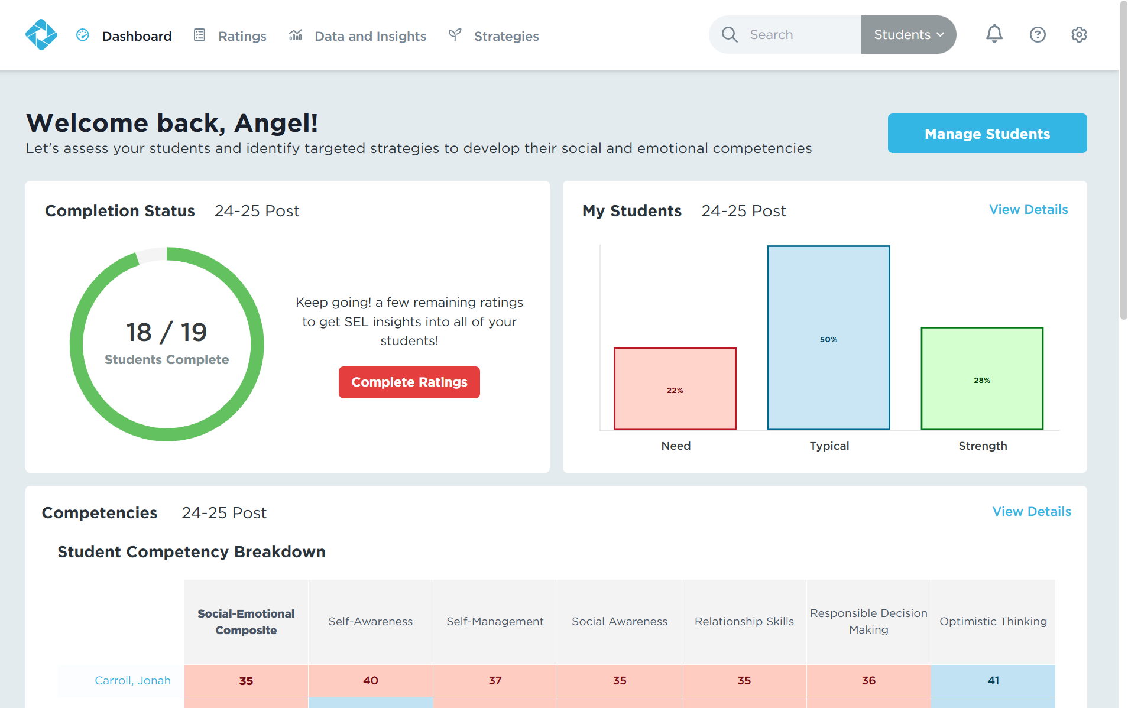
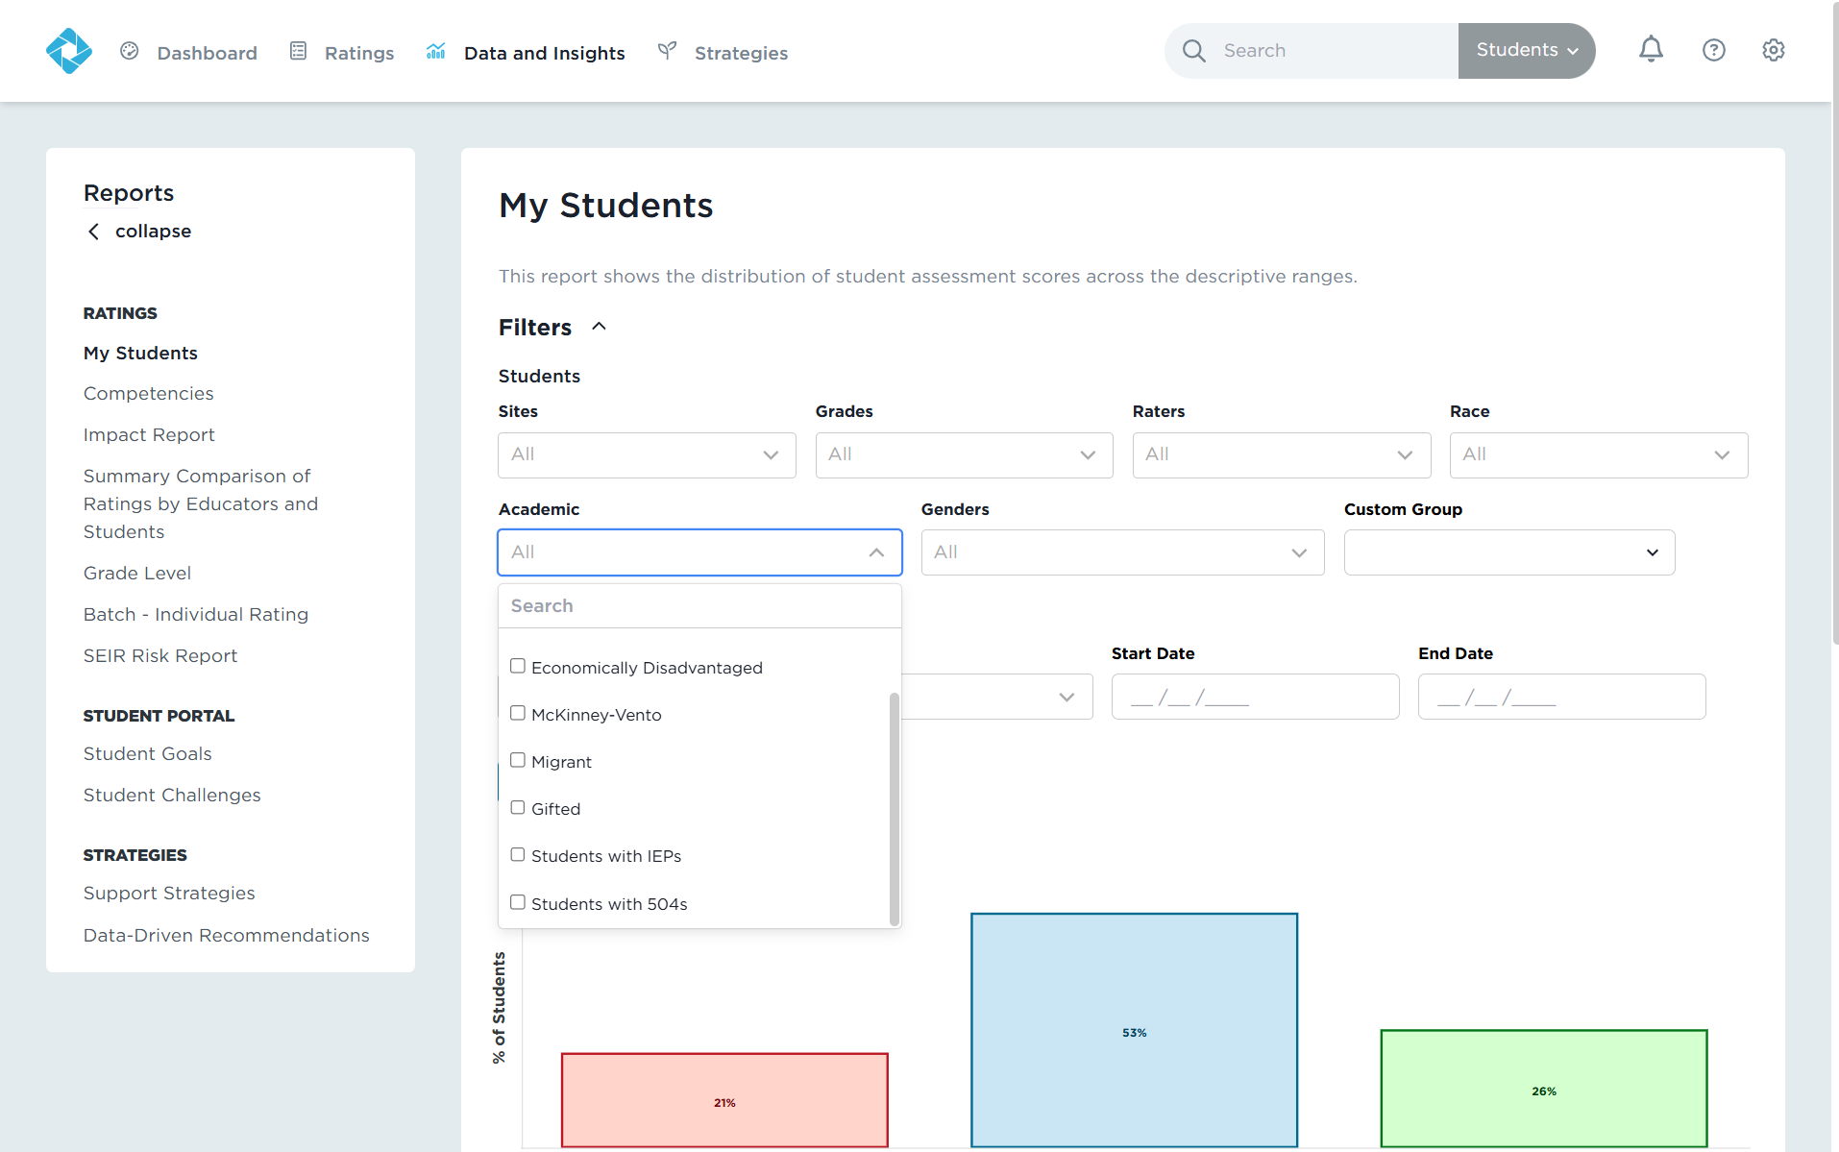
Accessing Student Data
Use the “Academic” filter to view students receiving special education services.
Click the “Data and Insights” tab.
Notes:
The first step to using DESSA data for the IEP process is accessing student data.
You may recall how to access your DESSA data in the online system.
You will click on the Data and Insights tab. [CLICK]You can use filters to view specific information.
[CLICK]Perhaps, you want to view students receiving special education services that have been rated on the DESSA assessment. You can filter for Special Ed under the Academic filter.

Slide 16
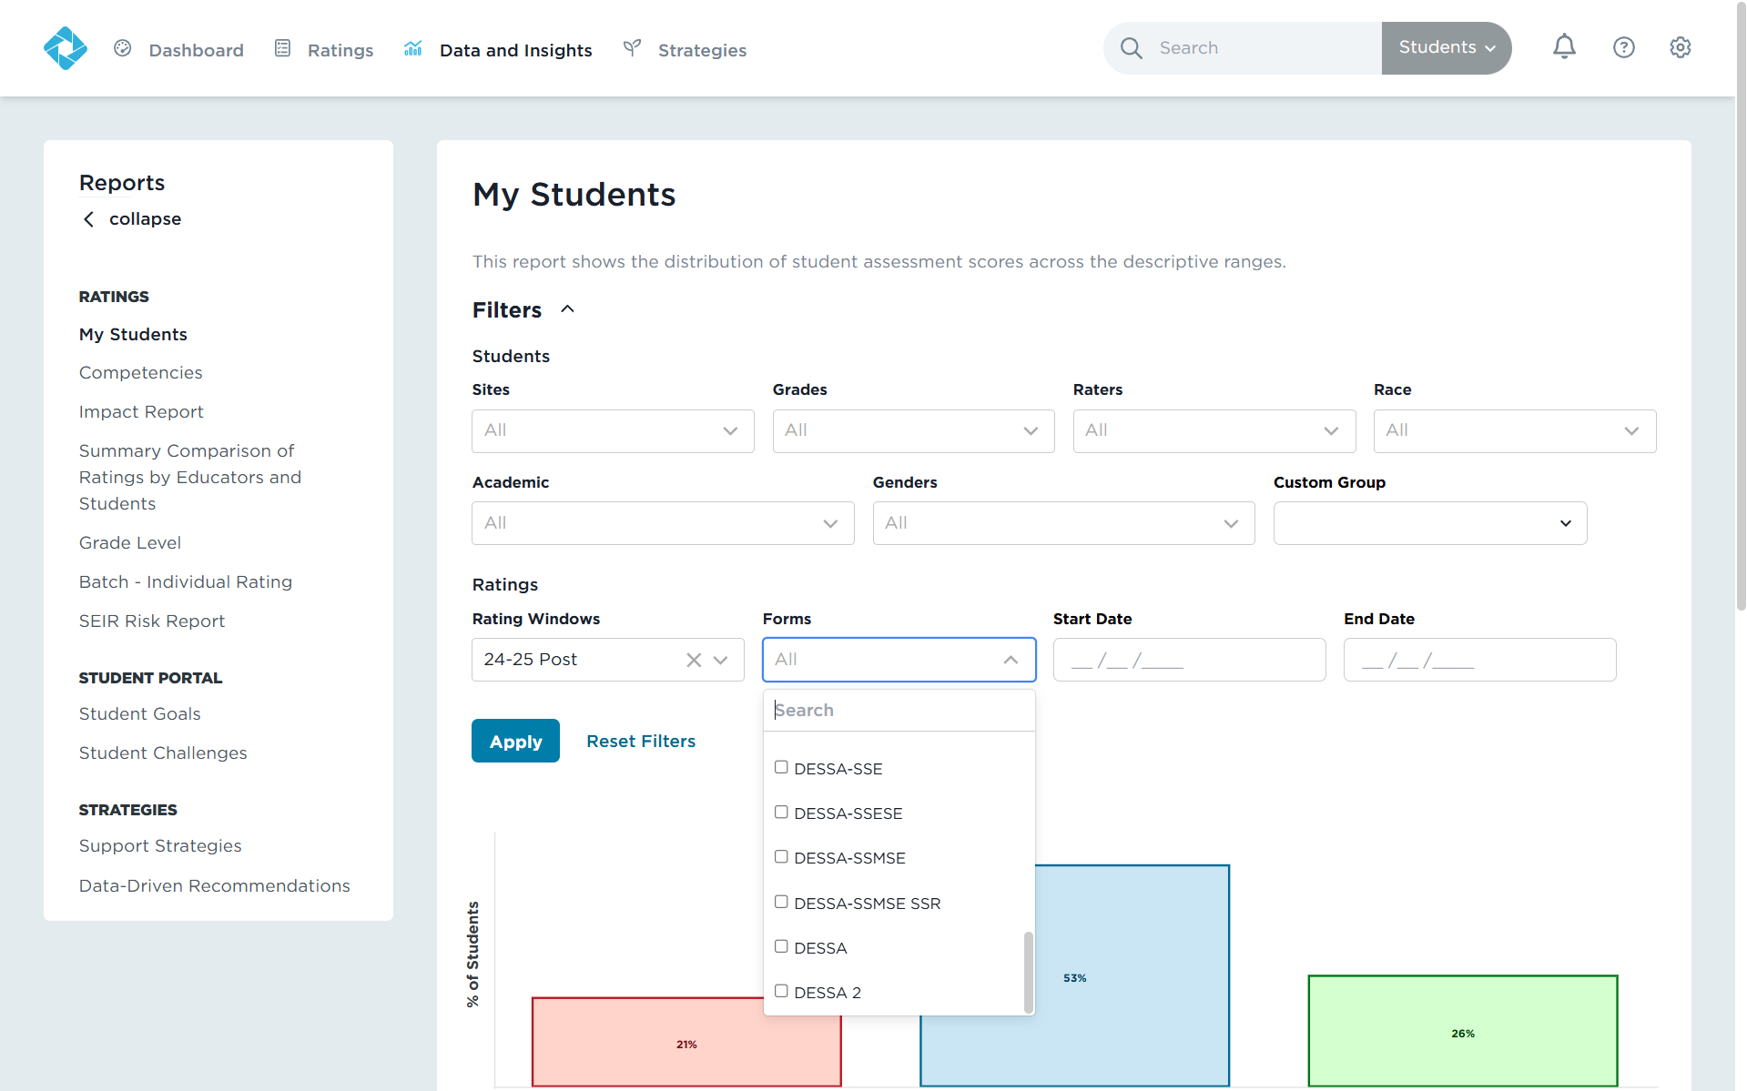
Accessing Student Data
Filter for the DESSA 2 form or DESSA-HSE form.
Click apply.
Notes:
After, choose the DESSA 2 or the DESSA HSE under the Forms filter.
Click Apply to see the results.

Slide 17
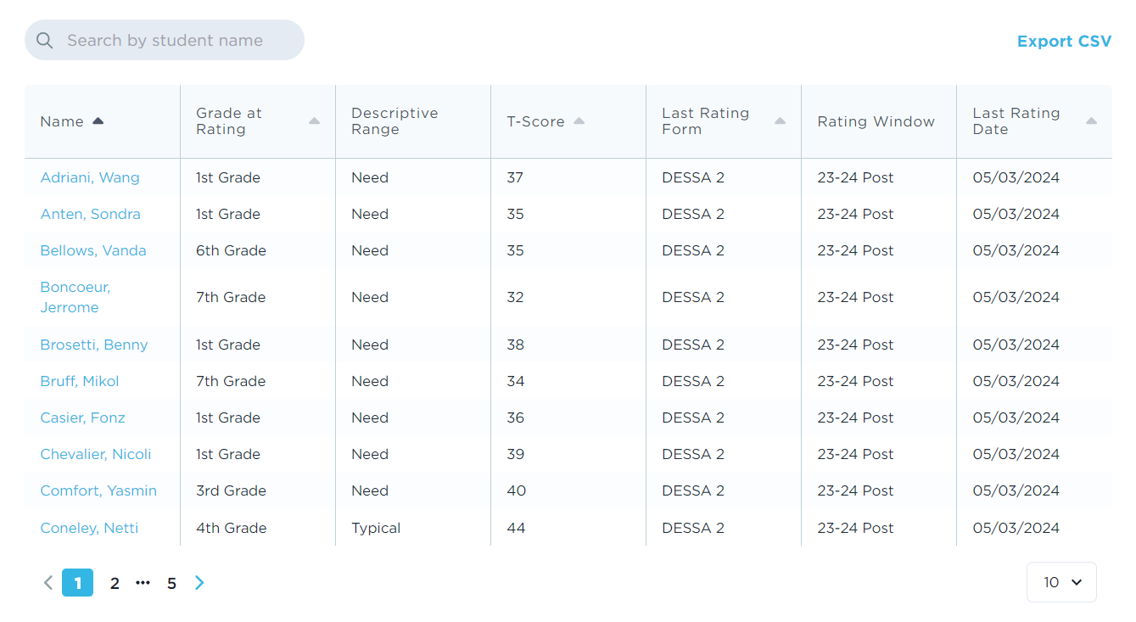
Accessing Student Data
Click on a student’s name to go to their individual student profile.
Notes:
Scrolling down to the student list, you can [CLICK] click on a student’s name to go to their individual student profile.

Slide 18
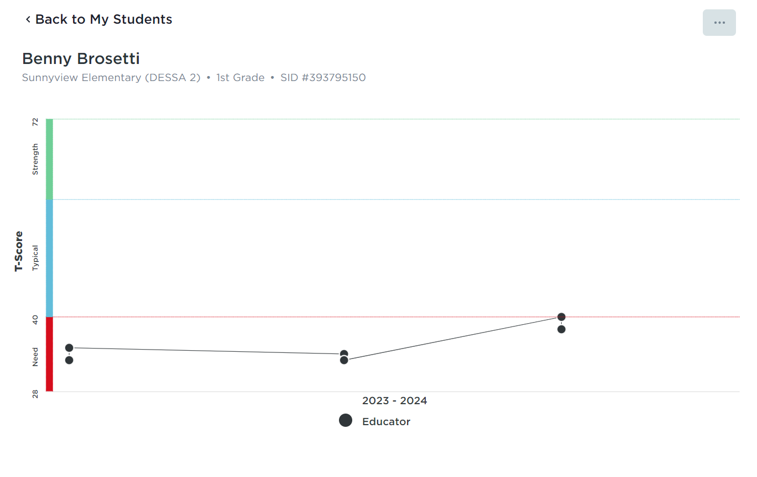
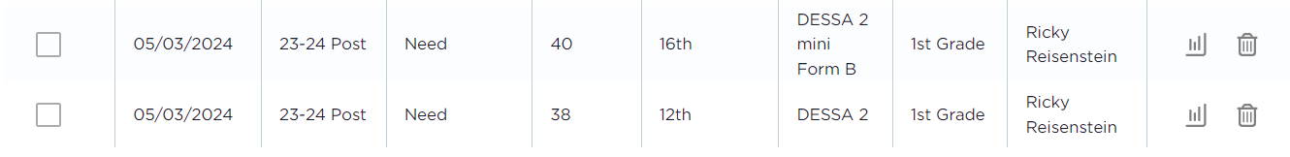
Accessing Student Data
View progress over time.
2. Scroll down to view general information about assessments on which the student previously has been rated.
3. Click on the report icon to review DESSA data from a specific rating.
Notes:
Here, you can view progress over time and [CLICK]scroll down to view general information about assessments on which the student has previously been rated.
[CLICK] Clicking on the report icon for a chosen DESSA rating will display the student’s individual score report.

Slide 19
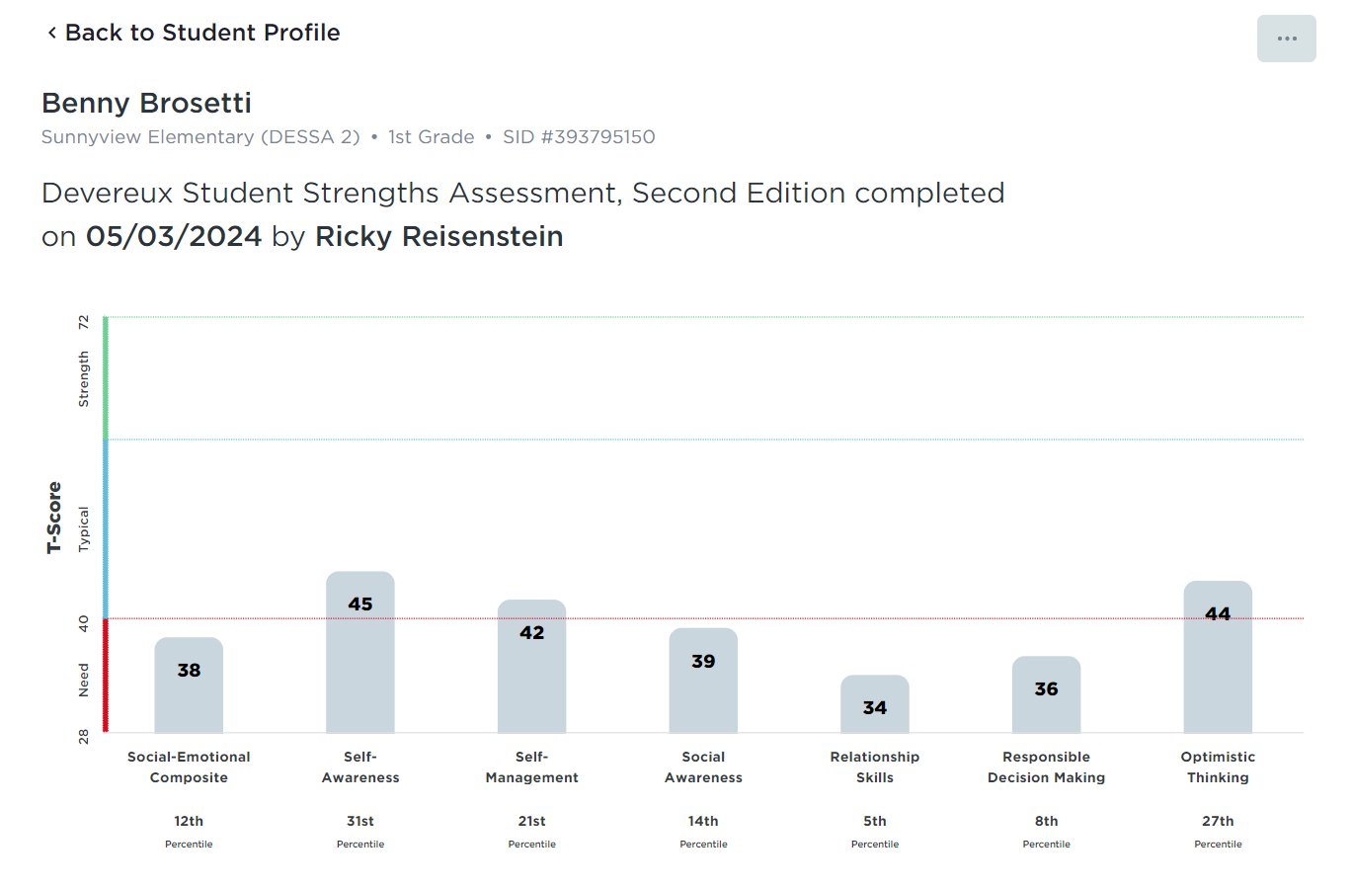
Individual Student Report
Relative Strengths:
Self-Awareness
Self-Management
Optimistic Thinking
Need for Instruction:
Social Awareness
Relationship Skills
Responsible Decision Making
Notes:
This student’s social and emotional composite score is a 38 in the Need for Instruction range.
First, we want to acknowledge some strengths the student possesses by highlighting Typical scores in self-awareness, self-management, and optimistic thinking.
Self-Awareness represents an area where the student has the strongest skill acquisition.
The student has a need for instruction in the other skill areas, in particular, relationship skills which represents the lowest score on this student’s DESSA report.
To find out even more detailed information about student skills in these competency areas, you can scroll down and view an individual item analysis, filtering out for specific areas you want to target.
We will use this student’s score report and individual item analysis to formulate an example present level of performance statement and individualized annual goal.

Slide 20
Individual Student Report
Notes:
As we view the score report, one way to begin considering how to support the student would be to first acknowledge the area where the student presents the most skill acquisition and strengths.
(click) In this case, Self-Awareness represents where the student has the greatest strengths. Recognition of this can be empowering for the student as well as for you.
Leveraging students’ skills and strengths in one area can help to motivate the student as you are supporting them in another area where they have a need for instruction.
In terms of the IEP process, focusing on skill acquisition in Self-Awareness may help guide you while writing the present level of performance statement on the IEP.
You can also identify where a student has the highest need for instruction to begin goal setting and establishing a plan for skill building
(click). Based on this score report, the area where the student has the highest need for continued support is Relationship Skills.
Let’s look more in depth at the student data starting with the individual item analysis for Optimistic Thinking.

Slide 21
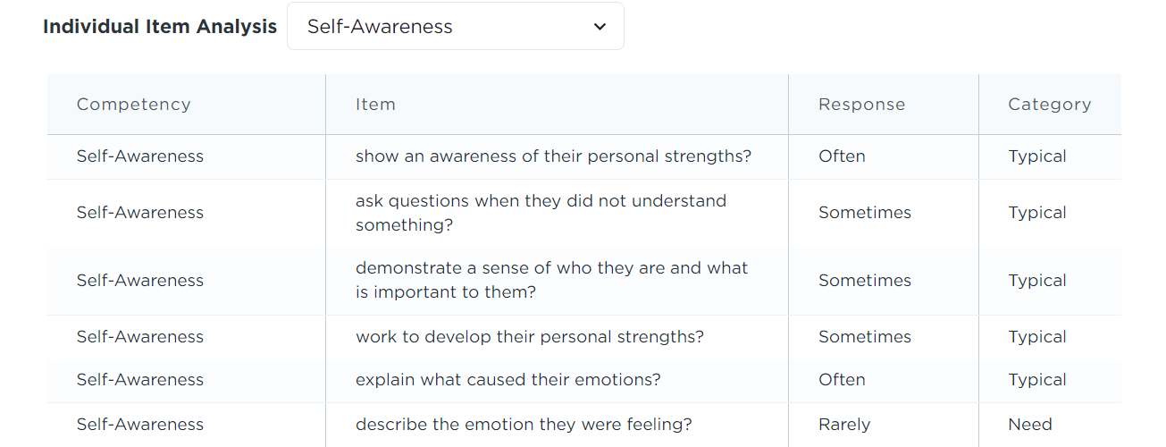
Present Level of Performance
Example: Student A has strong acquisition in Self-Awareness as they often show an awareness of their personal strengths and can often explain what caused their emotions. While Student A is self-aware, they require additional support to describe the emotion they were feeling.
Notes:
Viewing the individual analysis can help you identify where the student has acquired some skill mastery in Self-Awareness. Let’s apply this data to writing a present level of performance.
Again, the present level of performance statement serves a strength-based purpose to magnify where a student is currently performing well. In addition, it can connect how a student’s disability may impact access to the general education curriculum.
The individual item analysis reflects data-based information about a student’s current strengths just as we can see in this example. Using the DESSA data can help you to write an accurate and observable present level statement.
An example based on the sample data from the individual analysis displayed here is: Student A has strong acquisition in Self-Awareness as they often show an [CLICK] awareness of their personal strengths [CLICK] and can often explain what caused their emotions.
While Student A is self-aware, (click) they require additional support to describe the emotion they were feeling.
Please keep in mind that every school district and LEA may have specific guidelines on formatting the present level of performance statement. We recommend you follow those guidelines.
The formula used here is to first indicate the strengths based on DESSA data from the individual item analysis and then identify an area where the student has a need for instruction based on the DESSA data.
Here, the growth area is still in Self-Awareness; however, you may choose to identify a growth area within another competency where the student demonstrates a need for instruction.
Now that we know where the student has strong skills, we can identify where to set an annual goal in an area where your student has a need for instruction.

Slide 22
Individualized Goal
Example: “By the end of the school year, the student will be able to identify emotions they were feeling, and apply strategies taught to describe those emotions 8 out of 10 observed instances.”
Notes:
Individualized goals are set in an area where the student needs additional support or instruction to skill build.
You will identify an annual goal and, at times, short-term benchmarks/objectives.
After implementing strategies and instruction to support a student so they can reach these goals, progress monitoring is used as a measure effectiveness and goal mastery.
As previously mentioned, [CLICK] this student demonstrates a Need in describing the emotion they were feeling.
Using the DESSA data, we can set an intentional and targeted goal for the student. As with the present level of performance, please keep in mind that every school district and LEA may have specific guidelines on formatting the annual goal. We recommend you follow those guidelines.
Identifying emotions can be explicitly taught using individual lessons or curriculum, and then practiced and reinforced in their learning environment.
[CLICK] An annual goal for this student could be: “By the end of the school year, the student will be able to identify emotions they were feeling, and apply strategies taught to describe those emotions 8 out of 10 observed instances.”
To make a stronger connection to the strength we identified in the previous slide as well as to motivate the student, you might include as part of this strategy that the student will remind themselves that because they understand emotions, thoughts, and values and how they influence one's behavior, they can use that awareness to identify triggers before they erupt and then use the problem-solving strategies to resolve disputes.
After establishing the goal, you can choose strategies from the Educator Portal to support your work with the student.

Slide 23
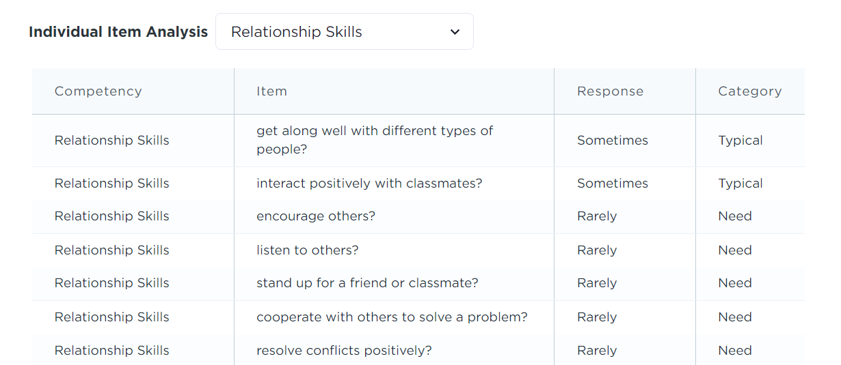
Individualized Goal
Example: By the end of the school year, the student will be able to identify conflict triggers and apply strategies taught to resolve disputes in 8 out of 10 observed instances.
Notes:
Because the student has a Need in Relationship Skills, you could also set an individual goal for Relationship skills.
The individual item analysis tells us that while [CLICK] the student gets along with different types of people and interacts positively with classmates, [CLICK]they rarely resolve conflicts positively.
Conflict resolution skills can be explicitly taught using individual lessons or curriculum, and then practiced and reinforced in their learning environment.
[CLICK] An annual goal for this student could be: “By the end of the school year, the student will be able to identify conflict triggers and apply strategies taught to resolve disputes in 8 out of 10 observed instances.”
Because the student has strengths in getting along with others, perhaps the educator would include other students in learning about how to identify conflict triggers and provide social scenarios that the students could work through together.
Chat activity: Let’s pause here to hear from you all. What are some ways that you would support Benny in meeting a goal set for conflict resolution skills? Enter them in the chat!

Slide 24

Reflect and Connect:
What are some ways that you would support Student A in meeting a goal set for conflict resolution skills?
Notes:
Now that we’ve discussed how to use the DESSA in the IEP process, what are some ways that you would support Student A in meeting a goal set for conflict resolution skills?

Slide 25

Data-Driven Skill Building
Notes:
Now that we’ve used our DESSA data to develop an IEP, let’s discuss how that same data can drive skill building.

Slide 26
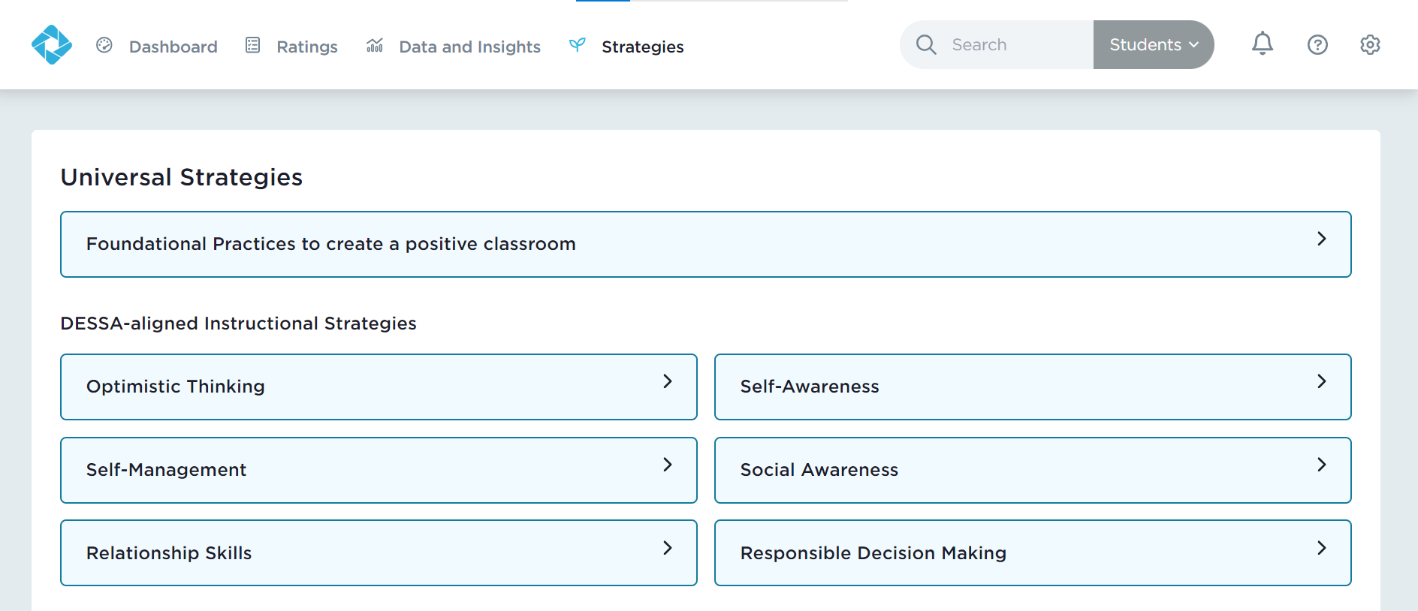
Data-Driven Skill Building
Notes:
Referring to the same student we have been discussing during this session, when looking for resources to support growth based on IEP goals, you could use DESSA-aligned strategies for [CLICK] Relationship Skills.
It may take collaboration with other colleagues to introduce, teach, and allow practice time for the student to generalize and apply the new skill.
For example, you may work with a School Counselor to aid in introducing the strategy in a small group or individual setting, then within the classroom, as the teacher, you will allow the student opportunities for further practice, reinforcing the student each time they demonstrate the new skill.

Slide 27
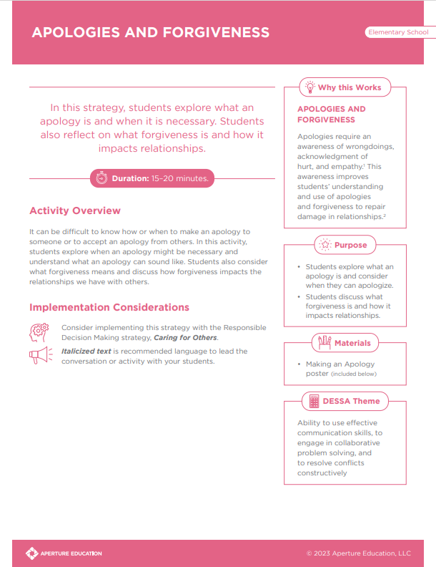
Data-Driven Skill Building
Relationship Skills: Apologies and Forgiveness
Students define what an apology is and learn when it is appropriate to apologize.
Students also reflect on what forgiveness is and how it impacts relationships.
At the end of the lesson, students make an apology.
Notes:
“Apologies and Forgiveness” might be a great strategy to start with because we know that Benny struggles to resolve conflicts positively.
In this strategy, students explore what an apology is and when it is necessary. Students also reflect on what forgiveness is and how it impacts relationships.

Slide 28

Optimistic Closure
How might a strength-based approach improve:
Conversations about student support?
Culture and climate?
Engagement with families?
Notes:
We know that a strength-based approach is pivotal for all students, but especially for those with exceptionalities.
So, to end our time together, let’s take a moment to reflect on the strength-based approach and how that might improve conversations, culture, climate, and engagement.
Take a moment to reflect and respond to the following questions: How might a strength-based approach improve:
Conversations about student support?
Culture and climate?
Engagement with families?
Thank you for your time and attention today! If you have any questions, please inform your building leaders.

