Slide 1

Getting Started with the DESSA System
Teacher-Completed Assessments
Notes:
Hello and welcome to Getting Started with the DESSA! In this session we’ll give a high-level overview of the DESSA System for all teacher-completed assessments including the DESSA 2 mini, the DESSA High School Edition (HSE) mini, the DESSA 2 and the DESSA High School Edition (HSE).

Slide 2
Goals for Today’s Session
By the end of today’s session, you will be able to:
Identify key components of the DESSA 2 and DESSA High School Edition (HSE) assessments.
Demonstrate best practices for completing ratings and interpreting the scoring result categories.
Explore key features of the Educator Portal.
Notes:
In our time together today, we will:
Identify key components of the DESSA 2 mini, DESSA HSE mini, DESSA 2, and DESSA HSE assessments,
Demonstrate best practices for completing ratings and interpreting the scoring result categories, and
Explore key features of the Educator Portal.

Slide 3
Opening Reflection
What hopes do you have for the students, staff, and families in our school community this year?
Notes:
As an opening activity, before diving right into content, let’s hear from you!
When we open training with hope, it centers us on our “why” and helps us frame our work accordingly.
So, I’ll take some volunteers to share. What hopes do you have for the students, staff, and families in our school community this semester?

Slide 4
Today’s Agenda
Here’s how we’ll spend our time together today:
What is the DESSA?
How to Complete Ratings
The Educator Portal
Implementation Overview
Optimistic Closure
Notes:
Thank you so much for sharing! Let’s talk through how we’ll spend the rest of our time together:
We’ll discuss what the DESSA is and what it is not,
We’ll practice completing a rating,
We’ll walk through an overview of the Educator Portal and the roles within it,
And finally, we’ll close out with an optimistic closure and opportunity for feedback.

Slide 5
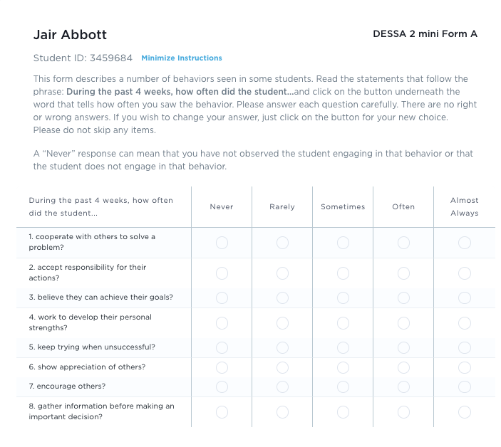
What is the DESSA?
An evidence-based social and emotional competency assessment to support student growth.
Notes:
In this session, we will dive into what the DESSA assessments are and how they can be used to support educators, students, and their families.
In short, the DESSA is an evidence-based social and emotional competency assessment to support student growth, including a screening tool and a full diagnostic assessment that educators complete for their assigned students.

Slide 6
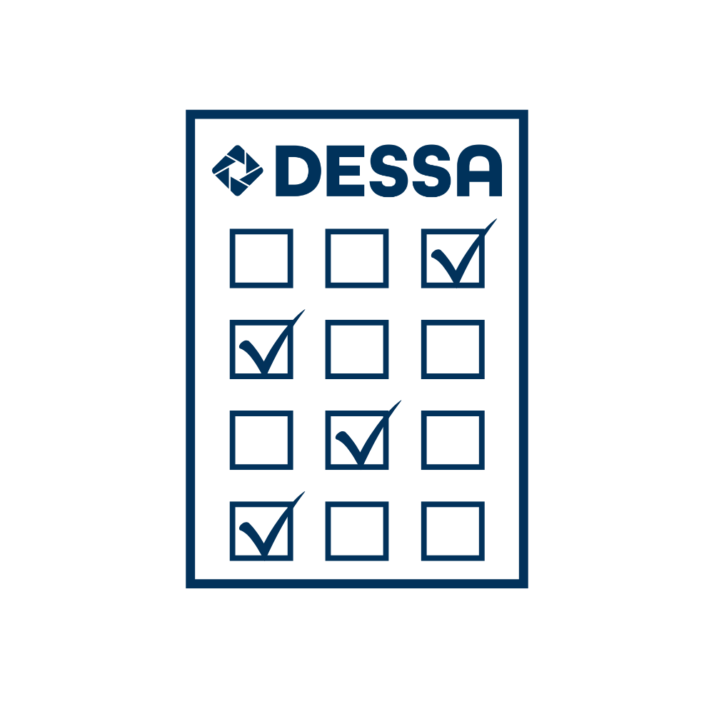

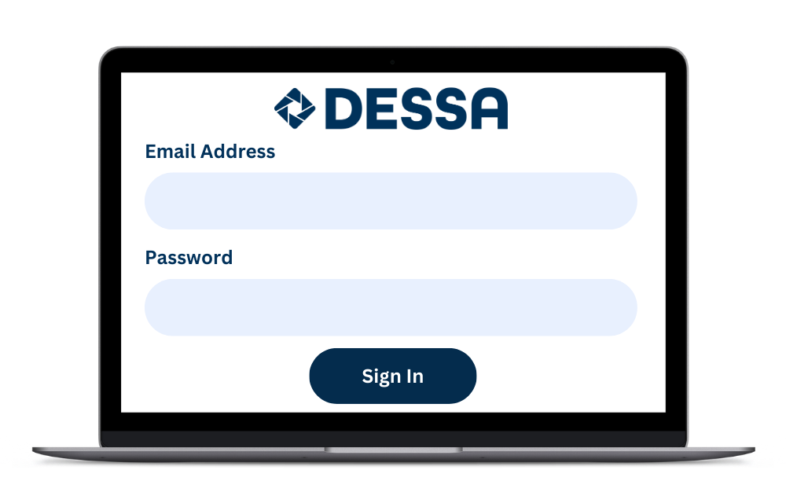
Overview: The DESSA
2024-2025
Strength-Based Behavior
Rating Scale
Site-based implementation schedule
Educator Portal:
DESSA ratings & data reports, resources, support
Notes:
As an overview:
(Click) It is a nationally standardized, strength-based behavior rating scale that assesses students’ social and emotional competence with editions that support students K-12.
(Click) It has been used by districts and out-of-school time programs across the country, and site or district-based implementation schedules are outlined for this data collection
(Click) Finally, DESSA assessments and real-time data reports are located in the online Educator Portal, along with additional resources, and support options.

Slide 7

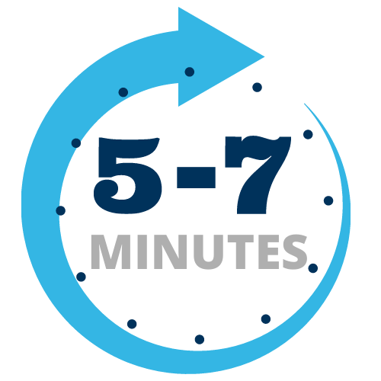

Fast Facts about the DESSA
Standardized
Norm-Referenced
Strength-Based
6th-12th Students Complete
K-12th Educators Complete
DESSA
SSR
DESSA-mini Universal Screener
DESSA Assessment
Notes:
On the bottom portion of this slide, the different DESSA assessments are noted, which we will expand on in just a moment.
First, let’s take a look at the development and standardization properties of the DESSA assessments.
(Click) All the DESSA assessments are standardized; there are established procedures for administering, scoring, and interpreting the results.​ The standardization sample was representative of the population across the United States and a bias analysis was completed for each question item.
(Click) They are norm-referenced scores and are based on a national sample of students. Students’ social and emotional competence can be compared or benchmarked to other students. ​The assessments are classified as Behavior Rating Scales which are one of the most common forms of assessment used in the educational field.
(Click)Most uniquely, the DESSA assessments are strength-based. Every question on the DESSA is a positively worded, desirable behavior, such as “get along with others”, rather than maladaptive ones, like “annoys others”. There are many advantages to this approach of promoting social and emotional competencies, a main benefit is that these social-emotional competencies contribute to a student’s resilience in the face of adversity. By highlighting students’ strengths, educators can help students leverage their strengths in areas of growth.

Slide 8
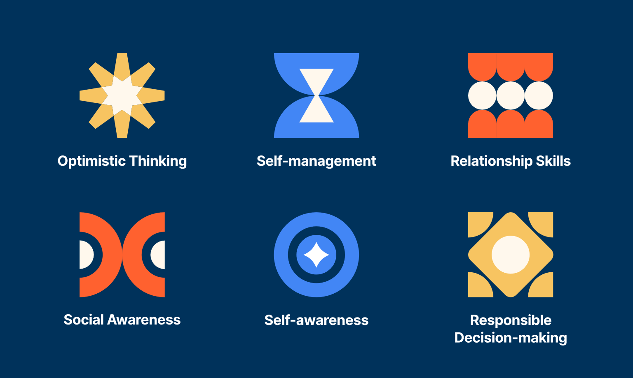
What does the DESSA measure?
Notes:
So what does the DESSA measure? It measures 6 competencies: Optimistic Thinking, Self-management, Relationship Skills, Social Awareness, Self-awareness, and Responsible Decision-making.
If anyone asks for definitions of them, we’ve provided them below:
Optimistic Thinking: the belief and demonstration of confidence, hopefulness, and positive thinking regarding oneself, others, and one’s life situations in the past, present, and future.
Self-management: the ability to manage emotions and behaviors across different situations and environments and to demonstrate agency as one works to set and achieve personal and collective goals.
Relationship Skills: the abilities to establish and maintain healthy and positive relationships including effective communication, collaborative problem-solving, negotiating conflict, and demonstrating helpful and supportive behaviors.
Social Awareness: the understanding of social norms for behavior; the ability to empathize with, respect, and take the perspectives of others; and the feeling of connection and belonging with family, peers, schools, and community groups.
Self-awareness: the ability to understand emotions, thoughts, and values and how they influence one’s behavior; recognize strengths and limitations; and develop healthy identities and a sense of purpose.
Responsible Decision-making: the ability to make careful, reliable, and constructive choices about personal and social behavior that are appropriate across diverse situations; to consider the personal, social, and collective impact of one’s actions; and to demonstrate curiosity and an open-mindedness to learning.
Article with definition of competencies https://selcompass.zendesk.com/hc/en-us/articles/29465433977357-DESSA-2-Competencies

Slide 9
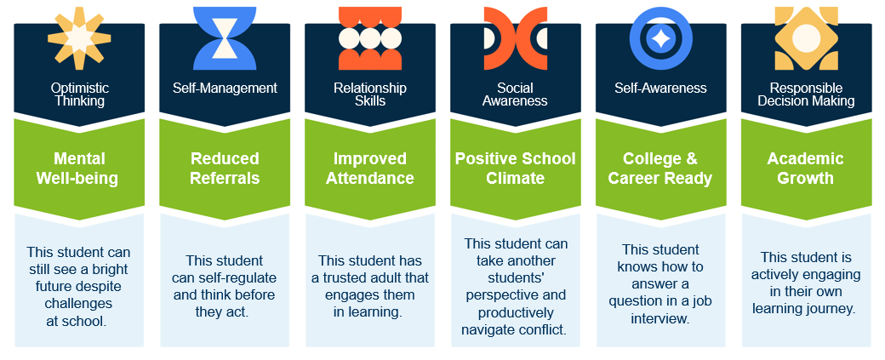
These skills are critical for students to be successful inside and outside the classroom
Notes:
Here’s a visual of what these competencies look like when we contextualize the whole child:
Read the slide if necessary.
Which of the competencies is most important to you right now?

Slide 10
DESSA Results
T-scores are categorized into 3 descriptive ranges
Need for Instruction T-Scores: 40 and below | Typical T-Scores: 41 – 59 | Strength T-Scores: 60 and above
Reflects a lack of skill acquisition
Notes:
Both the DESSA-mini and the DESSA report results using T-scores:
T-scores are categorized into three descriptive ranges, and as strength-based measures, higher T-scores mean a higher level of social and emotional competence.
Scores of 60 and above are considered a strength; scores between 41-59 inclusive are considered typical (demonstrating typical patterns of development); and scores of 40 and below indicate a need for instruction.
A common implementation practice includes completing a DESSA-mini screener for all students. For the students who demonstrate a need for instruction on the DESSA-mini, a full DESSA assessment is then completed.
(Click) The term need for instruction was thoughtfully chosen to convey that the student needs support and instruction in this area.
That is, it reflects that the student has not YET acquired these skills.
It is NOT a personality trait or deficit. Rather, it is simply a lack of skill acquisition.
So, the goal is not to label or stigmatize students within the “Need” range, but instead, it’s used to increase our awareness as educators that a student needs our instruction, assistance, and support in acquiring and practicing these important skills.
Once we’ve identified a need for instruction, it’s OUR responsibility to have a system or plan in place to support skill development and provide that instruction.
We use the information from the follow-up DESSA assessment to gather really specific information on a student so that we can support them moving forward.

Slide 11
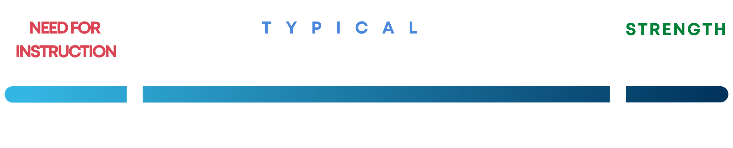
DESSA Continuum of Scores
Norms
16%
68%
16%
Notes:
The DESSA standardization sample closely approximated the student population of the United States with respect to age, gender, geographic region of residence, race, ethnicity, and socioeconomic status.
From the standardization sample, we can anticipate that the majority of students (68%) will demonstrate typical patterns of development when it comes to their social and emotional skills, and that 16% of students will demonstrate strengths in these areas, as well as 16% of students indicating a need for instruction.
The DESSA manual details the development and standardization of the assessments, including the psychometric properties (validity and reliability), and specific directions for administering, scoring, and interpreting the results of the assessments. The DESSA manuals can be downloaded from our Support Portal.

Slide 12
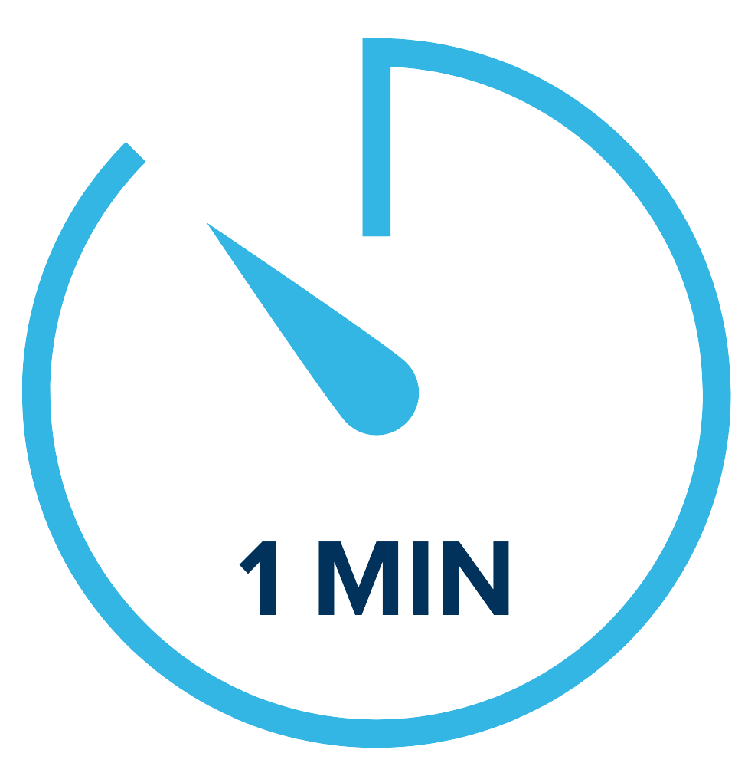
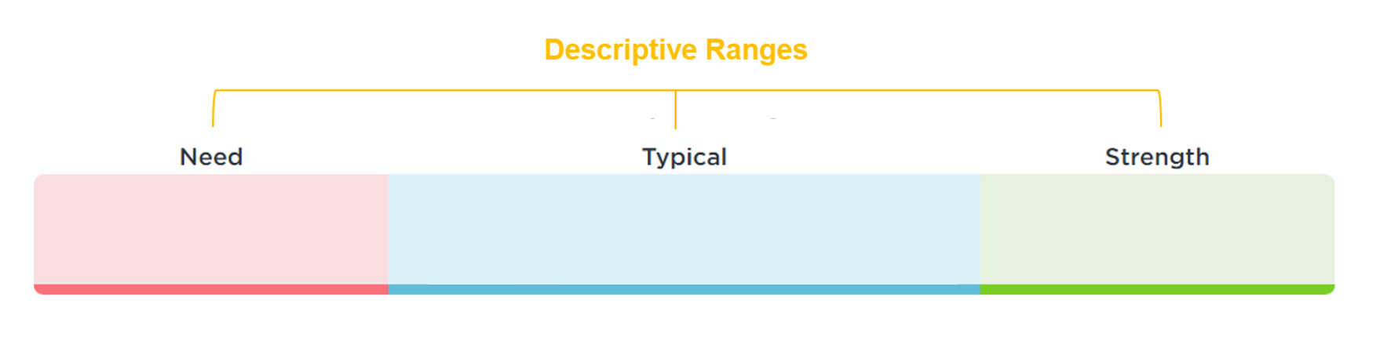
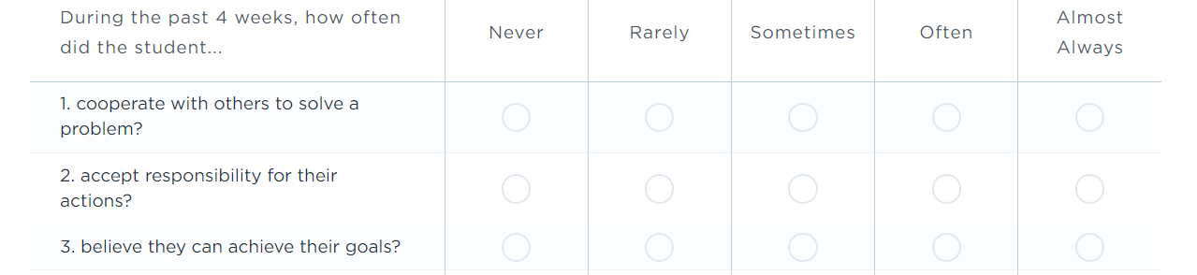
DESSA 2 mini (K-8)
Universal Screener
4 Forms
Score:
Social-Emotional Total (SET)
Educators Complete
Notes:
The DESSA 2-mini is a universal screener of social and emotional competence designed for all students. It has 8 questions and takes about 1 minute per student for an educator (or rater) to complete.
The primary purpose of the “mini” screener is to quickly and accurately identify which students may be at risk of academic and behavioral difficulties based on their social and emotional development.
The screener is completed online after at least 4 weeks, or a cumulative of 24 hours over a 4-week period of interaction and observation of the student. There are 4 different forms that can be utilized for progress monitoring throughout the school year.
(Click) The results from the DESSA-mini produce a Social-Emotional Total (SET) score that provides an indication of a student’s overall social and emotional competence at the time of assessment.
This data can help educators plan how best to strengthen, readjust, or add universal supports. This screener can also help to identify students that may benefit from additional assessment.
A few examples of questions that are on the DESSA-mini are listed here, with the answer options that can be selected based on the frequency in which the educator has observed the student to utilize a specific skill.
[Click] The student’s results will populate on this spectrum provided.

Slide 13
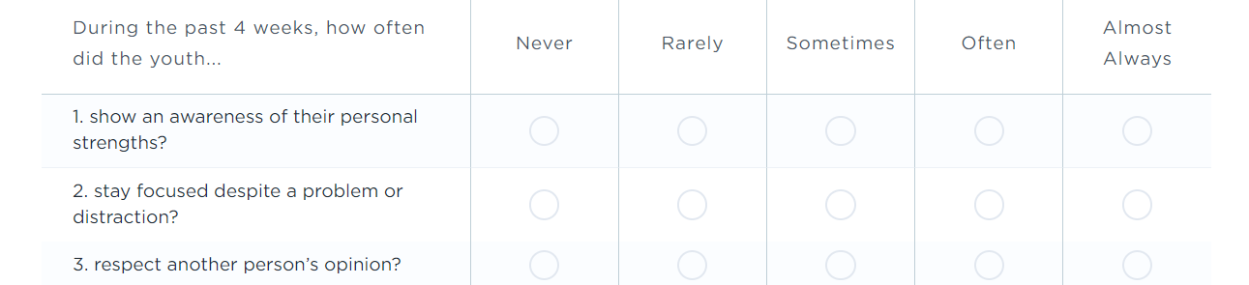
DESSA High School Edition (HSE) Mini (9-12)
Universal Screener
4 Forms
Score:
Social-Emotional Total (SET)
Educators Complete
Notes:
For the high school setting, educators complete a version of the screener called the High School Edition, or the DESSA-HSE mini.
Similar to the screener used for grades Kindergarten through 8th grade, educators complete the screening, which also results in one score, the Social and Emotional Total (SET).
(Click) There are differences in the language used on the high school edition (the HSE), including “youth” instead of child, and the frequency scale options for the educator to select from when answering the questions. The skills assessed on the HSE screener also reflect that of students within the 9th-12th grade range.

Slide 14
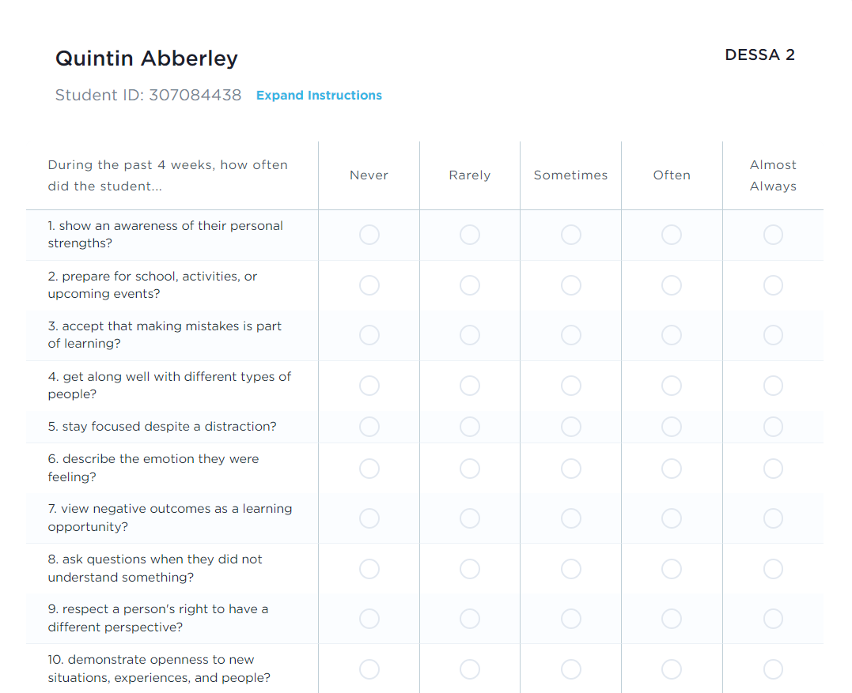
DESSA 2
K-8
Assessment of 6 competency areas
Educators Complete
Scores:
Social and Emotional Composite (SEC)
6 competency areas
Notes:
The DESSA 2 is a full assessment of students' social and emotional competencies. It takes about 5 minutes for an educator to complete, and it is typically completed as a follow-up assessment after the DESSA-mini for certain students, if needed. We will look at that conditional process in just a moment.
The results of the DESSA produce one total score, the Social and Emotional Composite (“SEC”) score, and a score for each of eight social and emotional competencies per student.
Similar to the DESSA-mini, each question on the DESSA is a positively worded, desirable behavior and offers the educator (or rater) the same Likert frequency scale to select their answer.
The DESSA data provides an indication of student strengths and needs across multiple competencies, it can help educators plan how best to strengthen, readjust, or add universal and tiered supports in specific areas.

Slide 15
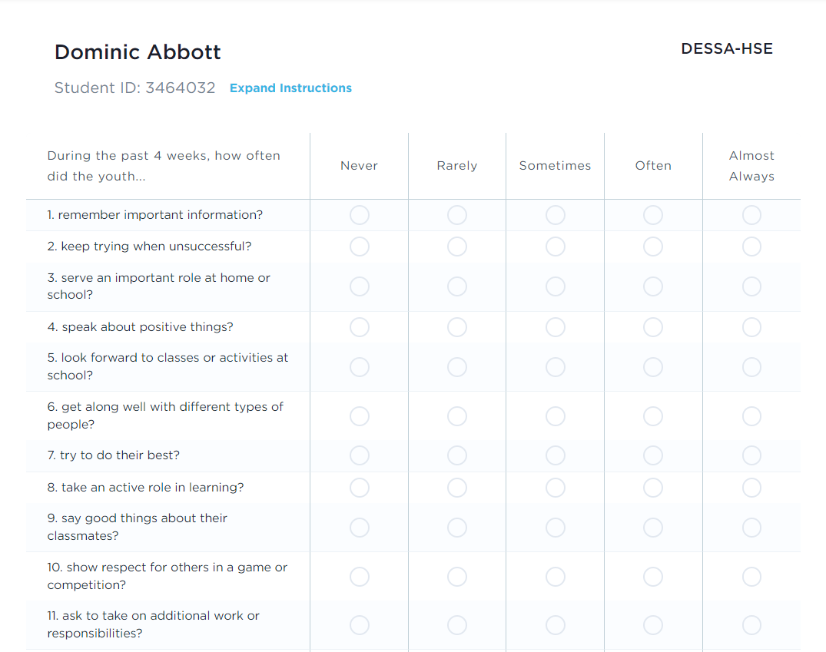
DESSA High School Edition (HSE)
9th-12th
Assessment of 8 competency areas
Educators Complete
Scores:
Social and Emotional Composite (SEC)
8 competency areas
Notes:
The high school version of the DESSA assessment mirrors that of the HSE screening tool, with the differences in language used to identify the student (“youth”) and the frequency scale options, as well as the skills measured for in 9th-12th grades, which we can see here in the examples on screen.
Just like the K-8 version, this follow-up assessment allows for educators to have a deeper insight into the strengths of an individual student, with t-score results in each of the 8 competency areas.

Slide 16
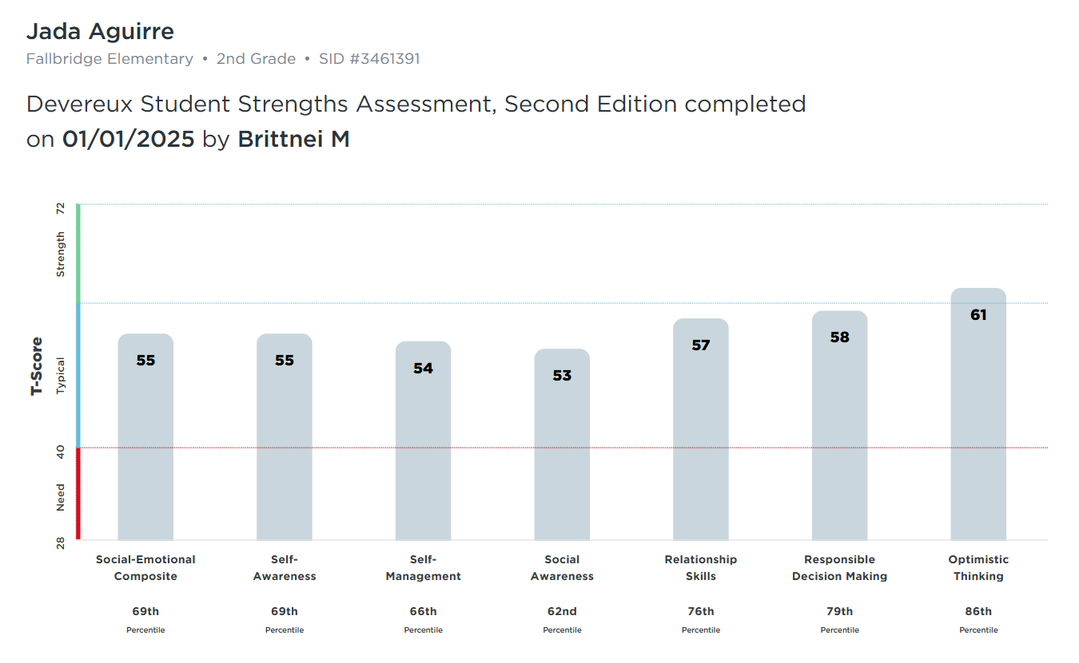
DESSA 2 and DESSA HSE Results
Notes:
Here is what you’ll see after the DESSA 2 is completed.
You will see a social-emotional composite score and a score for each individual competency.

Slide 17

Think-Pair-Share:
How might a strength-based approach improve:
Conversations about students?
Culture and climate?
Engagement with families?
Notes:
We’ve talked a lot about a strength-based approach and how DESSA can support that mindset.
In a few moments, I will invite you to pair up and discuss how a strength-based approach can improve school culture and climate.
Take a moment to jot down some thoughts and then we’ll pair up and share.

Slide 18

Q & A
What questions, curiosities, or big ideas would you like to share regarding any of the DESSA assessments?

Slide 19
How to Complete a Rating
Notes:
Now that we know what the DESSA is, let’s practice how to use it. It’s time to complete a rating.

Slide 20

Tips for Educators Preparing to Rate
Be intentional in observation.
Get familiar with the DESSA items.
Don’t overthink it.
Stick to your facts.
Plan your rating time.
Notes:
In just a moment, we’ll take some time to complete a DESSA-mini as our next engagement activity. First, we’ll include some tips or best practices for completing ratings:
Be intentional with observations. Doing this helps you to get to know your students better, puts on a positive lens to look for strength-based behaviors, and also helps you to understand more about social and emotional competence. It also allows for you to be less biased when observing your students.
Familiarize yourself with the DESSA assessment questions. The more you know about the assessment, the easier your intentional observation will be and the more accurately you will be able to complete your rating. You can download the DESSA-mini/DESSA you will use from the support portal. I will show you where to find it later when we look at the online system. Read it over, think about the behaviors it asks about, and when and how you might observe them. Do a sample rating on someone you know for practice.
Try not to overthink or overanalyze, especially when completing the rating for the DESSA-mini. Ask yourselves simple questions like this: What can students do on their own? How often do they do it?
Stick to the facts. Raters will base their rating on the last 4 weeks with the student, not an interpretation or what they have “heard” about the student. Remember an intentional observation and accurate rating will be unbiased and based only on what the rater views during the observation period.
(Click) Finally, it’s important to plan your rating time. School leaders are encouraged to identify a time for educators to complete the ratings, such as during or in lieu of a staff meeting or PLC.
(Optional Facilitation: Read each question aloud to educators as they complete the rating).

Slide 21
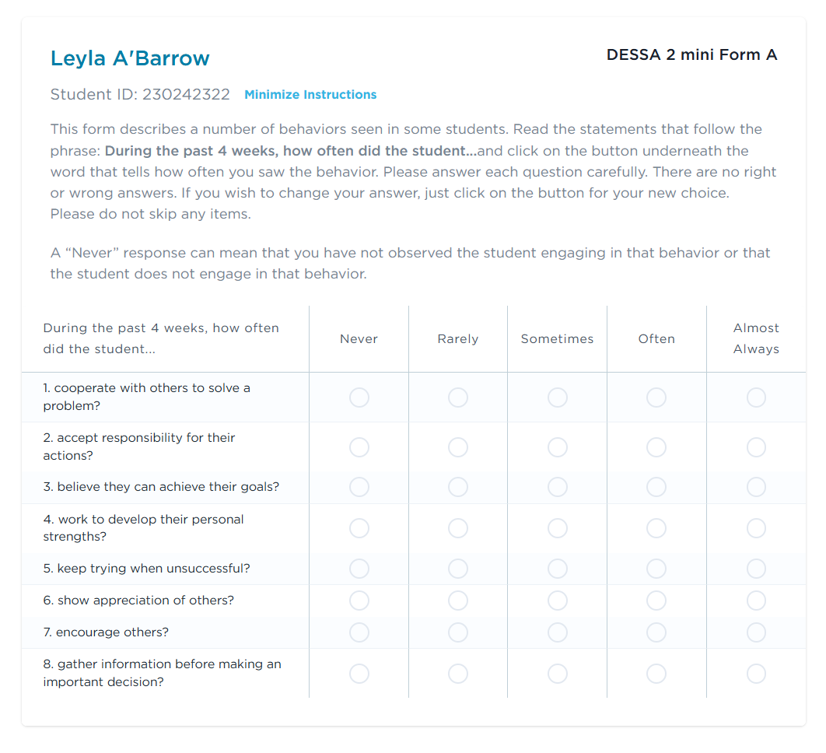
Let’s Practice a Rating
Imagine your school-aged self or someone you know. You can even imagine your favorite book character.
Answer each question according to that person’s behavior.
Notes:
Now it’s time to practice a rating!
Imagine your school-aged self or someone you know. You can even imagine your favorite book character.
Answer each question according to that person’s behavior.
Optional: The facilitator can print PDF versions of the DESSA 2 mini and have participants complete the practice rating on paper. Use this link to access those materials: https://selcompass.zendesk.com/hc/en-us/articles/28654035405837-Printable-PDF-DESSA-2-mini-and-DESSA-2.

Slide 22
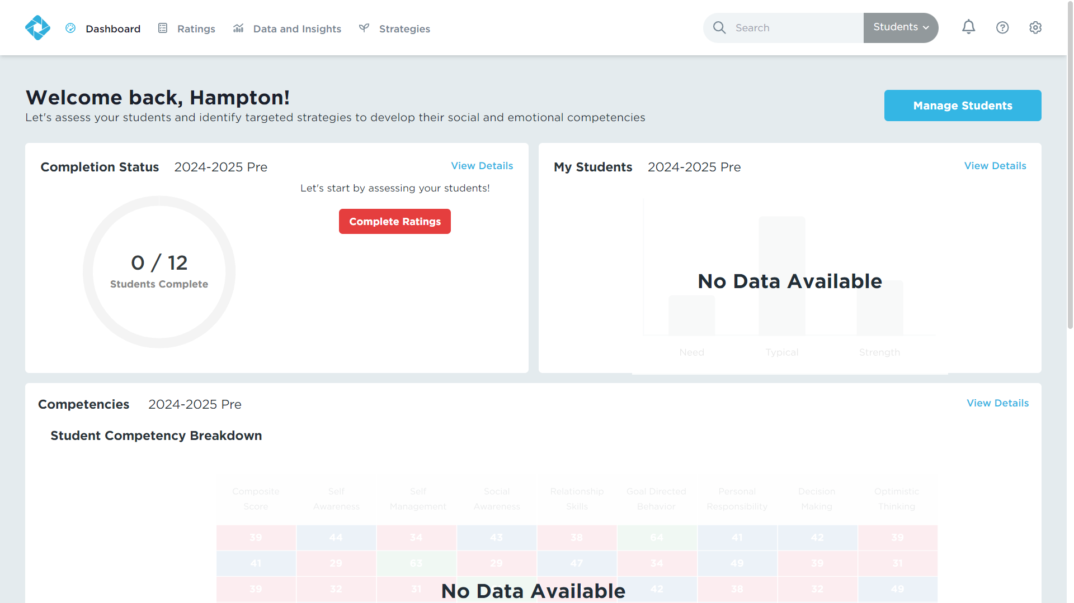
Completing a Rating
Login to your Educator Portal.
Click the Ratings tab.
Notes:
Here are the steps to completing a rating.
Login to your Educator Portal.
Click the Ratings tab.

Slide 23
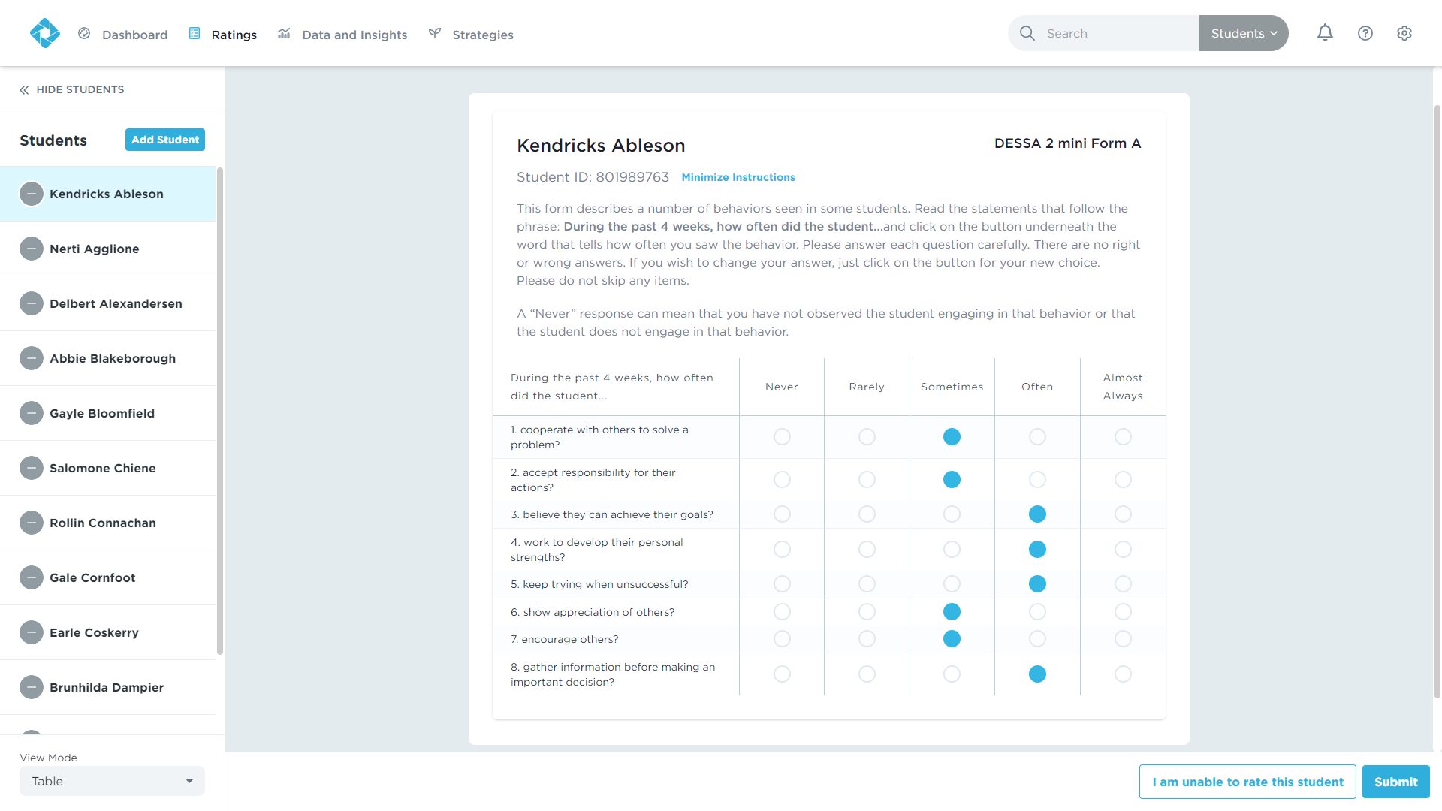
Completing a Rating
Select a student to rate.
Read the instructions.
Answer every question as honestly as possible.
Click “Submit”.
Notes:
Select a student to rate.
Read the instructions.
Answer every question as honestly as possible.
Click “Submit”.

Slide 24
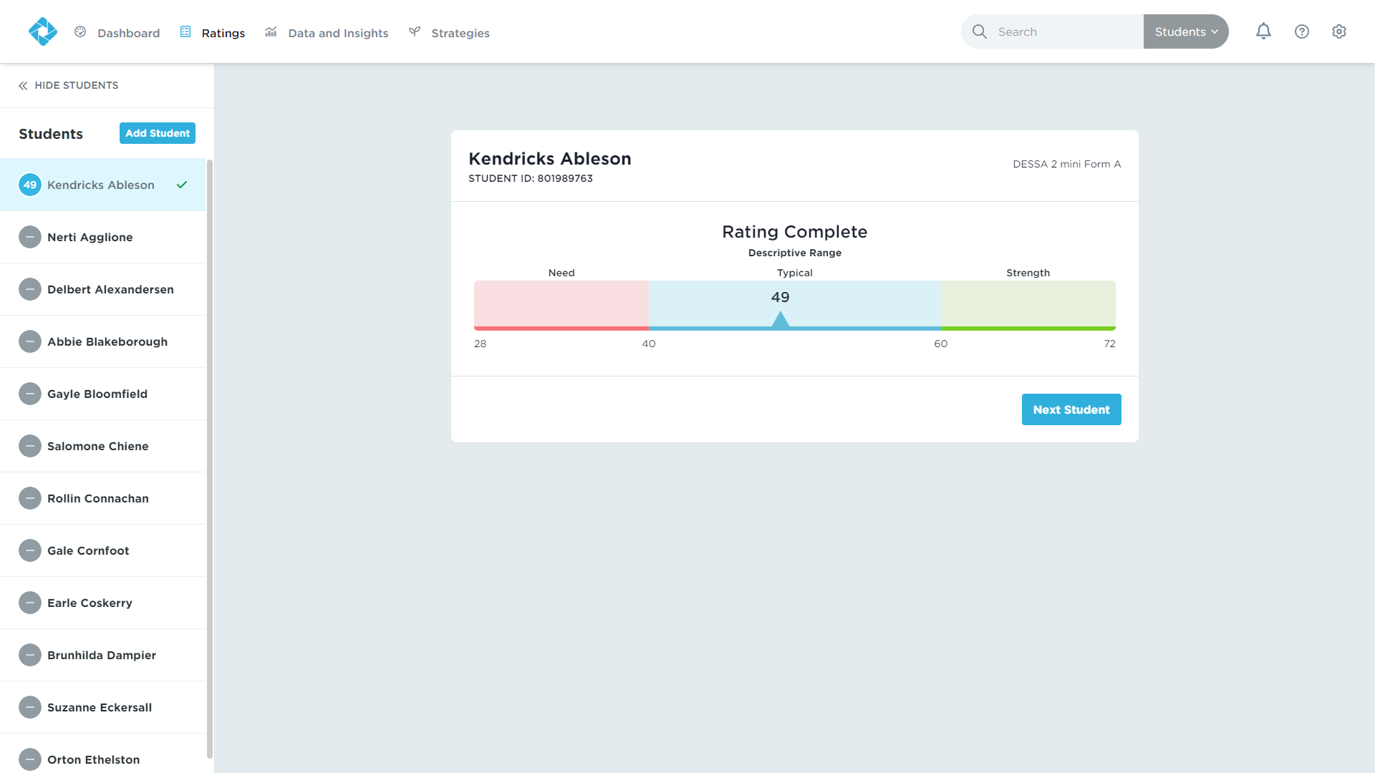
Completing a Rating
Results will be available immediately.
Continue rating the remainder of your student roster.
Notes:
Results will be available immediately.
Continue rating the remainder of your student roster.

Slide 25
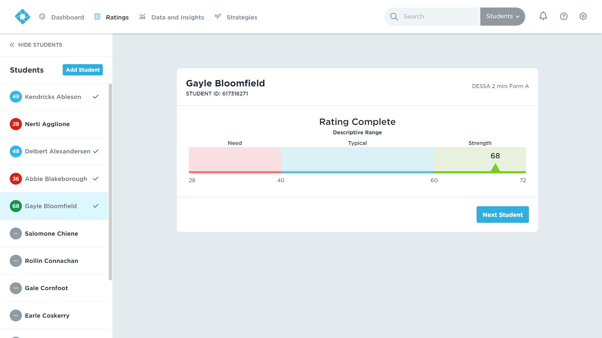
Completing a Rating
A red circle represents the Need for Instruction range.
A blue circle represents the Typical range.
A green circle represents the strength range.
A gray circle means the student has not yet been rated.
Notes:
I know we mentioned this before, but I want to reiterate the meaning of each colored circle.
A red circle represents the Need for Instruction range.
A blue circle represents the Typical range.
A green circle represents the strength range.
A gray circle means the student has not yet been rated.

Slide 26
Completing a Rating
Students with a green check mark do not require additional rating.
Students without a green check require a full DESSA.
Example: Nerti’s teacher has completed the DESSA mini but not the DESSA for Nerti. This same teacher completed a DESSA mini and full DESSA for Abbie.
Notes:
Students with a green check mark do not require additional rating.
Students without a green check require a full DESSA.
Example: Nerti’s teacher has completed the DESSA mini but not the DESSA for Nerti. This same teacher completed a DESSA mini and full DESSA for Abbie.

Slide 27
The Educator Portal
Notes:
Now that we’ve covered the DESSA, let’s walk through the Educator Portal!

Slide 28



User Roles in the DESSA System
Can generate and view all reports for the program, sites, and students.
Can generate and view reports from their site only.
Can generate and view reports for their assigned students.
Notes:
There are 3 different types of user access. The user access in the Educator Portal dictates what information is displayed on the dashboard and the types or amount of data viewable in your DESSA account.
First, the Program Administrator access is typically provided to district leaders or other staff responsible for setting up rostering, assessment windows, and rating assignments. Program administrator access will allow the user to view data for all sites within their district.
Next, the Site Leader access is generally provided to school or site-based leaders, including Principals and Assistant Principals, as well as other leaders that may need access to data across the campus, such as School Counselors, School Psychologists, Social Workers, etc. Site Leader access will allow the user to access to data for their specific site.
Finally, the Rater access is provided to educators that are assigned to complete ratings within the Educator Portal. The Rater access allows for educators to complete DESSA assessment for the students that they have been assigned to rate and view the data for their assigned students.

Slide 29
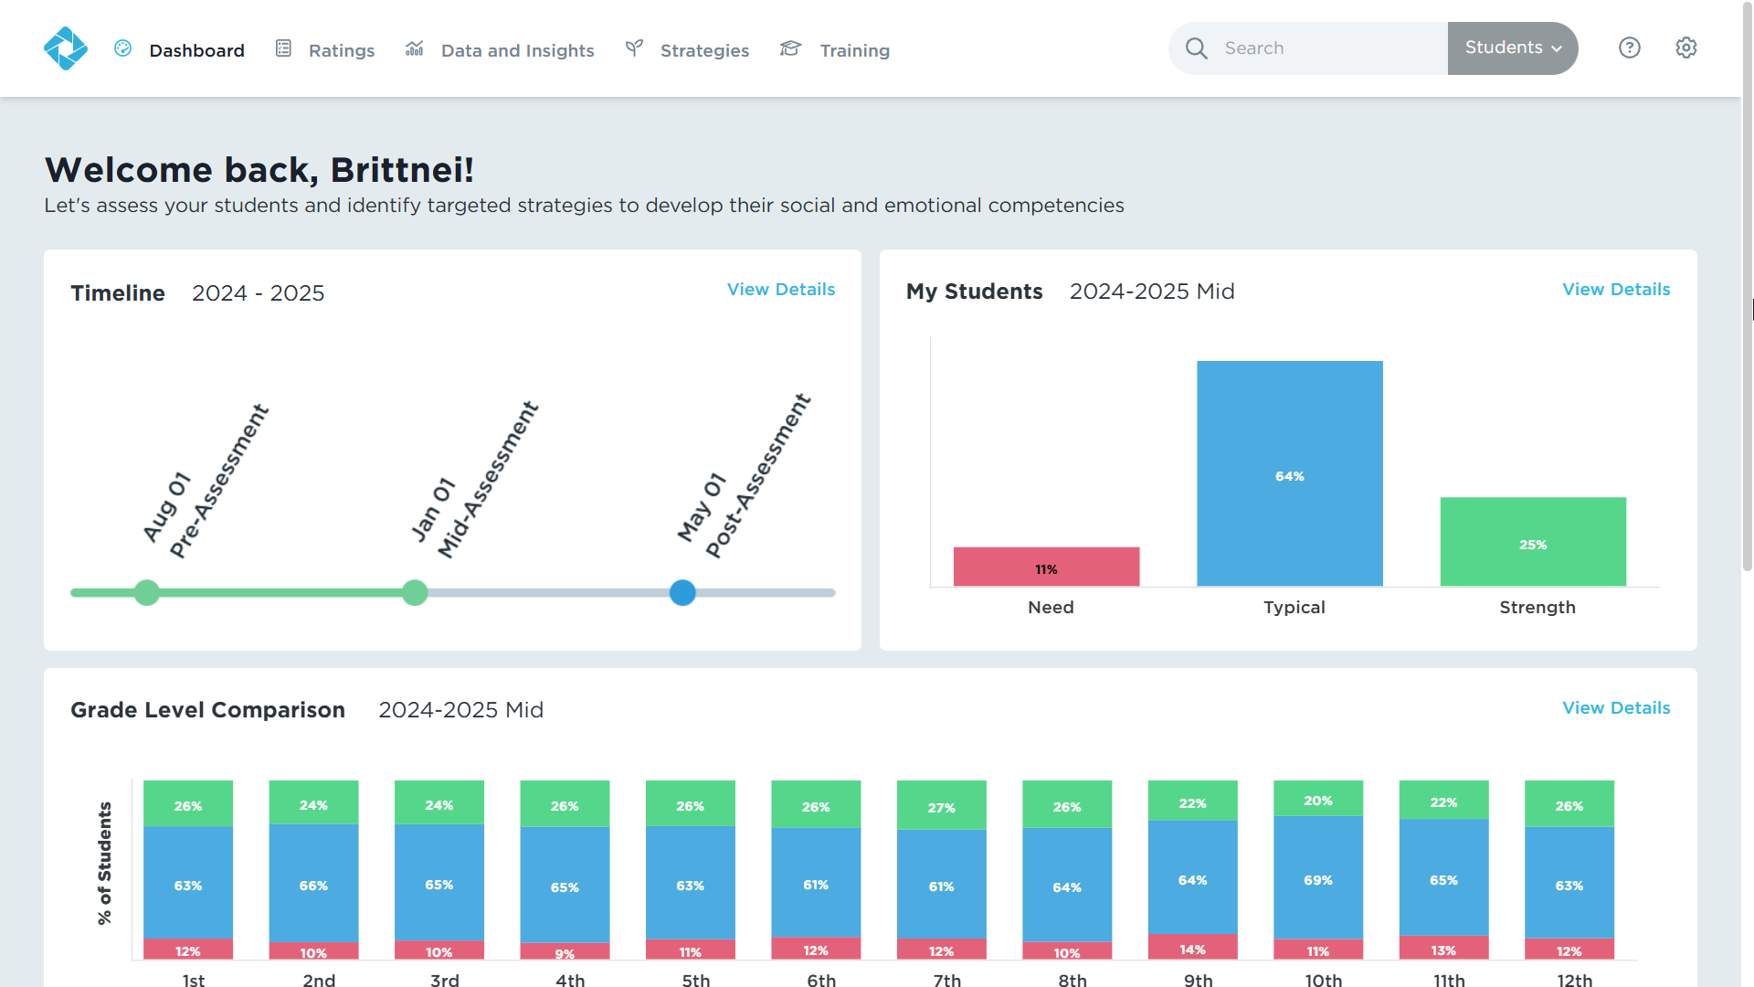
Site Leader Dashboard
Notes:
When Site Leaders log in to their account, the dashboard will provide a quick snapshot of the rating window timeline, a preview of the My Students report, which displays an overview of student performance. On the bottom of the screen, they will see a grade-level comparison of all the grades in their building.

Slide 30
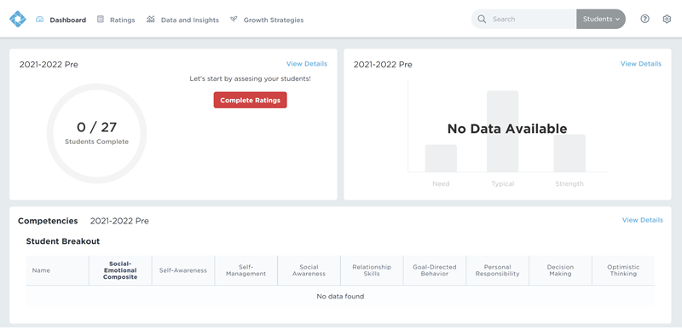
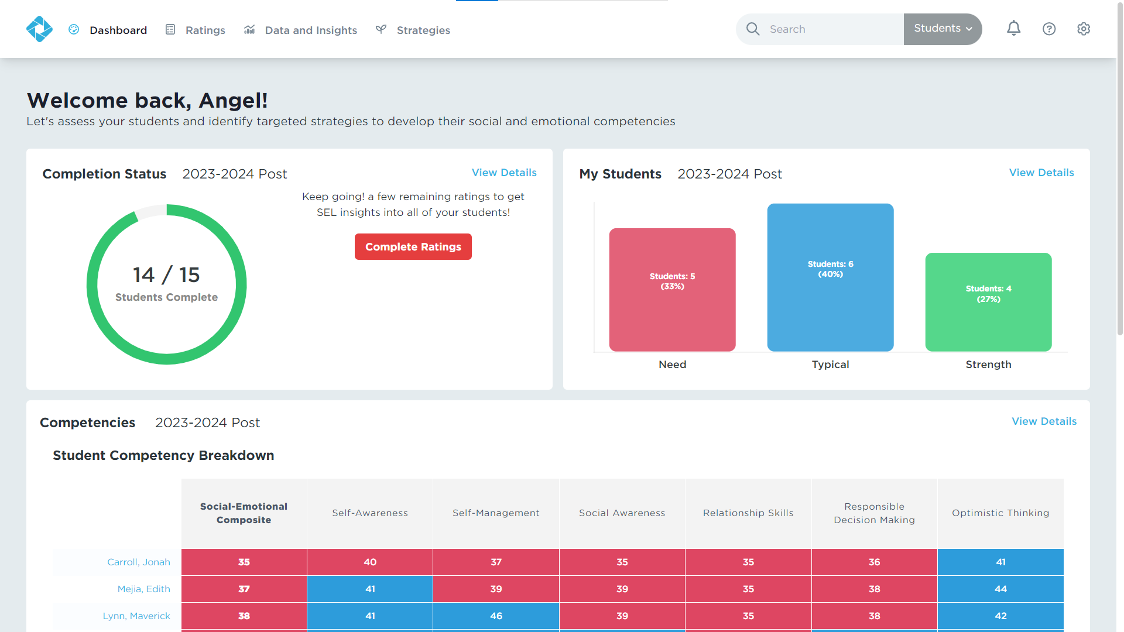
Educator Dashboard
Notes:
When a user first logs into the Educator Portal, the dashboard will likely appear blank since there won’t be any ratings completed yet and therefore, there won’t be any data in the system.
Once ratings begin to occur that data will populate in the system and be able to be viewed here as well in the data and insights tab, which we will go over in more detail in a few moments.
Educators will see a quick snapshot of the rating progress and data that has been collected based on the current or most recent rating window, an overview of the student performance on the right side, and a breakdown of student scores who received a DESSA 2 assessment at the bottom of the screen. Educators will only see data for the students in their classroom or on their roster.

Slide 31
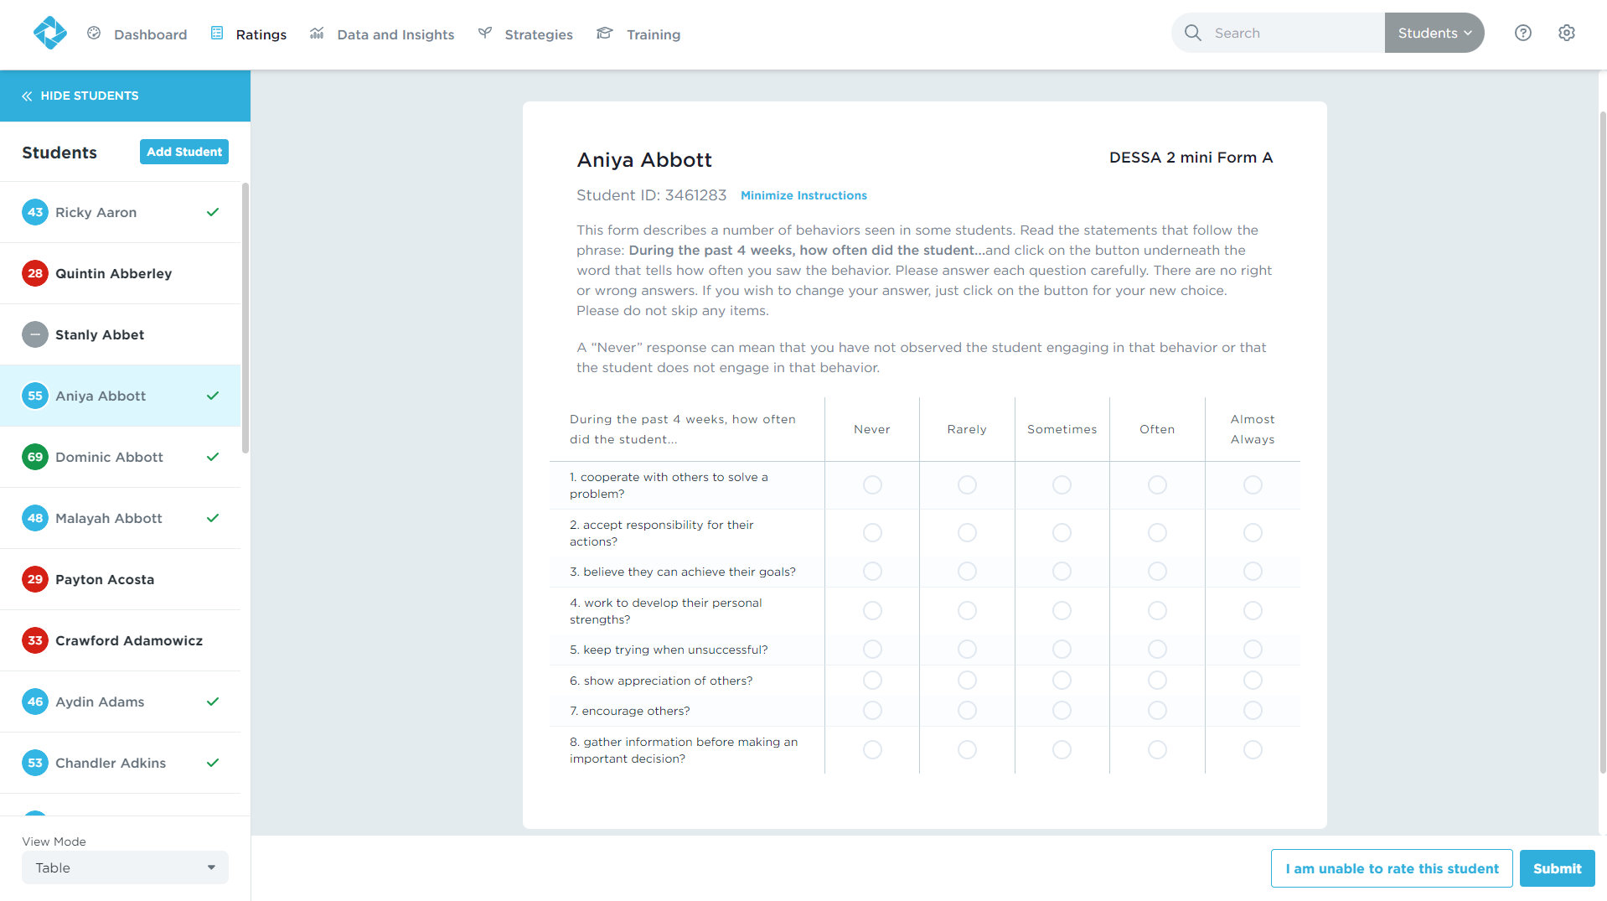
Ratings Tab
The Ratings tab shows the assigned roster of students.
Answer all DESSA 2 mini questions.
Educators can skip up to 2 questions on DESSA 2
Notes:
Under the “Ratings” tab, educators will be able to view their assigned roster of students.
As a reminder, an educator will have to answer all 8 questions on a DESSA-mini. You can skip a question and come back to it; however, you cannot skip a question and complete the rating.
The circles on the left side of the student names indicate whether or not they’ve been rated, and the descriptive range in which they scored.
Gray signifies that they have not been rated, red means they have a need for instruction, blue means they scored in the typical range, and green means they scored in the strength range.
Students with a check mark do not need any further assessment.
Clicking on a student with a red circle and no check mark will automatically initiate a full assessment.
Clicking on a student with a blue or green circle and no check mark, will show you their T-Score and give you the option to progress monitor.

Slide 32
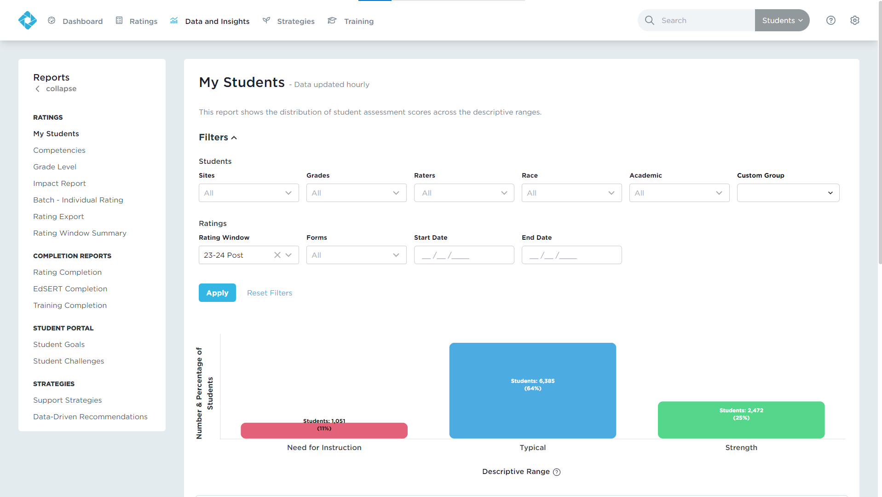
Data and Insights
Real-time results
Interactive, filterable charts
Downloadable reports
Notes:
Data and Insights will give you just that: data from the DESSA assessments and insights into how you can support your students.
You’ll get Real-time results, Interactive, filterable charts, and Downloadable reports.

Slide 33
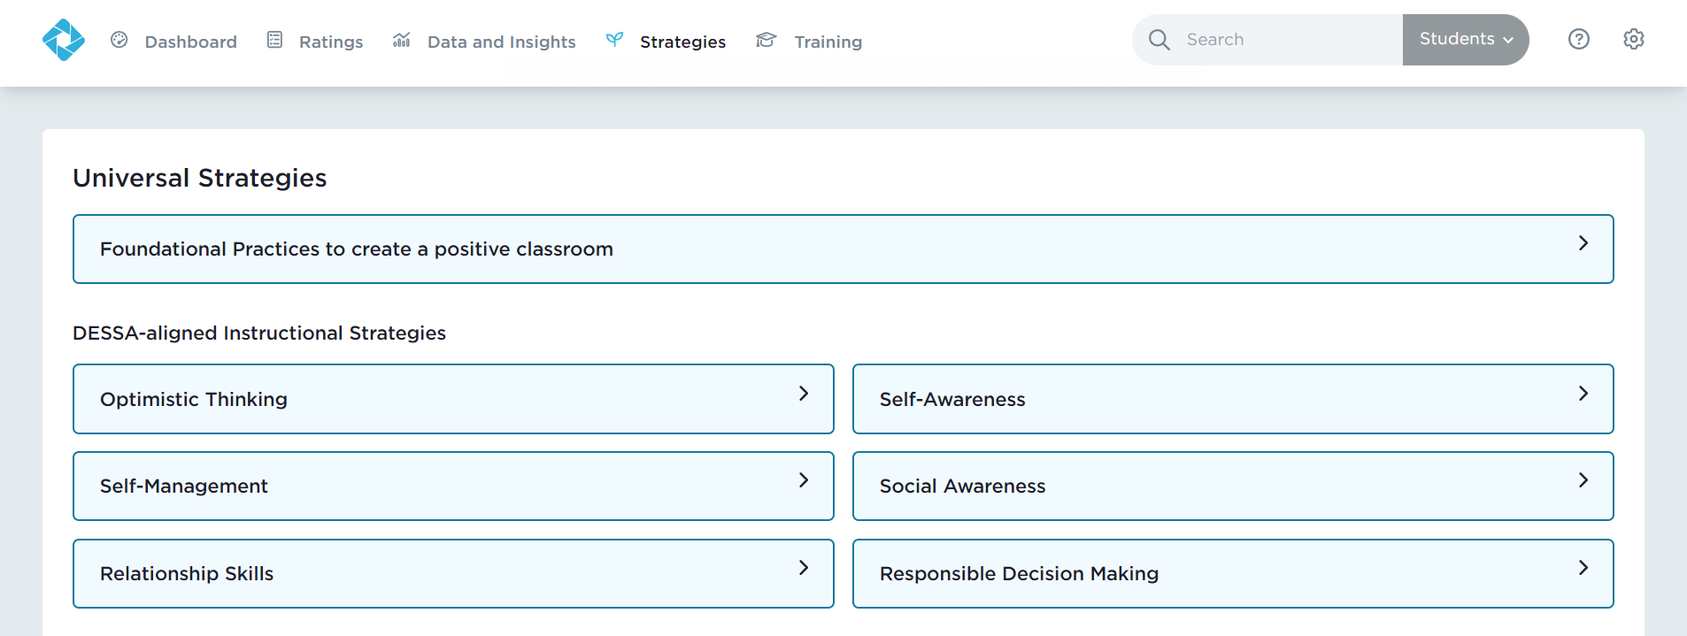
DESSA-Aligned Strategies
Notes:
Under the Strategies tab, there are resources to build social-emotional competence and future-ready skills categorized by competency and grade level. These scripted strategies can be implemented by anyone at any time.

Slide 34
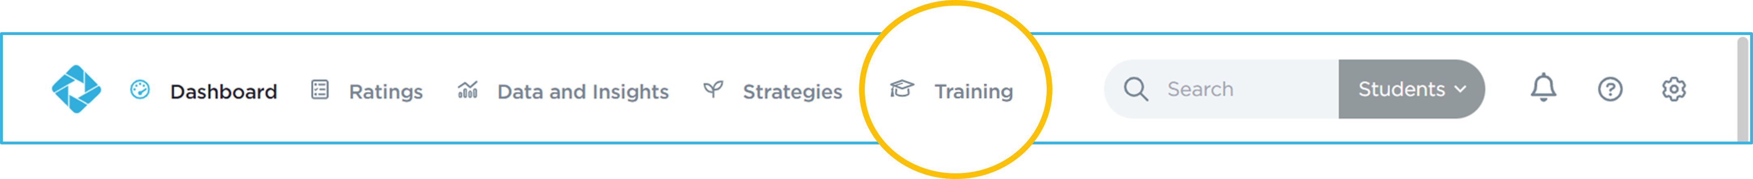
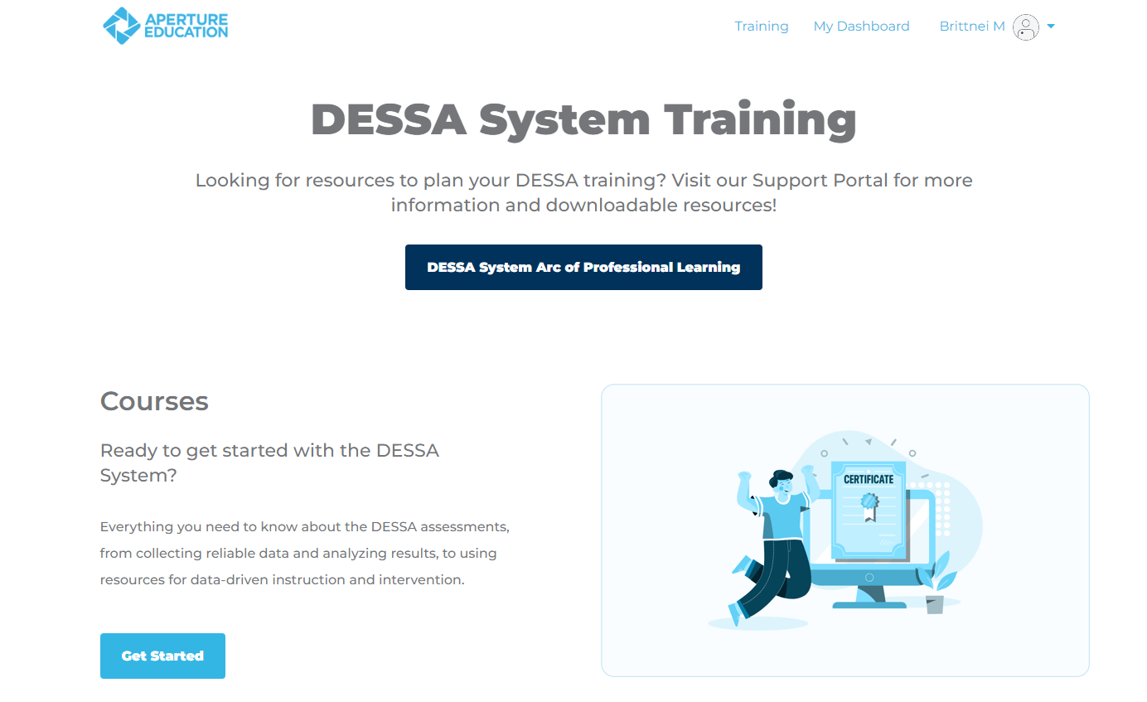
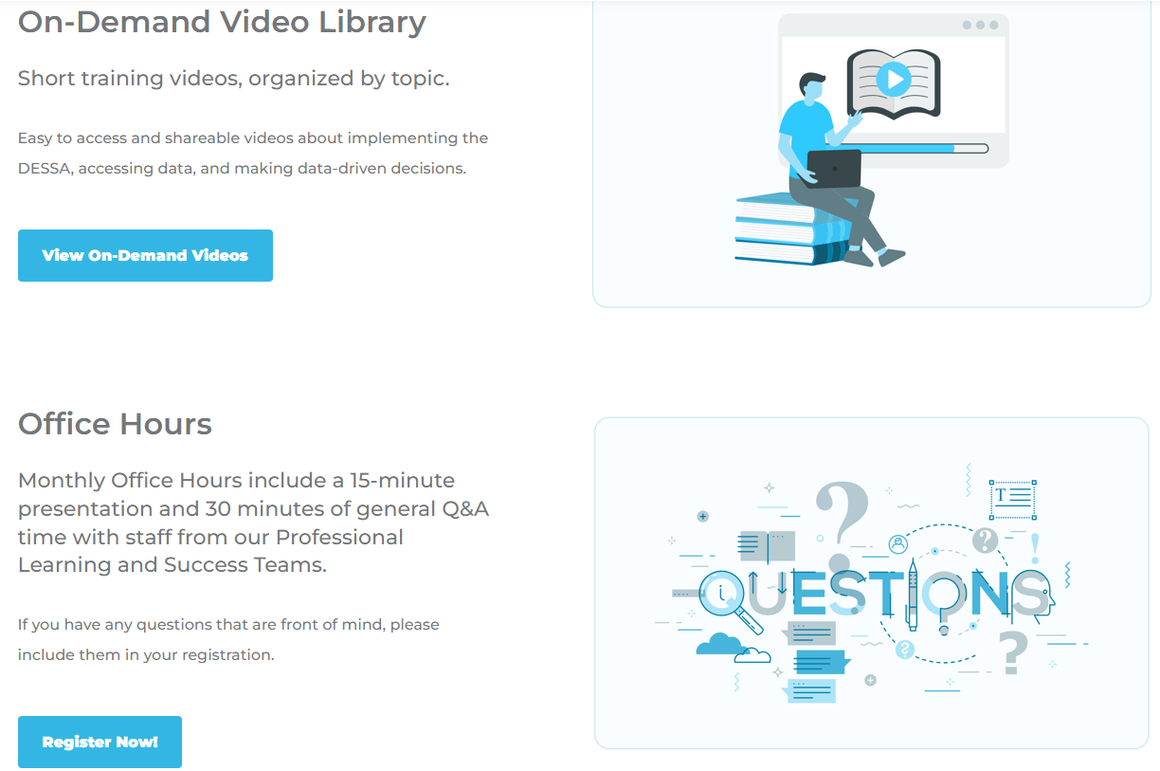
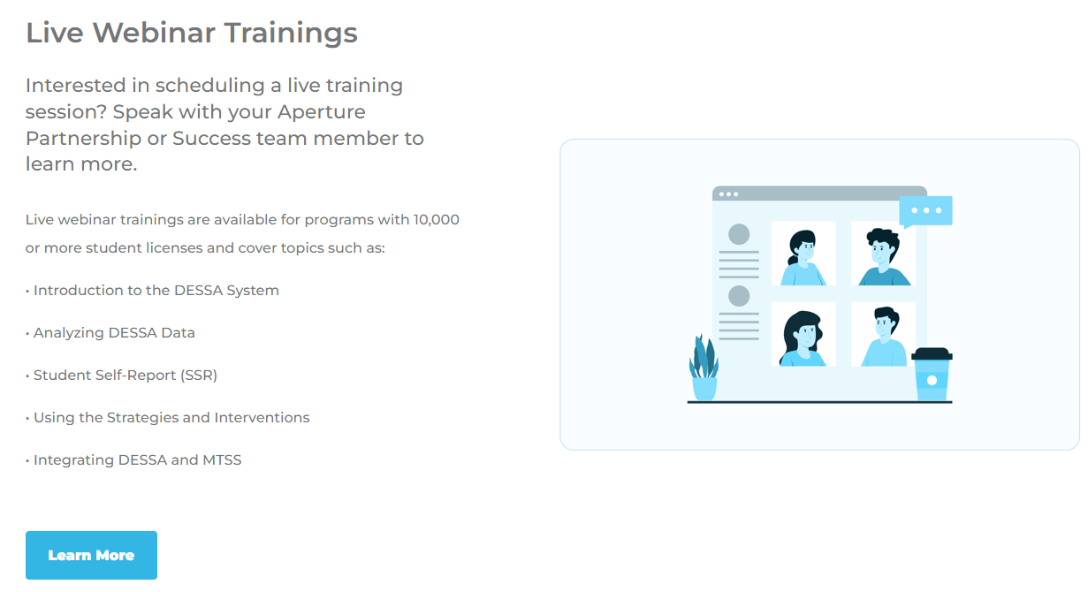
Training
Notes:
Choose your preferred learning modality! The Training tab allows you to choose your own adventure to learn more about the DESSA.
There are self-paced courses for individuals who are new to the DESSA or those who just need a refresher.
The on-demand video library provides short self-service videos that help users with DESSA implementation, and we offer live monthly office hours on pre-selected topics as well.
The Support Portal is open 24/7, offering resources to help guide users through the DESSA system.

Slide 35
Implementation Timeline
Notes:
So, we know what the DESSA is, we know how to rate students using the DESSA, and we’ve ventured into the Educator Portal. Let’s now take a step back to talk through how all of this information fits within the full scope of implementation.

Slide 36
Educator Implementation Checklist
Educator (Rater) Checklist
 | 1. Attend a DESSA training or complete the self-paced training courses available under the DESSA System Training tab.
 | 2. Become familiar with the DESSA assessment items. You might also consider rating someone you know (or a fictional character) for practice.
 | 3. Plan your observations strategically- what activities provide opportunities to observe the skills included in the DESSA? (e.g., building in small-group activities gives students the opportunity to cooperate, contribute to a group, etc.)
 | 4. Make sure you have blocked time to complete your ratings- your school SEL team might have a schoolwide schedule or may provide a ‘window’ of time to complete ratings. Be sure you dedicate time for completing your ratings.
 | 5. Schedule time to review DESSA results for your case load of students.
 | 6. Schedule time to complete DESSA 2 or DESSA HSE ratings for students who demonstrate a need for instruction.
 | 7. Schedule time to review DESSA 2 or DESSA HSE results for the students you rated.
 | 8. Use the DESSA results to guide classroom, group, or individual instruction.
Notes:
Here’s a step-by-step guide for implementing the DESSA for Raters. If you do these things, you’re on the right track!
Remember that right now we are focused on completing DESSA assessments, so items 5-8 are optional

Slide 37
General Implementation Overview
Pre-Assessment
Post-Assessment
End of School Year
Start of
School Year
Ongoing, universal, and data-driven SEL Instruction
Targeted intervention and individualized instruction, as needed
Notes:
For your awareness, here’s what a yearlong DESSA implementation typically looks like
(Click) Generally speaking:
After the educator has had a minimum of 4 weeks to observe their class, all students are screened using the DESSA-mini. A follow-up DESSA assessment is typically completed if a student demonstrates a need for instruction based on the DESSA-mini results.
A post-assessment is completed prior to the end of the school year.
(Click) Throughout the school year, ongoing, universal, and data-driven instruction of social and emotional skills is provided to all students, and targeted intervention and/or individualized instruction is provided to students who demonstrate a need for further support in specific skills areas, typically in the small group or individual setting. You can also complete a mid-year assessment
Additionally, throughout the school year, staff are having discussions about the data they collect or best practices for supporting students in this development and are working together to create a supportive school culture and climate, the foundation for students to grow.
(Click) A key point to keep in mind is that the teaching and learning of social and emotional competencies are continuous.
Educators are constantly teaching these skills, whether it’s through explicit instruction, modeling, or relationship building with students.
Students are constantly learning from each other, about themselves, and by interacting with adults within their school environment.
It’s not just during the rating windows of collecting data that we are actively involved in this process; it’s all year round.

Slide 38

Optimistic Closure
What are you looking forward to most about using the DESSA?
Notes:
What are you looking forward to most about using the DESSA?

Slide 39

Thank You!
Thank you for your time and attention today!
Notes:
Thanks so much for joining us today!

