Slide 1

Getting Started with the
DESSA System
Teacher and Student
Completed Assessments
Notes:
Hello and welcome to Getting Started with the DESSA System! In this session we’ll give an overview of the DESSA System for teacher and student-completed Second Step assessments.

Slide 2
Goals for Today’s Session
By the end of today’s session, you will be able to:
Identify key components of the DESSA teacher-completed and student-completed assessments.
Demonstrate best practices for completing ratings and interpreting the scoring result categories.
Explore key features of the Educator and Student Portals.
Notes:
By the end of today’s session, you will be able to:
Identify key components of the DESSA teacher- and student-completed assessments
Demonstrate best practices for completing ratings and interpreting the scoring result categories.
Explore key features of the Educator and Student Portals.

Slide 3
Session Structure
Introductory, focused on an overview of the DESSA System and assessments
Program-specific details will be provided by your leadership team
As questions come to mind, feel free to drop them in the chat so that they can be compiled and shared with leadership team members.
Opportunities to collaborate and connect are embedded in the session. Halfway through, we will take a break!
Notes:
Introductory, focused on an overview of the DESSA System and assessments
Program-specific details will be provided by your leadership team
As questions come to mind, feel free to drop them in the chat so that we can compile them and share back with your administrators to address
Opportunities to collaborate and connect are embedded in the session. Halfway through, we will take a break!

Slide 4
Opening Reflection
What hopes do you have for the students, staff, and families in your school community this year?
Notes:
As an opening activity, before diving right into content, let’s take a moment to do an opening reflection. What hopes do you have for the students, staff, and families in your school community this year?
When we open training with reflection, it centers us on our “why” and helps us frame our work accordingly. Take a moment to just think about your response, maybe jot something down.

Slide 5
Today’s Agenda
Here’s how we’ll spend our time together today:
What is the DESSA?
How to Complete Ratings
The Educator and Student Portals
Implementation Overview
Optimistic Closure
Notes:
Thank you so much for taking a moment to center. Let’s talk through how we’ll spend the rest of our time together:
We’ll start with an overview of the DESSA assessments, both the teacher completed version and the student completed version. Matteson is using a version of these assessments called the DESSA Second Step, which aligns with your Second Step curriculum, so we will be looking at those details specifically.
We’ll practice completing a rating,
We’ll walk through an overview of the Educator and Student Portals and the roles within it,
And finally, we’ll close out with an overview of the implementation timeline.

Slide 6
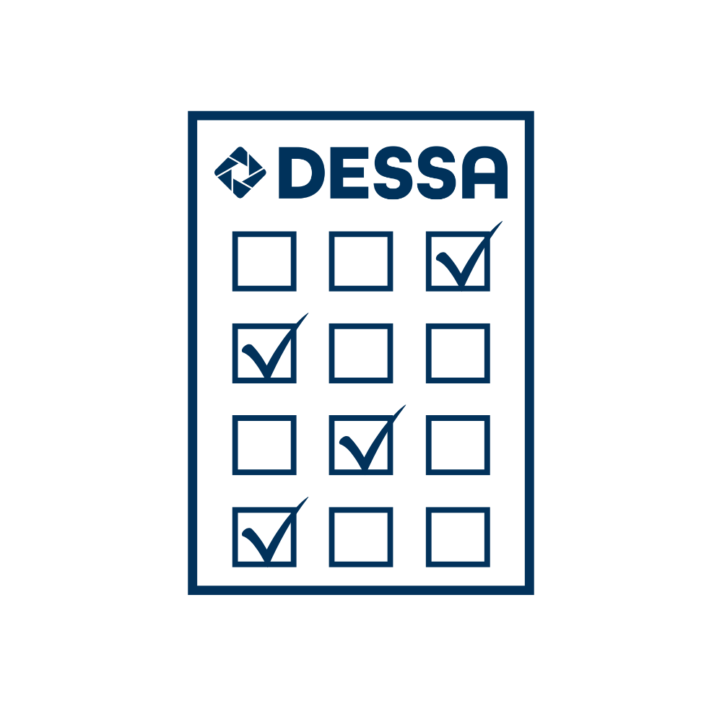

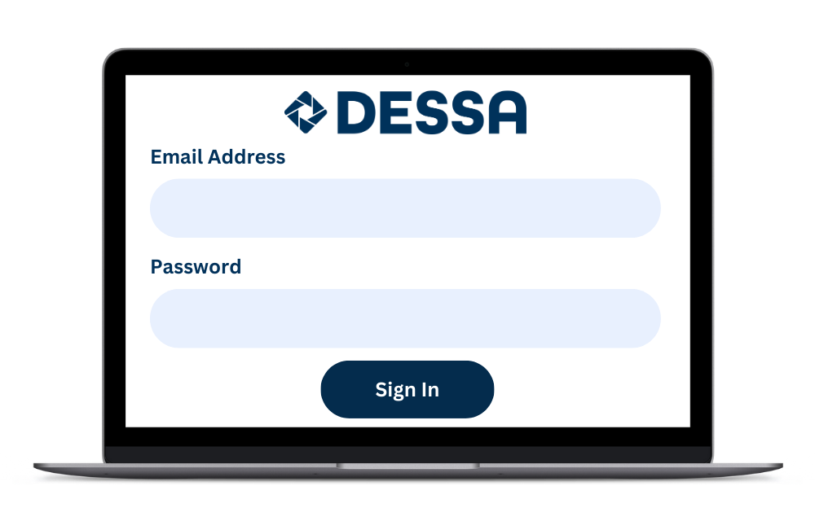
Overview: The DESSA
2025-2026
Strength-Based Behavior
Rating Scale
District-based implementation schedule
Educator Portal:
DESSA ratings & data reports, resources, support
Notes:
As an overview:
(Click) It is a nationally standardized, strength-based behavior rating scale that assesses students’ social and emotional competence with editions that support students K-12.
(Click) It is used by districts and out-of-school time programs across the country, with district-based implementation schedules
(Click) Finally, DESSA assessments and real-time data reports are located in the online Educator Portal, along with additional resources, and support options.

Slide 7

Fast Facts about the DESSA
Standardized
Norm-Referenced
Strength-Based
Notes:
Let’s take a look at the development and standardization properties of the DESSA assessments.
(Click) All the DESSA assessments are standardized; there are established procedures for administering, scoring, and interpreting the results.​ The standardization sample was representative of the population across the United States and a bias analysis was completed for each question item.
(Click) They are norm-referenced scores and are based on a national sample of students. Students’ social and emotional competence can be compared or benchmarked to other students. ​The assessments are classified as Behavior Rating Scales which are one of the most common forms of assessment used in the educational field.
(Click)Most uniquely, the DESSA assessments are strength-based. Every question on the DESSA is a positively worded, desirable behavior, such as “show an awareness of their personal strengths”, rather than maladaptive ones, like “annoys others”. There are many advantages to this approach of promoting social and emotional competencies, a main benefit is that these social-emotional competencies contribute to a student’s resilience in the face of adversity. By highlighting students’ strengths, educators can help students leverage their strengths in areas of growth.

Slide 8
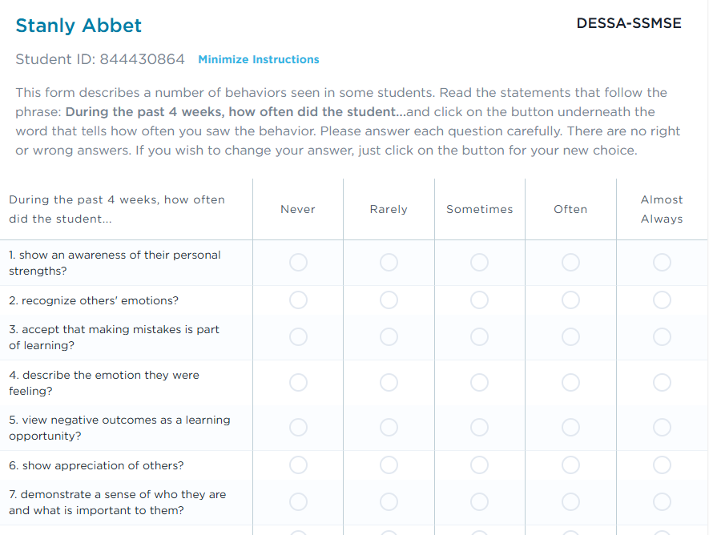
What are the DESSA Second Step Assessments?
Strength-based behavior rating scales comprised of DESSA items, aligned to Second Step programs.
Standardized & norm-referenced.
Reliable & valid measures of students’ social and emotional skills.
Include educator completed and student self-report versions.
Notes:
Second Step is an evidence-based social-emotional learning curriculum with distinct programs for different grade levels.
The DESSA Second Step Assessments are a suite of strength-based, behavior rating scales aligned with the Second Step programs.

Slide 9
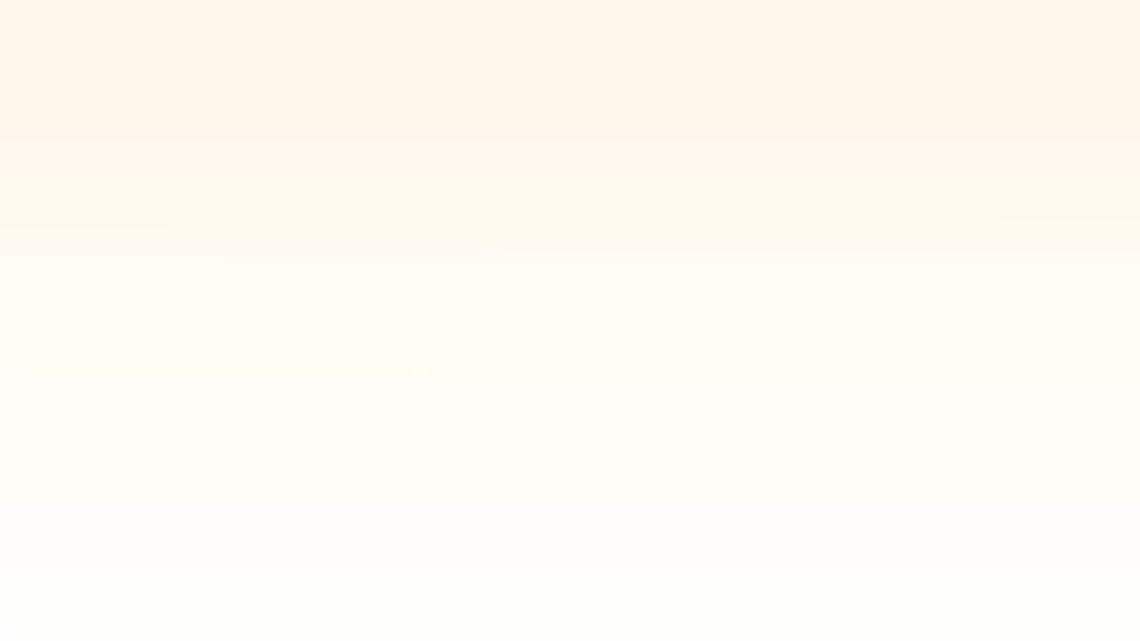
Video: DESSA Second Step Overview
Notes:
This video gives us an overview of the DESSA Second Step assessments.
(The Mp4 video is embedded, the online version can be found here: https://go.screenpal.com/watch/cZfXbtVsBYZ)

Slide 10


The DESSA Second Step Assessments
Educator Completed
Student Self-Report
Educators* should have sufficient opportunity to observe the student to rate accurately.
Items and scales are aligned to the Second Step programs.
Educators and administrators have immediate access to data and reports.
Student-completed DESSA Second Step Assessments promote student voice and agency.
Items and scales are aligned to the Second Step programs.
Students receive their results immediately; educators and administrators have access to student data and reports.
NOTE: The educator completing the rating may or may not be the person delivering Second Step lessons to students. Our existing DESSA recommendations should be followed to determine who may be the best rater in middle school settings where students have multiple teachers.
Notes:
The DESSA provides two versions of the Second Step Assessments: Educator Completed Forms and Student Completed Forms. The Educator Completed Forms include the DESSA Elementary School Edition (DESSA-SSESE) and the DESSA Second Step Middle School Edition (DESSA-SSMSE). The Student Completed Form includes the DESSA Second Step Middle School Edition Student Self Report (DESSA-SSMSE SSR).
Each of the DESSA Second Step assessments will evaluate students based on the competencies taught within that specific Second Step curriculum.

Slide 11
The DESSA Second Step Assessments
.
The DESSA Second Step Elementary School Edition is a 26-item, teacher completed assessment aligned to the Second Step digital K-5 curriculum.
The DESSA Second Step Middle School Edition is a 33 item, teacher completed assessment aligned to the Second Step digital 6-8 grade curriculum.
The DESSA Second Step Middle School Edition Student Self-Report includes 37 items, aligned to the Second Step Middle School digital program. It’s available in 11 languages
Notes:
The DESSA Second Step Elementary School Edition is a 26-item, teacher completed assessment aligned to the Second Step digital K-5 curriculum.
The DESSA Second Step Middle School Edition is a 33 item, teacher completed assessment aligned to the Second Step digital 6-8 grade curriculum.
The DESSA Second Step Middle School Edition Student Self-Report includes 37 items, aligned to the Second Step Middle School digital program.

Slide 12
What does the DESSA measure?
DESSA Second Step Elementary School Assessment
Growth Mindset and Goal Setting
Emotion Management
Empathy & Kindness
Problem Solving
DESSA Second Step Middle School Assessments
Mindsets & Goals
Developing a Positive Sense of Self
Thoughts, Emotions,& Decisions
Managing Relationships & Social Conflict
Notes:
So what does the DESSA measure? In elementary, it measures Growth Mindset and Goal Setting, Emotion Management, Empathy and Kindness, and Problem Solving. At the middle school level, it measures mindsets & goals, developing a positive sense of self, thoughts, emotions and decisions, and managing relationships and social conflict

Slide 13
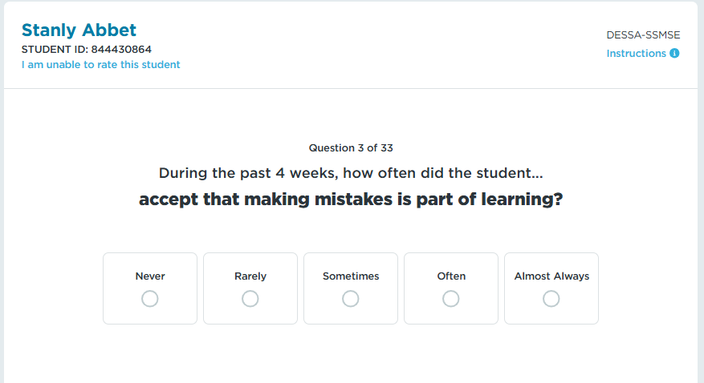
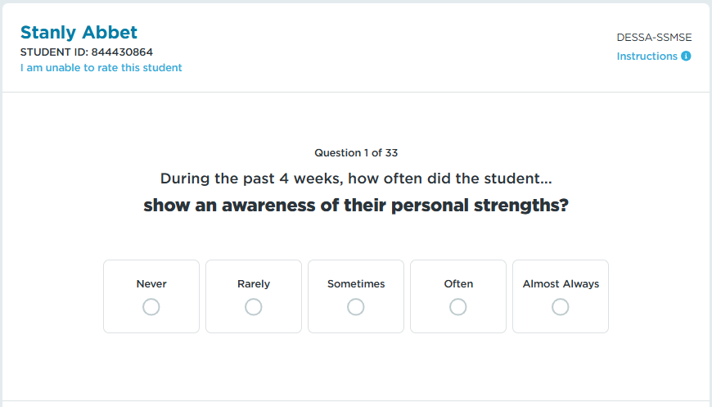
Example Items
Notes:
Let’s take a look at a sample each question or two. Each item (or question) on the DESSA is a positively worded, desirable behavior and offers the educator (or rater) the same Likert frequency scale to select their answer. (click to view samples)
The DESSA data provides an indication of student strengths and needs across multiple competencies, it can help educators plan how best to strengthen, readjust, or add universal and tiered supports in specific areas.

Slide 14
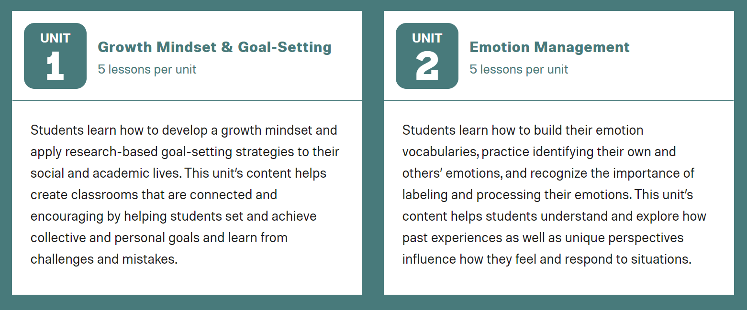
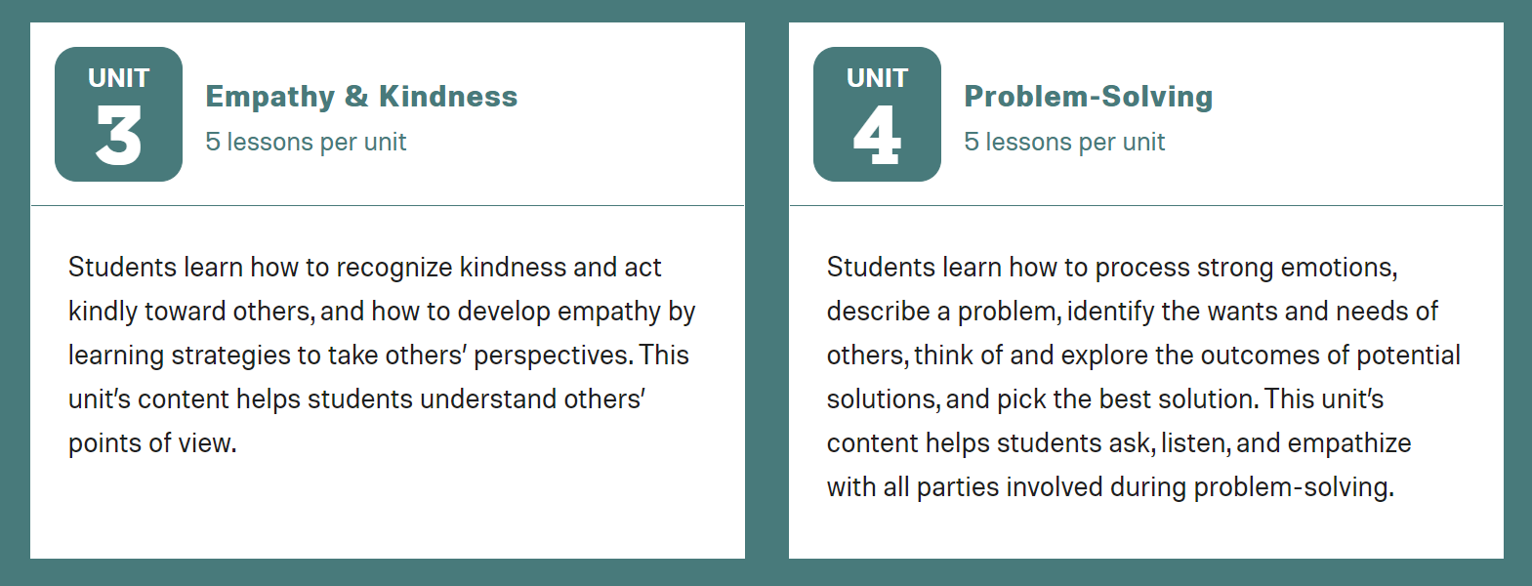
Second Step Elementary Digital Program Units
Notes:
The Second Step K-5 digital program includes four units. Each unit focuses on one social and emotional competency. Lessons and units are sequenced to help students develop their skills.

Slide 15
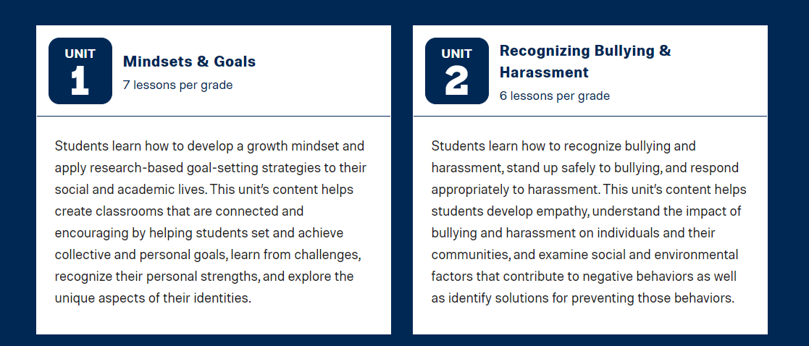
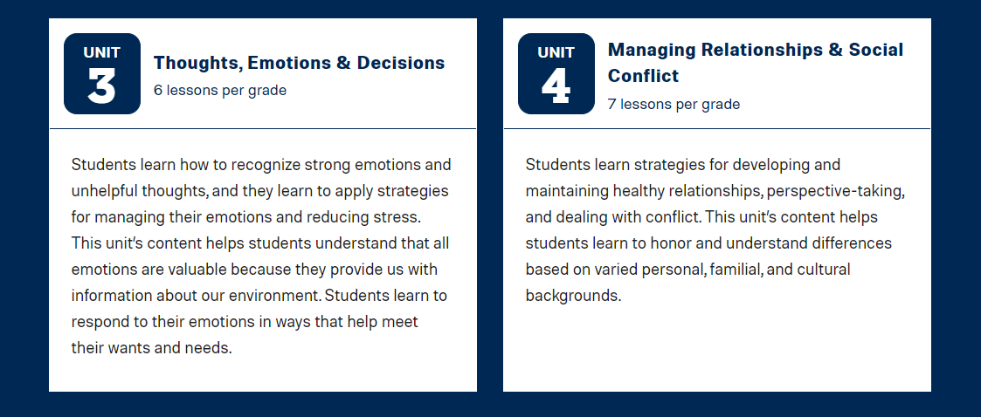
Second Step Middle School (6-8) Digital Program Units
Notes:
The Second Step 6-8 digital program includes four units. Each unit focuses on one social and emotional competency. Lessons and units are sequenced to help students develop their skills.

Slide 16




How can schools use the DESSA Second Step assessments?
Assess students’ social and emotional competence.
Inform instructional planning.
Evaluate Second Step program implementation.
Evaluate and monitor students’ response to Second Step instruction.
You can use data at the individual, class, grade, and school level to inform your Second Step instructional decisions and determine if reteaching or more support for some students is needed.
Review growth and outcomes to determine if your Second Step implementation is helping you reach your school’s social and emotional learning goals.
The DESSA Second Step assessments provide a reliable and valid indicator of an individual student’s social and emotional competence.
Because these assessments are aligned to Second Step programs, they provide an indication of a student’s ability to demonstrate taught skills.
Notes:
There are several use cases for the DESSA Second Step assessments. – read slide visuals
DESSA users should have training in the interpretation and use of the data obtained from these assessments.
Refer to the manual for the specific version of the DESSA Second Step assessment you are using.

Slide 17
The DESSA Second Step Assessments report scores in 1 of 3 descriptive categories.
Strength
Typical
Need for Instruction
T-scores:60-72
T-scores: 41-59
T-scores: 28-40
Students with results in the strength range likely have well-developed skills
Students in this range are on their way to developing strong social and emotional competence
Students with DESSA results in this range should be considered for Tier 2 support.
Continued work developing their social and emotional skills will help them thrive and serve as protective factors to build resilience so they can navigate future challenges.
Reviewing scale and item performance can identify specific skills to work on. In Tier 1, working on skills in class provides an authentic way to support growth.
Continued work through explicit teaching of skills can help students in this range grow.
Consider reteaching or providing support to students whose T score is < 45 to proactively target their skill development.
Tier 2 intervention programs within the Aperture System can be used with small groups.
The DESSA is nationally normed. About 16% of students will have a strength; about 68% will be in the typical range; and about 16% will demonstrate a need for instruction.
Notes:
The DESSA is norm-referenced, and reports T-scores, where the mean is 50 and the SD is 10.
A Social Emotional Composite (SEC) and a score for each competency area are reported.
T-scores are then categorized into 3 descriptors:
60 - 72 = Strength
41 - 59 = Typical
28 - 40 = Need for Instruction

Slide 18
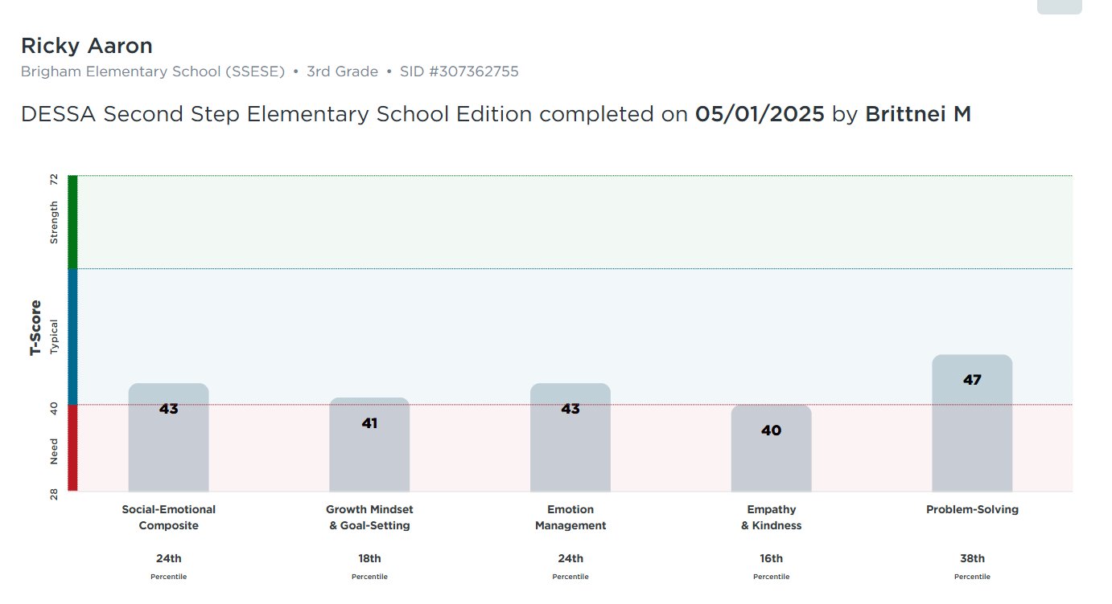
Notes:
Here’s an example of what those scores will look like. The DESSA Second Step Elementary School Edition (DESSA-SSESE) assesses the four competencies taught in the Second Step Elementary Digital Program. The Educator Portal will provide scores for each of the four competencies and a total (composite) score.

Slide 19

Student-Completed Assessment
DESSA Second Step Middle School Edition Student Self-Report
Notes:
Let’s review our student-completed version, The DESSA Second Step Middle School Edition Student Self-Report

Slide 20
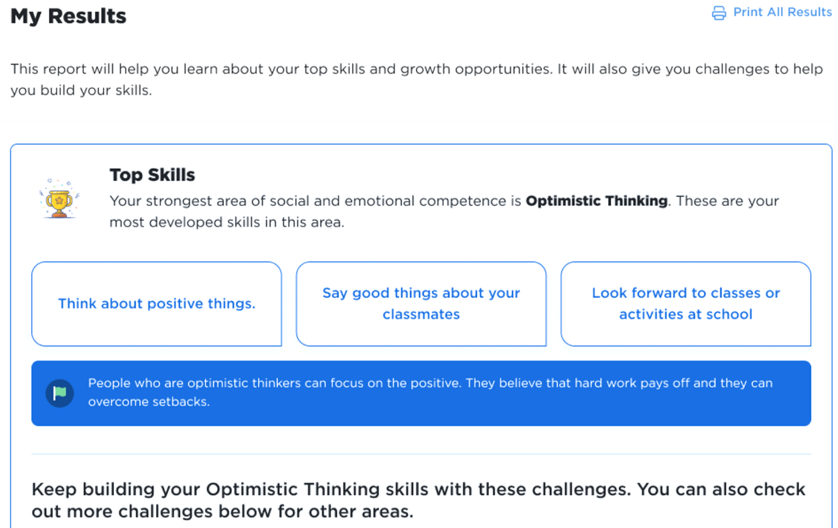
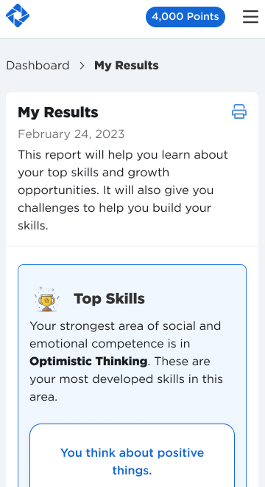
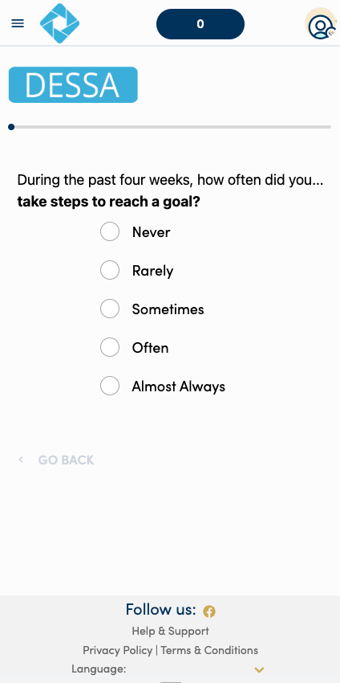
Overview: The DESSA Student Self-Report
Data & Insights:
Educators access
SSR data and view students’ progress
Assessments are completed by students in the Student Portal, and there are opportunities for goal setting.
Notes:
The DESSA Student Self-Report is completed by students in grades 6-8 and the results can be found both in the Student Portal and Educator Portal.
The DESSA Student Self-Report is a self-assessment for middle school students to rate themselves on social emotional competencies and takes most students less than 7 minutes to complete. Students complete assessments in the student portal.
It was normed using a nationally representative diverse sample spanning different races, ethnic, and socioeconomic groups.

Slide 21
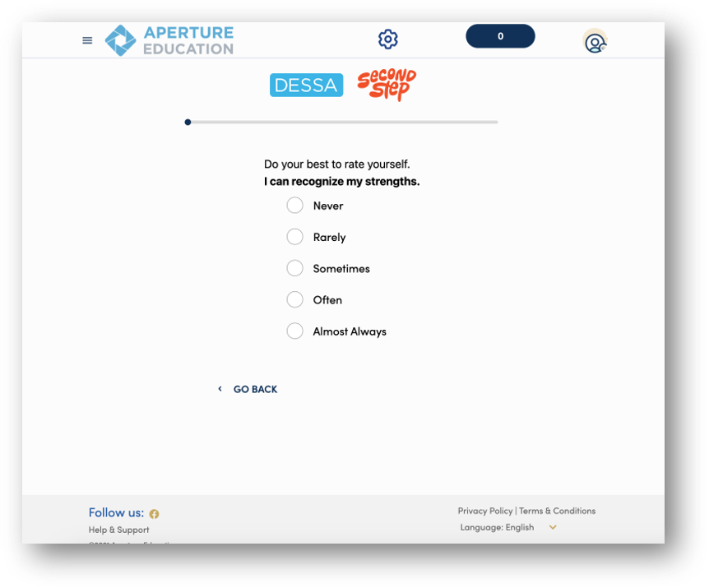
Sample Student Self-Report Questions
Notes:
Here is an example Student Self-Report questions.

Slide 22
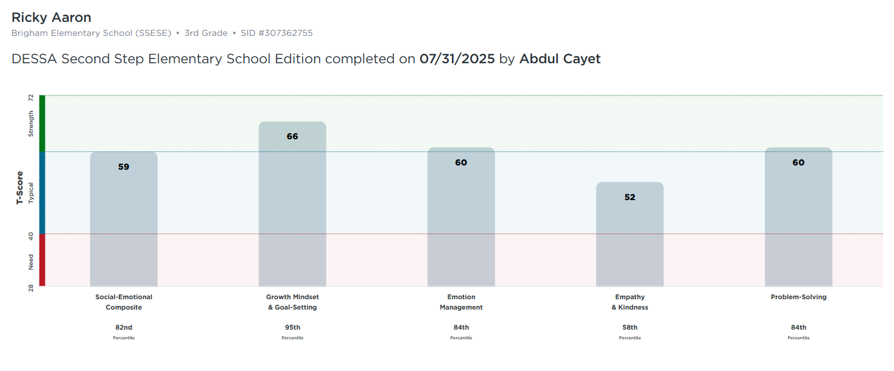
DESSA Second Step Student-Completed Results
Educator View
Notes:
Here is what you’ll see after the full teacher Second Step DESSA or student-completed assessment is complete.
You will see a social-emotional composite score and a score for each individual competency.

Slide 23
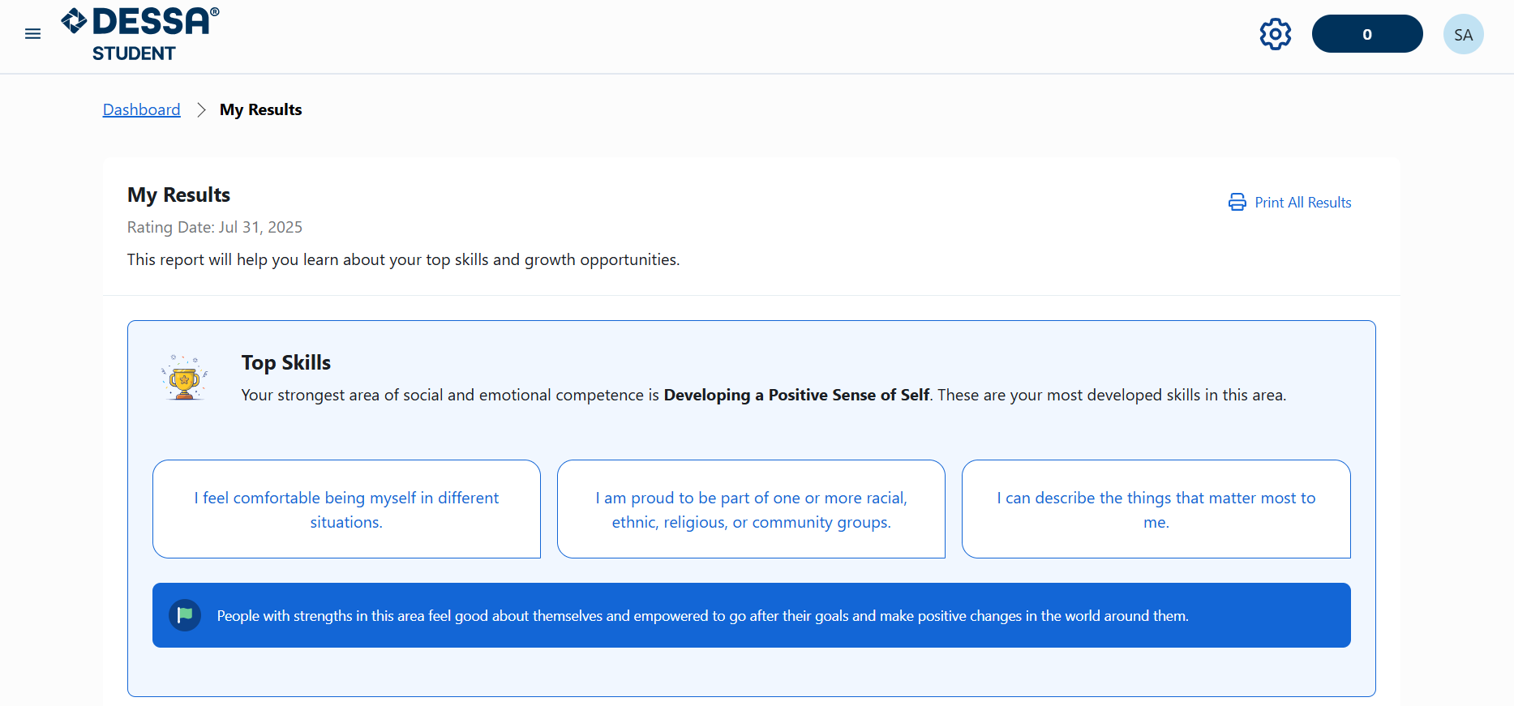
DESSA Second Step Student-Completed Results
Student View
Notes:
Here is what you’ll see after the full teacher Second Step DESSA or student-completed assessment is complete.
You will see a social-emotional composite score and a score for each individual competency.

Slide 24

Think-Pair-Share:
How might a strength-based approach improve:
Conversations about students?
Culture and climate?
Engagement with families?
Notes:
We’ve talked a lot about a strength-based approach and how DESSA can support that mindset.
In a few moments, I will invite you to pair up and discuss how a strength-based approach can improve school culture and climate.
Take a moment to jot down some thoughts and then we’ll pair up and share.

Slide 25

Q & A
What questions, curiosities, or big ideas would you like to share regarding any of the DESSA assessments?
Notes:
What questions, curiosities, or big ideas would you like to share regarding any of the DESSA assessments?

Slide 26
Take a break!
Let’s meet back in 5 mins

Slide 27

How to Complete a DESSA Rating
Now that we know what the DESSA is, let’s practice how to use it. It’s time to complete a rating. This information is most relevant to those using the DESSA teacher-completed forms.
Notes:
Now that we know what the DESSA is, let’s practice how to use it. It’s time to complete a rating. This information is most relevant to those using the DESSA teacher-completed forms.

Slide 28

Tips for Educators Preparing to Rate
Be intentional in observation.
Get familiar with the DESSA items.
Don’t overthink it.
Stick to your facts.
Plan your rating time.
Notes:
In just a moment, we’ll take some time to complete a DESSA-mini as our next engagement activity. First, we’ll include some tips or best practices for completing ratings:
Be intentional with observations. Doing this helps you to get to know your students better, puts on a positive lens to look for strength-based behaviors, and also helps you to understand more about social and emotional competence. It also allows for you to be less biased when observing your students.
Familiarize yourself with the DESSA assessment questions. The more you know about the assessment, the easier your intentional observation will be and the more accurately you will be able to complete your rating. You can download the form you will use from the support portal. I will show you where to find it later when we look at the online system. Read it over, think about the behaviors it asks about, and when and how you might observe them. Do a sample rating on someone you know for practice.
Try not to overthink or overanalyze. Ask yourselves simple questions like this: What can students do on their own? How often do they do it?
Stick to the facts. Raters will base their rating on the last 4 weeks with the student, not an interpretation or what they have “heard” about the student. Remember an intentional observation and accurate rating will be unbiased and based only on what the rater views during the observation period.
(Click) Finally, it’s important to plan your rating time. School leaders are encouraged to identify a time for educators to complete the ratings, such as during or in lieu of a staff meeting or PLC.
(Optional Facilitation: Read each question aloud to educators as they complete the rating).

Slide 29
Let’s Practice a Rating
Imagine your school-aged self or someone you know. You can even imagine your favorite book character.
Answer each question based on your observations and interaction with that person.
Jot down your answers in your own workspace
Notes:
Now it’s time to practice a rating!
Imagine your school-aged self or someone you know. You can even imagine your favorite book character.
Answer each question according to that person’s behavior.

Slide 30
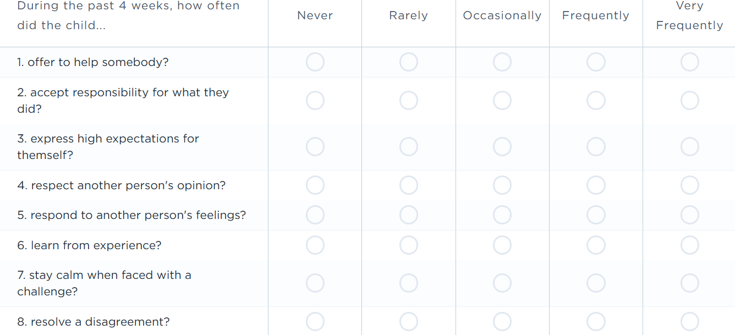
Let’s Practice a Rating
Notes:
Use the example for the grades that most attendees indicated during the opening poll
Elementary example

Slide 31
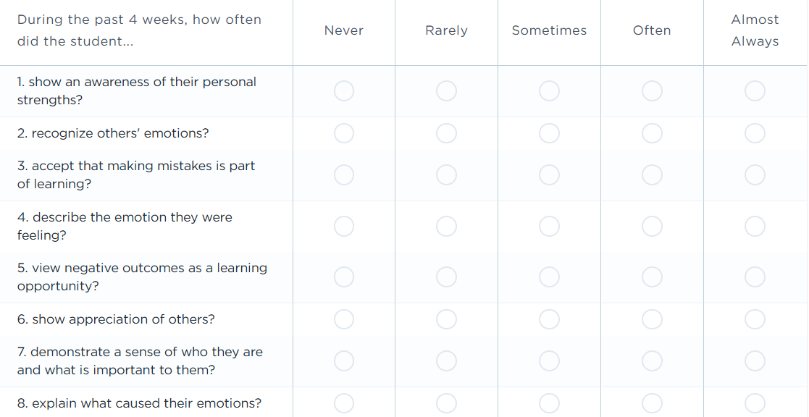
Let’s Practice a Rating
Notes:
Use the example for the grades that most attendees indicated during the opening poll
Middle example

Slide 32
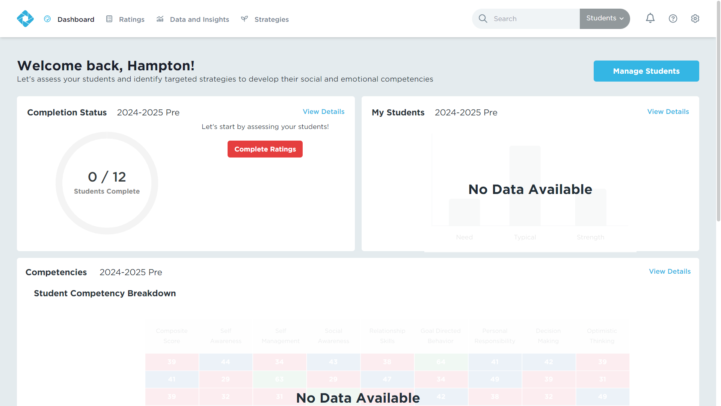
Completing a Rating
Login to your Educator Portal.
Click the Ratings tab.
Notes:
We seem to have the hang of it on paper, so let’s look at how to complete a rating in our Educator Portal.
Here are the steps to completing a rating.
Login to your Educator Portal.
Click the Ratings tab.

Slide 33
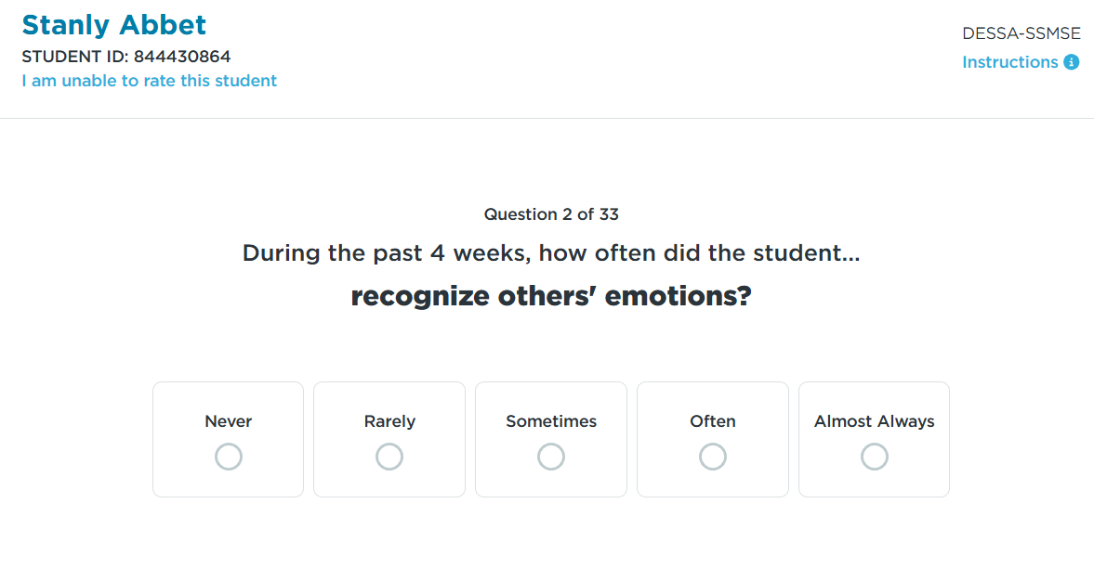
Completing a Rating
Select a student to rate.
Read the instructions.
Answer every question as honestly as possible.
Click “Submit”.
Notes:
Select a student to rate.
Read the instructions.
Answer every question as honestly as possible.
Click “Submit”.

Slide 34
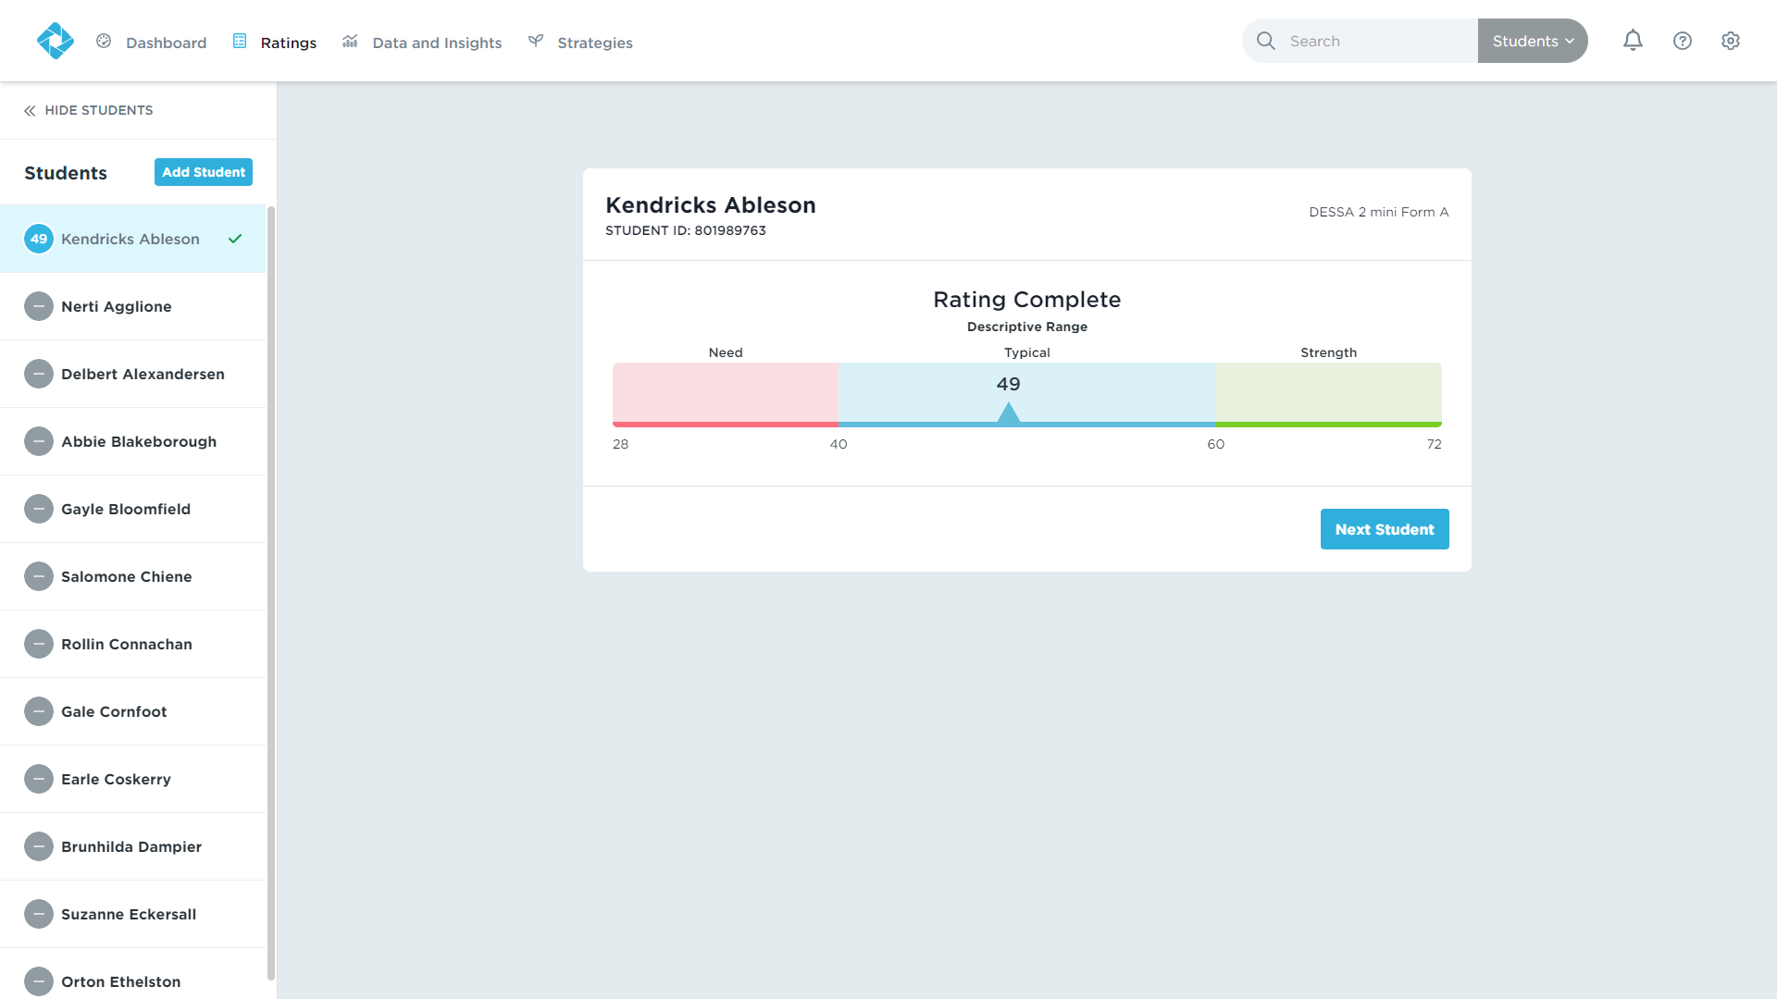
Completing a Rating
Results will be available immediately.
Continue rating the remainder of your student roster.
Notes:
Results will be available immediately.
Continue rating the remainder of your student roster.

Slide 35
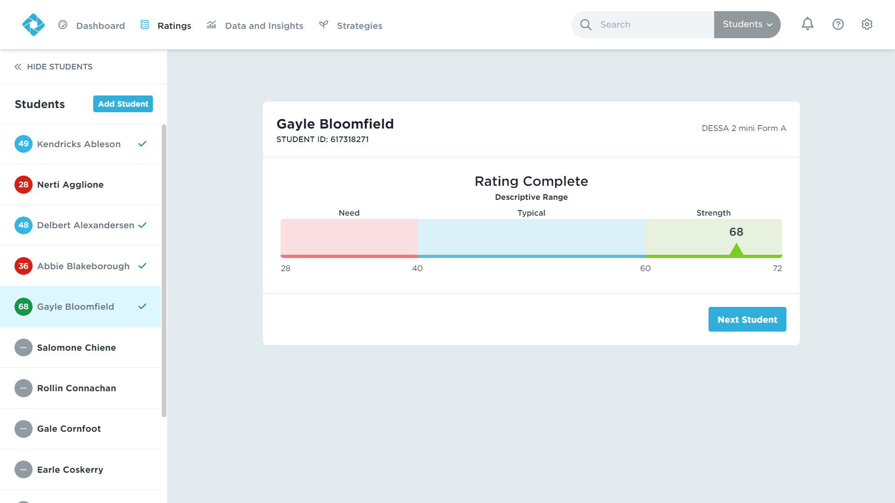
Completing a Rating
A red circle represents the Need for Instruction range.
A blue circle represents the Typical range.
A green circle represents the strength range.
A gray circle means the student has not yet been rated.
Notes:
I know we mentioned this before, but I want to reiterate the meaning of each colored circle.
A red circle represents the Need for Instruction range.
A blue circle represents the Typical range.
A green circle represents the strength range.
A gray circle means the student has not yet been rated.

Slide 36
Quick Connect
What are your thoughts so far about completing the DESSA ratings?
How did you feel completing the practice rating?

Slide 37
Student Portal
Notes:
Talking Points:
In this next section, we are going to review the Student Portal.
We will end our session with looking at the Educator Portal, which houses everything you need as the educator.

Slide 38

Notes:
Talking Points
We’ll start by viewing this video that will share an overview of the Student Portal. This video is shared with students when they log into their Student Portal and it’s a help introduction to both the assessment and platform.
https://www.youtube.com/watch?v=EWt1YMYDLLs

Slide 39
Accessing the Student Portal
Access through website login with user name and password or SSO login
District leadership manages the integration and assignments
Educators are assigned a roster of students to support
Notes:
Talking Points:
There are different ways students can access their student portal, including a website login with username and password or through an SSO login, such as Clever or ClassLink. These integration details of adding students into the DESSA System and the method for accessing their own Student Portal account is managed by designated district leadership.
Once that is set up, educators are typically assigned a roster of students to support for accessing and completing the SSR, as well as continuing their growth using the Student Portal activity features.

Slide 40
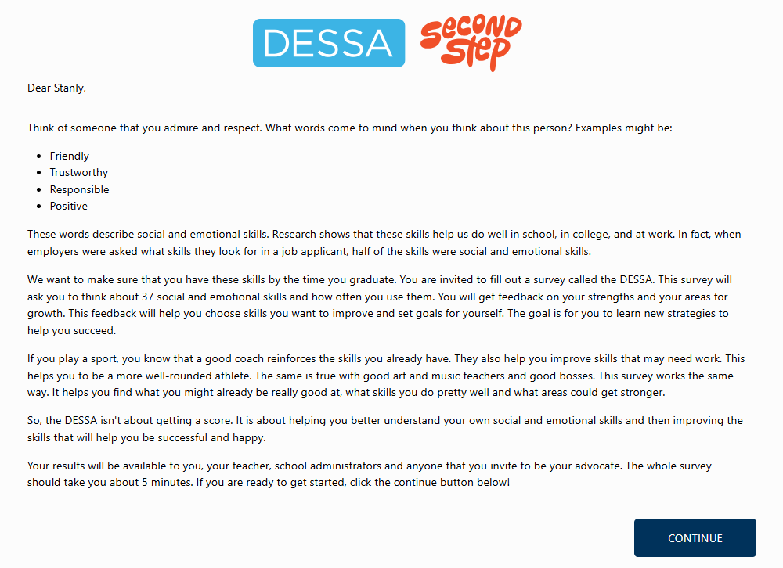
After students register and log in, they will be met with a welcome letter and can follow the prompts to the assessment.
Notes:
Talking Points:
When a Rating Window is open and students login to their Student Portal account for the first time, they will be met with a welcome letter and can follow the prompts to the assessment.

Slide 41
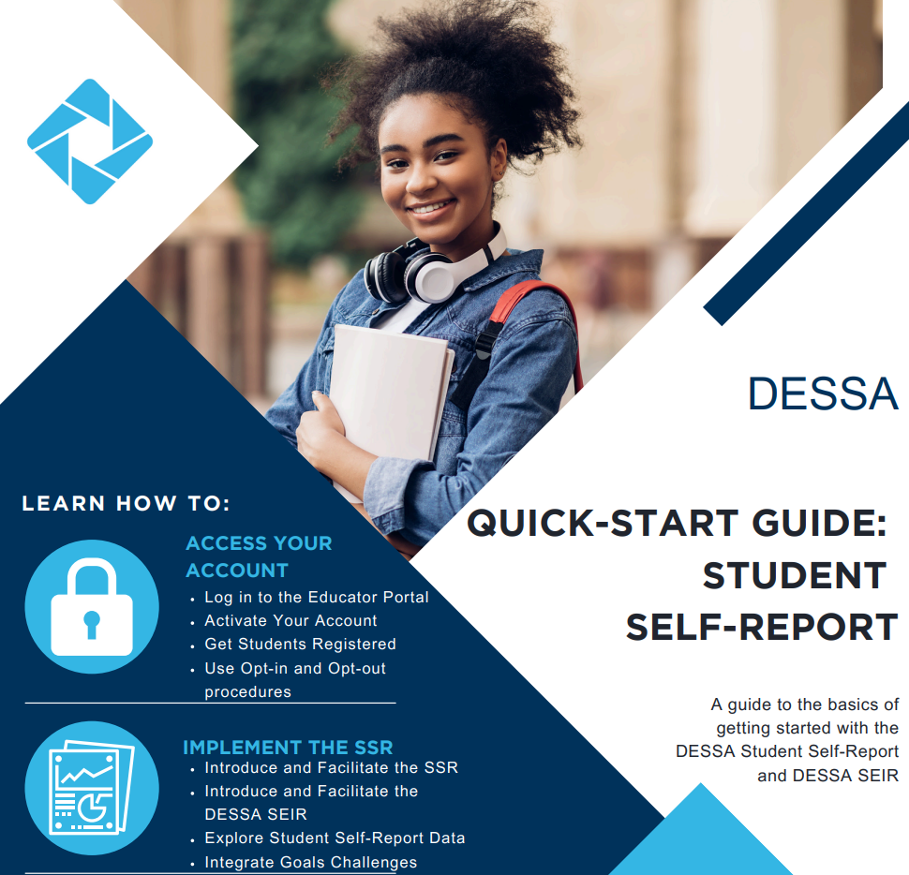
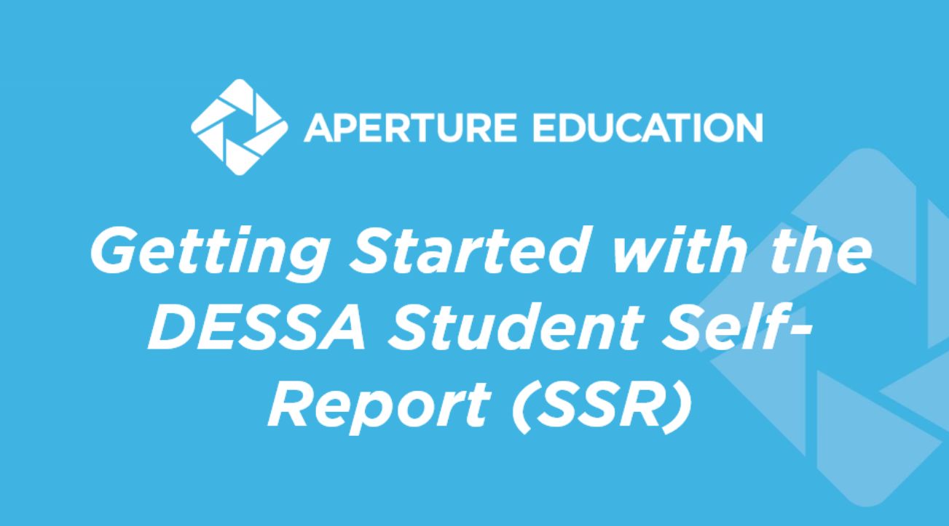
Implementation Resources
Notes:
Talking Points
To support the implementation in the classroom, we recommend using the ready-to-use materials available within the Support Portal.
The PowerPoint slide deck is an in-classroom resource can be used by teachers to introduce the SSR to students and guide them in the process of Registering and Accessing the Student Portal.
The quick start guide provides an overview of the main components needed to successfully collect SSR data.
There is also a one-page resource that is student-facing that connects the skills measured by the DESSA to their overall development and growth.
https://info.apertureed.com/en/hc/getting-started-with-the-dessa-student-self-report-ssr-educator-and-student-facing-resources

Slide 42
The Student Portal
My Results Page
Notes:
Talking Points:
Let’s take a look at those different features within the Student Portal that were mentioned in the video.
Once students complete the SSR, they will have access to their results.
Students will first be able to see the Top Skills that they have developed and a specific competency that aligns to their strengths.

Slide 43
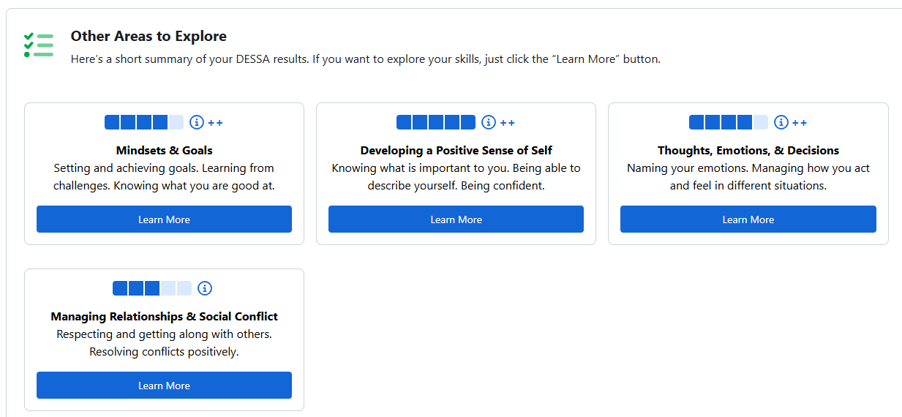
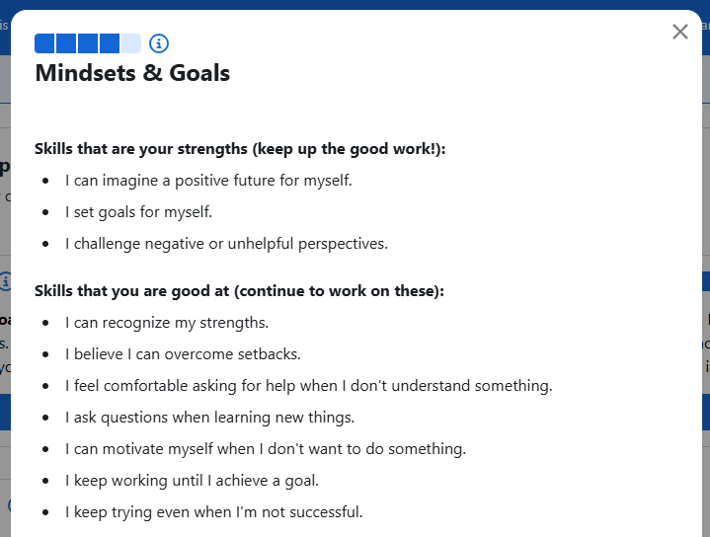
The Student Portal
Notes:
Students can also see their results for each competency, represented with battery pack imagery. By clicking the “Learn More” button each competency, they can also see specific skills that are strengths and areas of growth for them.
Optional engagement activity: In the chat, share some ways that you might use this information to inform your work or conversations with students.

Slide 44
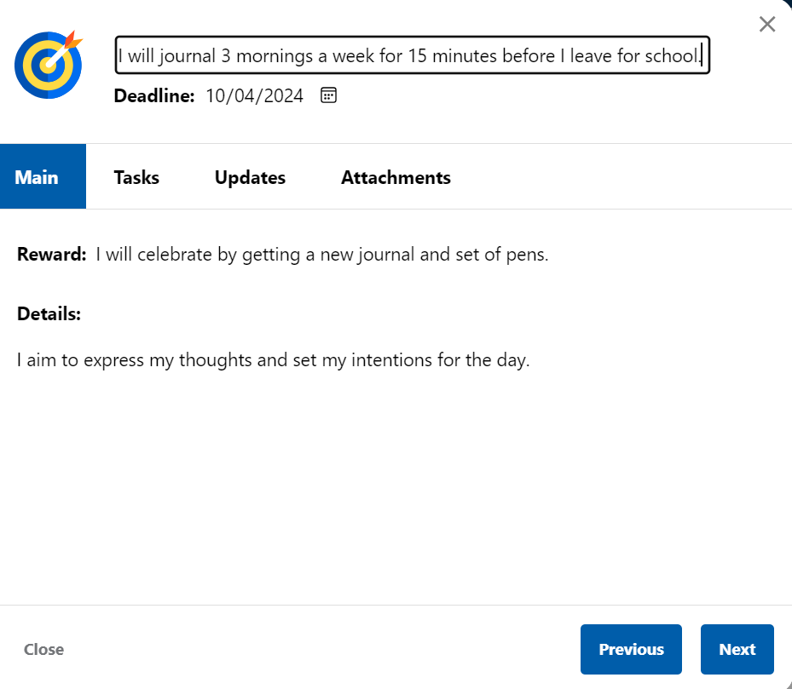
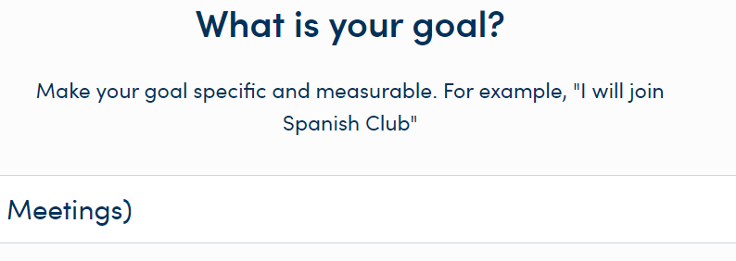
The Student Portal
Independent SMART
Goal Setting
Notes:
There is also independent goal setting. This platform prompts students to set SMART goals in some suggested areas here or a specific area in which they want to set a goal. What I really like about it is that it allows us to communicate back with the student.
The system will walk the student through how to set their smart goal by focusing in on their “why” which reinforces student agency and buy in and input.
They then will select when they want to reach that goal and can generate bulleted tasks that act as steps to obtaining their goal, along with providing updates and attachments.
So, if you're an assigned educator who is working in the program, or working with a student or roster of students, you can communicate and provide feedback, as well as watch their progress as they enter items into the system.

Slide 45
Quick Connect
How do you think students will feel as they complete their self-assessment?
With your students’ needs in mind, how would you approach this process to ensure students complete the form to the best of their ability?

Slide 46

The Educator Portal
Notes:
Educators, you are not forgotten! Now that we’ve covered the DESSA and the Student Portal, let’s walk through the Educator Portal!

Slide 47



User Roles in the DESSA System
Can generate and view all reports for the program, sites, and students.
Can generate and view reports from their site only.
Can generate and view reports for their assigned students.
Notes:
There are 3 different types of user access. The user access in the Educator Portal dictates what information is displayed on the dashboard and the types or amount of data viewable in your DESSA account.
First, the Program Administrator access is typically provided to district leaders or other staff responsible for setting up rostering, assessment windows, and rating assignments. Program administrator access will allow the user to view data for all sites within their district.
Next, the Site Leader access is generally provided to school or site-based leaders, including Principals and Assistant Principals, as well as other leaders that may need access to data across the campus, such as School Counselors, School Psychologists, Social Workers, etc. Site Leader access will allow the user to access to data for their specific site.
Finally, the Rater access is provided to educators that are assigned to complete ratings within the Educator Portal. The Rater access allows for educators to complete DESSA assessment for the students that they have been assigned to rate and view the data for their assigned students.

Slide 48
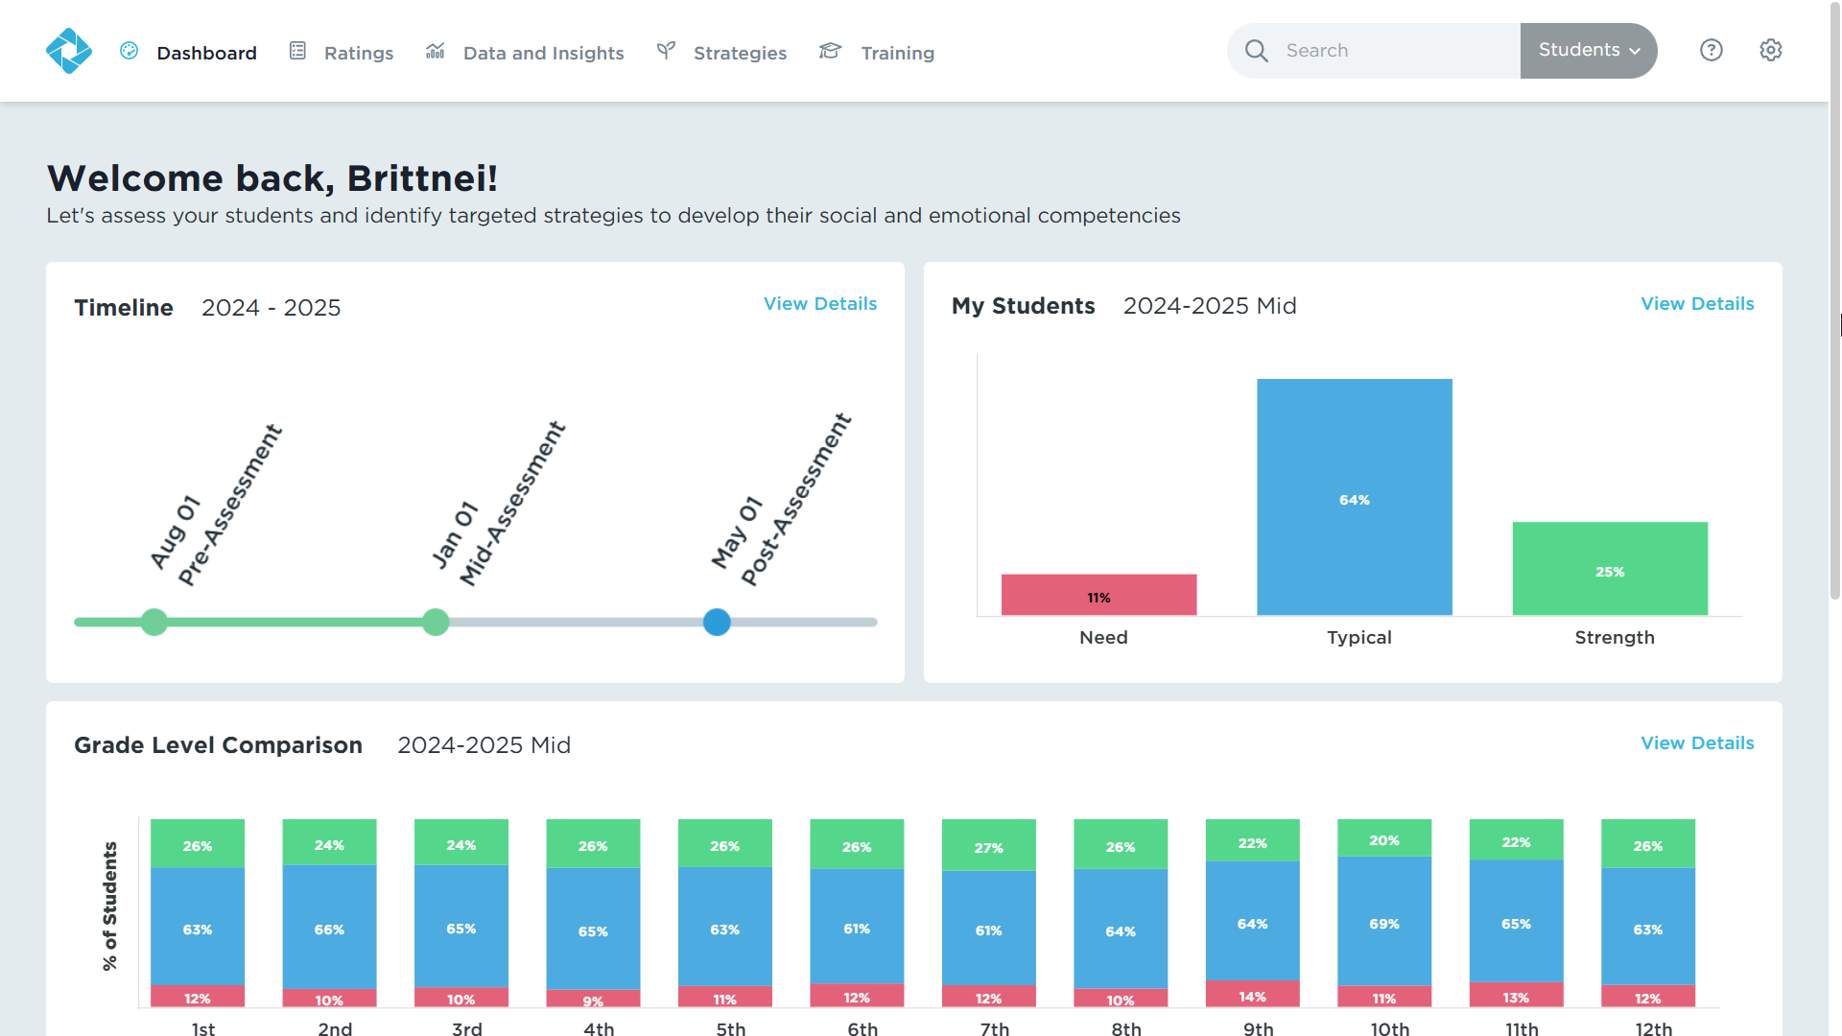
Site Leader Dashboard
Notes:
When Site Leaders log in to their account, the dashboard will provide a quick snapshot of the rating window timeline, a preview of the My Students report, which displays an overview of student performance. On the bottom of the screen, they will see a grade-level comparison of all the grades in their building.

Slide 49
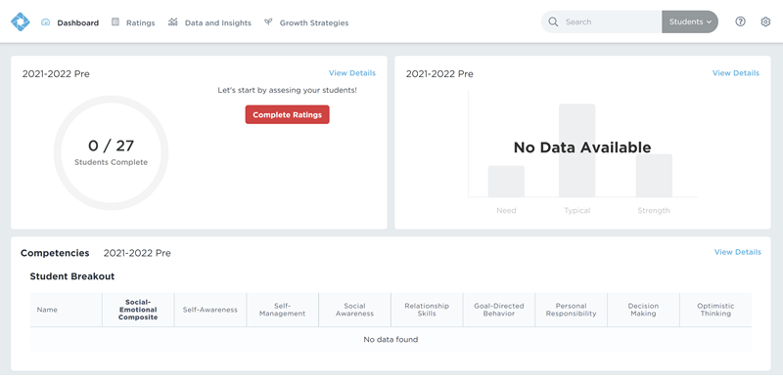
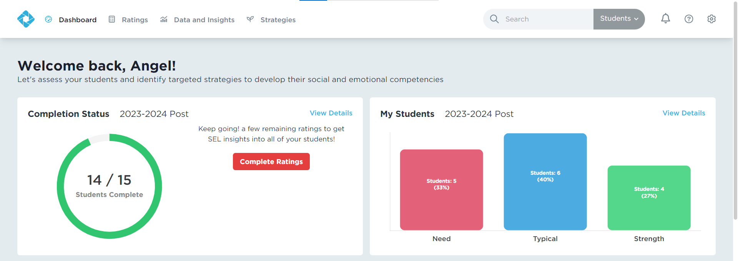
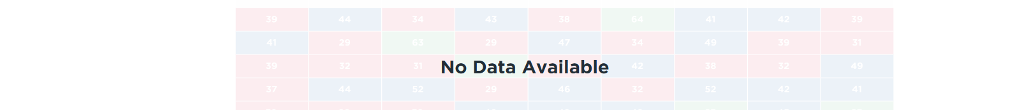
Educator Dashboard
Notes:
When a user first logs into the Educator Portal, the dashboard will likely appear blank since there won’t be any ratings completed yet and therefore, there won’t be any data in the system.
Once ratings begin to occur that data will populate in the system and be able to be viewed here as well in the data and insights tab, which we will go over in more detail in a few moments.
Educators will see a quick snapshot of the rating progress and data that has been collected based on the current or most recent rating window, an overview of the student performance on the right side, and a breakdown of student scores who received a DESSA 2 assessment at the bottom of the screen. Educators will only see data for the students in their classroom or on their roster.

Slide 50
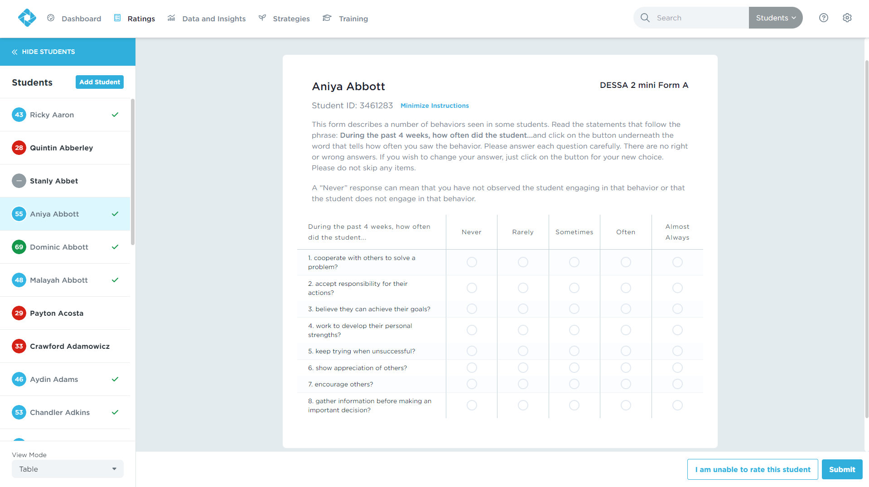
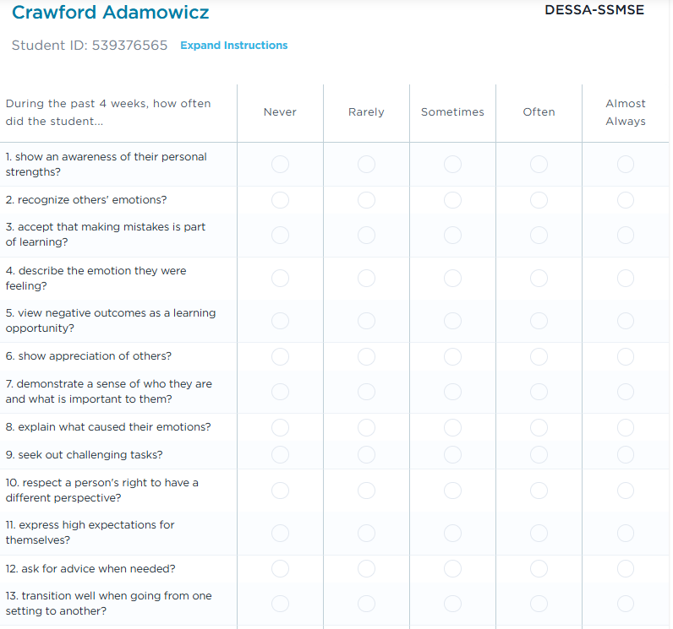
Ratings Tab
The Ratings tab shows the assigned roster of students.
Notes:
Under the “Ratings” tab, educators will be able to view their assigned roster of students.
As a reminder, the circles on the left side of the student names indicate whether or not they’ve been rated, and the descriptive range in which they scored.
Gray signifies that they have not been rated, red means they have a need for instruction, blue means they scored in the typical range, and green means they scored in the strength range.
Students with a check mark do not need any further assessment.

Slide 51
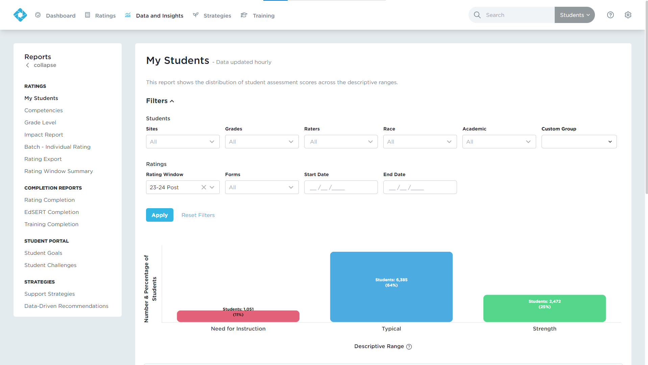
Data and Insights
Real-time results
Interactive, filterable charts
Downloadable reports
Notes:
Data and Insights will give you just that: data from the DESSA assessments and insights into how you can support your students.
You’ll get Real-time results, Interactive, filterable charts, and Downloadable reports.

Slide 52
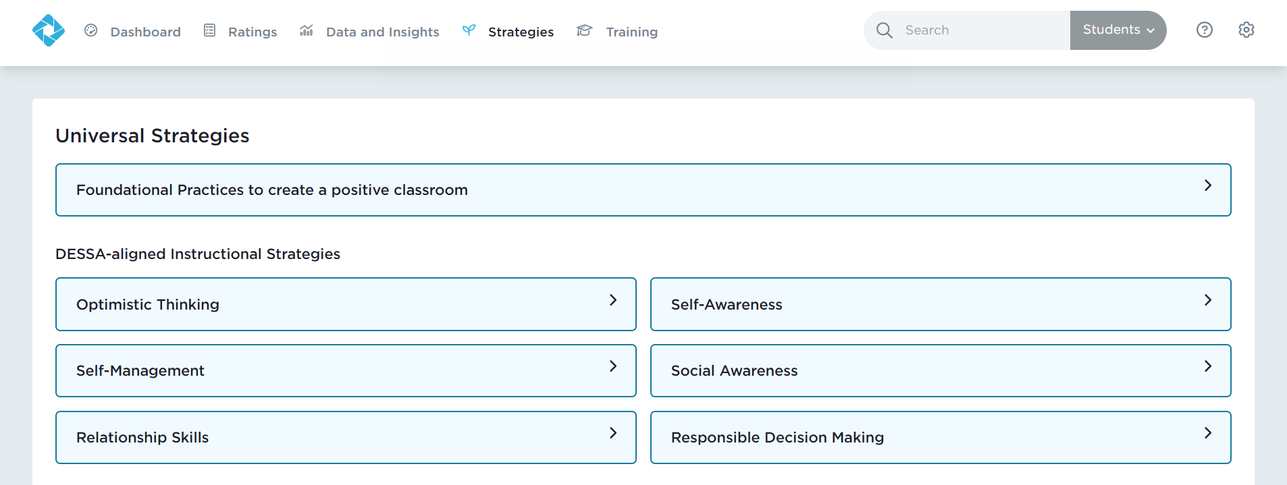
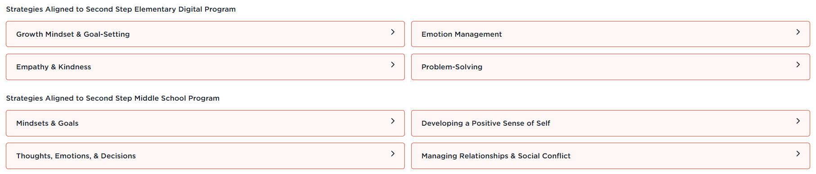
Strategies
Notes:
Under the Strategies tab, there are resources to build social-emotional competence and future-ready skills categorized by competency and grade level. These scripted strategies can be implemented by anyone at any time.

Slide 53
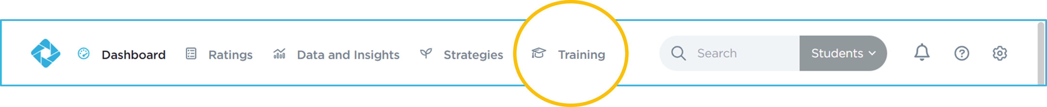
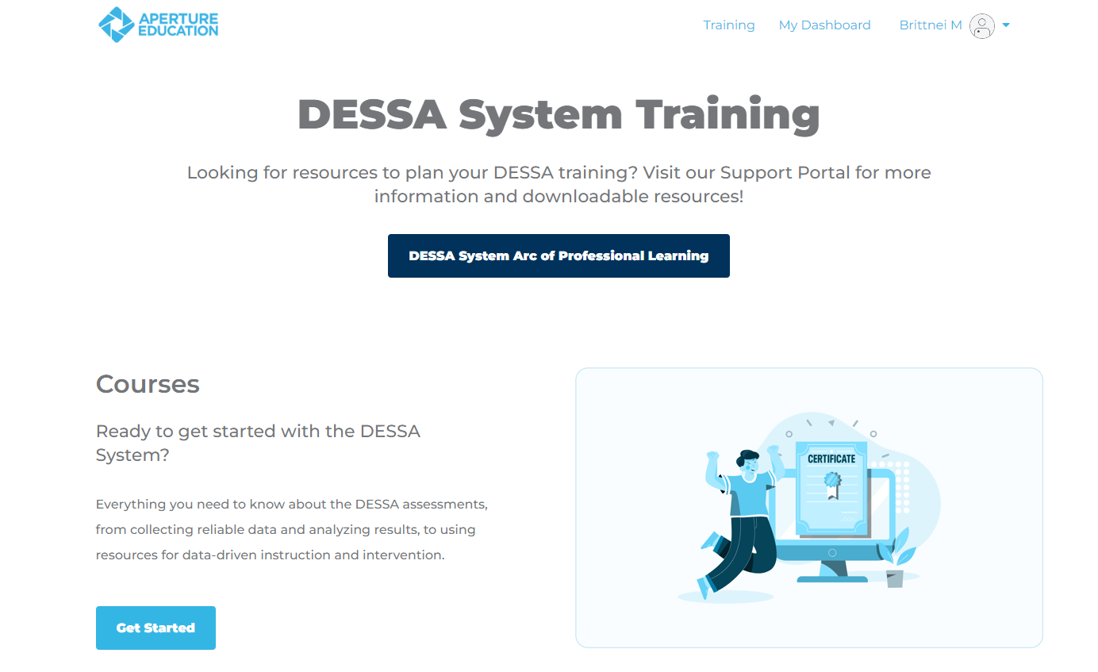
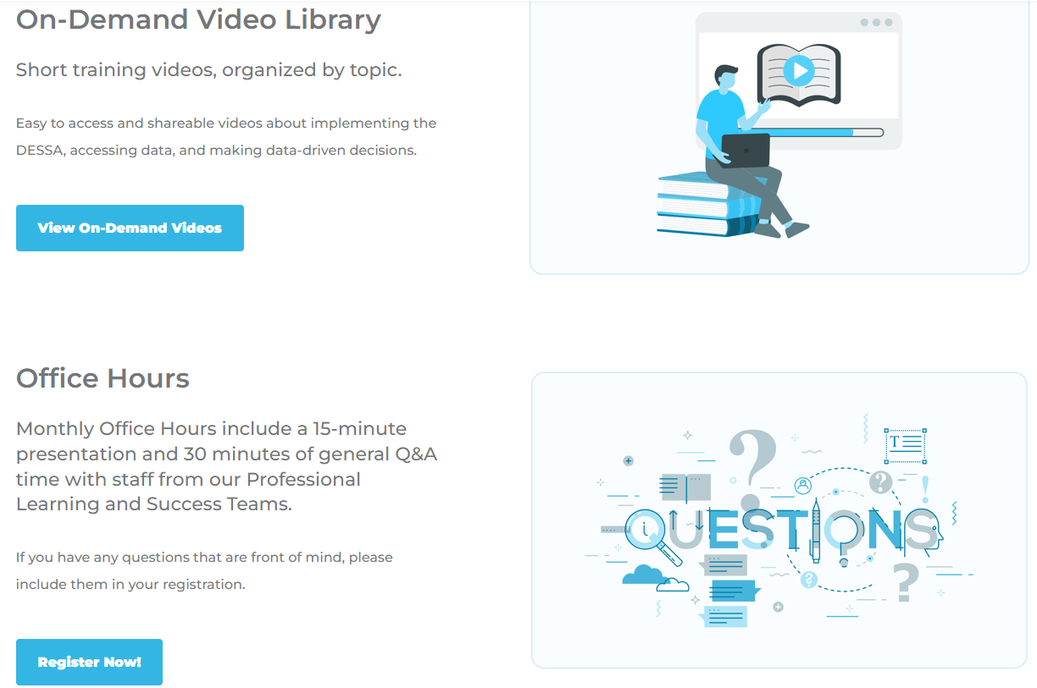
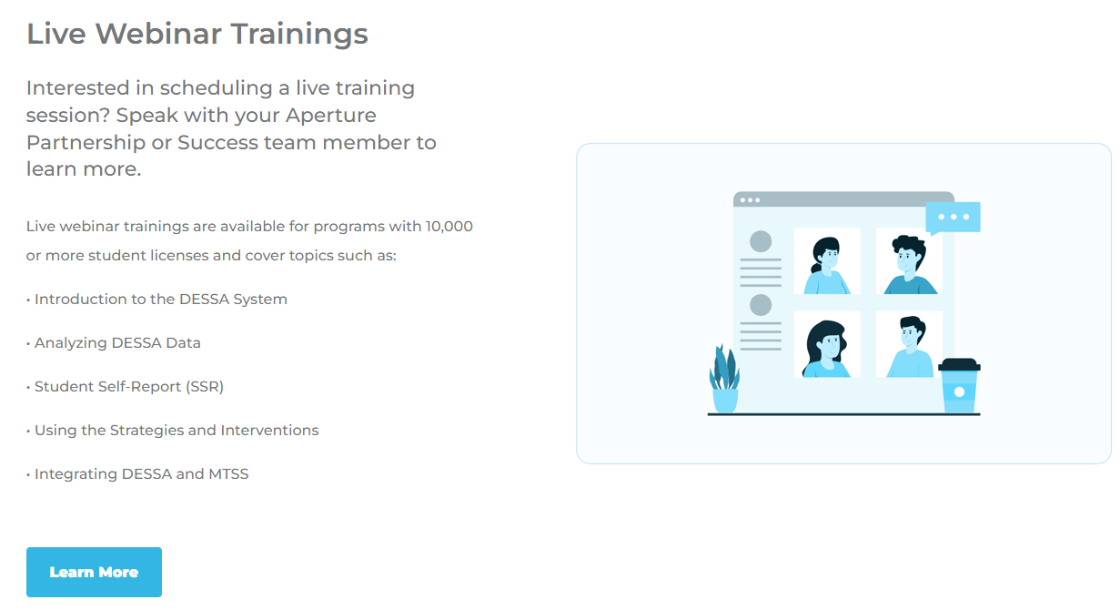
Training
Notes:
Choose your preferred learning modality! The Training tab allows you to choose your own adventure to learn more about the DESSA.
There are self-paced courses for individuals who are new to the DESSA or those who just need a refresher.
The on-demand video library provides short self-service videos that help users with DESSA implementation, and we offer live monthly office hours on pre-selected topics as well.
The Support Portal is open 24/7, offering resources to help guide users through the DESSA system.

Slide 54
Implementation Timeline
Notes:
So, we know what the DESSA is, we know how to rate students using the DESSA, and we’ve ventured into the Educator Portal. Let’s now take a step back to talk through how all of this information fits within the full scope of implementation.

Slide 55
General Implementation Overview
Pre-Assessment
Post-Assessment
End of School Year
Start of
School Year
Ongoing, universal, and data-driven SEL Instruction
Targeted intervention and individualized instruction, as needed
Notes:
For your awareness, here’s what a yearlong DESSA implementation typically looks like
(Click) Generally speaking:
After the educator has had a minimum of 4 weeks to observe their class, they complete the DESSA assessment for their students.
A post-assessment is completed prior to the end of the school year. Students complete assessments during the same rating windows as their teachers
(Click) Throughout the school year, ongoing, universal, and data-driven instruction of social and emotional skills is provided to all students, and targeted intervention and/or individualized instruction is provided to students who demonstrate a need for further support in specific skills areas, typically in the small group or individual setting. You can also complete a mid-year assessment
Additionally, throughout the school year, staff are having discussions about the data they collect or best practices for supporting students in this development and are working together to create a supportive school culture and climate, the foundation for students to grow.
(Click) A key point to keep in mind is that the teaching and learning of social and emotional competencies are continuous.
Educators are constantly teaching these skills, whether it’s through explicit instruction, modeling, or relationship building with students.
Students are constantly learning from each other, about themselves, and by interacting with adults within their school environment.
It’s not just during the rating windows of collecting data that we are actively involved in this process; it’s all year round.

Slide 56
Q & A
What questions, curiosities, or big ideas would you like to share regarding any of the DESSA assessments?
Notes:
What questions, curiosities, or big ideas would you like to share regarding any of the DESSA assessments?

Slide 57

Optimistic Closure
What are you looking forward to most about using the DESSA?
Notes:
What are you looking forward to most about using the DESSA?

Slide 58

Thank You!
Thank you for your time and attention today!
Notes:
Thanks so much for joining us today!

