Slide 1
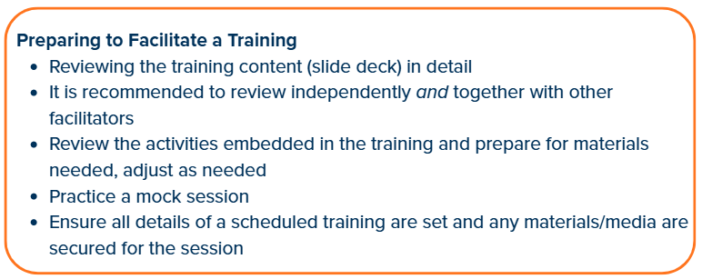
Training Prep

Slide 2
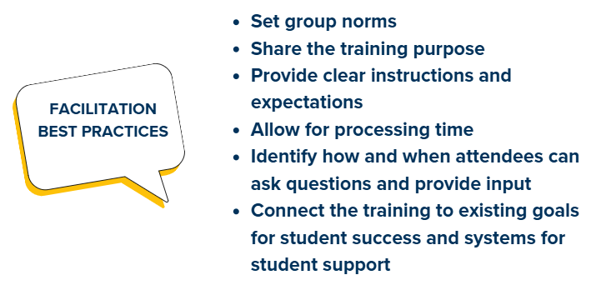
Facilitation Best Practices

Slide 3
Facilitator Resources to Bookmark
Completing Ratings Frequently Asked Questions
Information about the DESSA Likert Scale
DESSA Rating Forms (PDF)
On-Demand Video Library

Slide 4

Rating Window Reflection
Rating Window Reflection
What are some “Glows” and “Grows” from the first DESSA rating window?
Glow: Highlights, celebrations, things that went well
Grow: Challenges, areas for improvement, things to do differently next time
Notes:
Talking Points
Let’s start today by checking in on how the first DESSA rating window went.
I invite you to reflect on two different areas – the “Glows” and “Grows” of your first DESSA ratings.
Glows are highlights, celebrations, and things that went well in the overall process.
Grows would include any challenges, areas for improvement, and things to do differently next time.
(offering think/participation time)
Train the Trainer Facilitation:
Consider: How do you want attendees to respond and share out?
Some ideas could be:
Turn and talk with someone near you, then share out some responses (connection)
Have staff get up to share with someone (pre-plan by providing connection cards to find other half or just encourage staff to get up) (movement)
Have staff write on sticky notes and post them on a chart (movement)
Independent reflection and share out with group (discussion)
(After facilitating activity):
As we discuss the DESSA today, it’s important to remember that implementation of a new program or assessment takes time. These reflections and conversations are crucial to the success and we can continue to discuss both the “glows” and “grows” throughout the year to make sure we are adapting as needed.

Slide 5
DESSA Implementation Goals & Roles
Insert: [Add in the specific goals that your district has for implementing the DESSA, the specific roles involved for staff, and how data are used]
Notes:
Talking Points:
[Add in the specific goals that your district has for implementing the DESSA and the specific roles involved for staff]

Slide 6
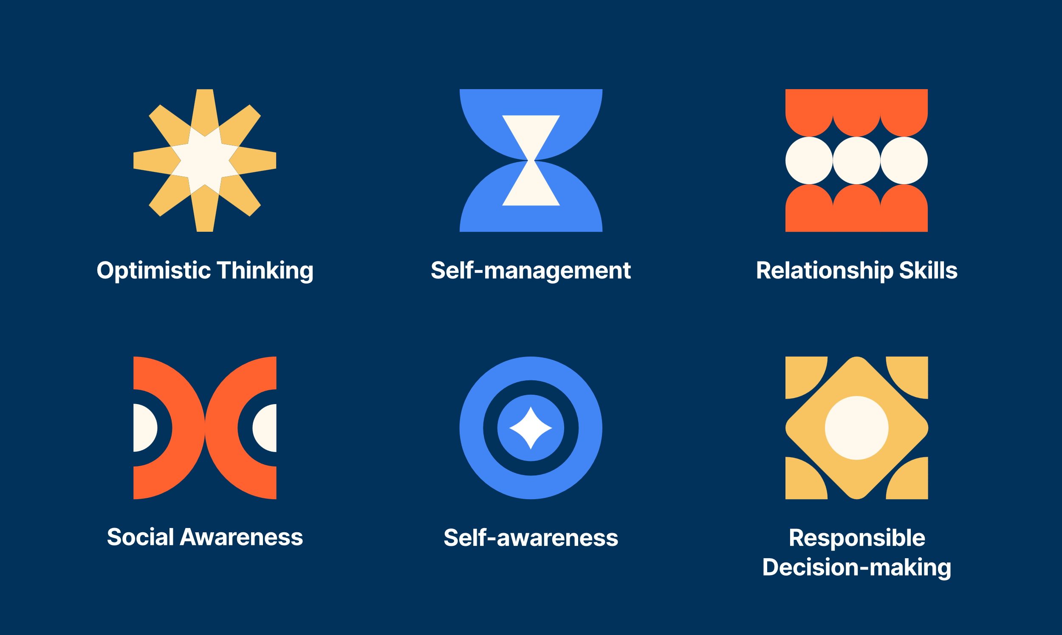
Gallery Walk: Competencies in Action
Notes:
Train the Trainer Facilitation:
Review the slide notes on the next slide for the directions and talking points for this activity

Slide 7
Gallery Walk: Competencies in Action
Each chart has a single competency definition. Start at one chart and read the definition on the chart.
On the chart, write down some specific ways that your students typically demonstrate these skills.
Then, move on to another chart and list your examples for the next competency.
Return to your seat when you’ve had a chance to add something to each chart or when we call everyone back together.
Notes:
Train the Trainer Facilitation:
Consider: Planning for and facilitating a gallery walk for “Competencies in Action.” Educators will add specific ways that they have seen students use these skills in the classroom.
Create a chart for each of the competency areas and add the definitions as outlined below and provide the directions listed in the “Talking Points” section below.
Optimistic Thinking: the belief and demonstration of confidence, hopefulness, and positive thinking regarding oneself, others, and one’s life situations in the past, present, and future.
Self-management: the ability to manage emotions and behaviors across different situations and environments and to demonstrate agency as one works to set and achieve personal and collective goals.
Relationship Skills: the abilities to establish and maintain healthy and positive relationships including effective communication, collaborative problem-solving, negotiating conflict, and demonstrating helpful and supportive behaviors.
Social Awareness: the understanding of social norms for behavior; the ability to empathize with, respect, and take the perspectives of others; and the feeling of connection and belonging with family, peers, schools, and community groups.
Self-awareness: the ability to understand emotions, thoughts, and values and how they influence one’s behavior; recognize strengths and limitations; and develop healthy identities and a sense of purpose.
Responsible Decision-making: the ability to make careful, reliable, and constructive choices about personal and social behavior that are appropriate across diverse situations; to consider the personal, social, and collective impact of one’s actions; and to demonstrate curiosity and an open-mindedness to learning.
Talking Points:
We are going to take some time to brainstorm together – what does it look like for our students to demonstrate these different skills? These skills are everyday, observable behaviors and the way students use them will vary based on the classroom, grade level, teacher, time of day, etc.
The directions are:
Each chart has a single competency definition. Start at one chart and read the definition on the chart.
On the chart, write down some specific ways that your students typically demonstrate these skills. For example, if you are on the self-awareness chart, maybe one way that you have seen your students demonstrate this competency looks like “my students can label common emotions that they feel” or “my students are aware of their preferences.” The more specific you can get, the better – maybe it sounds like “My students can express when they are mad” or “My students know that they like outdoor recess better than indoor recess.”
Then, move on to another chart and list your examples for the next competency.
Return to your seat when you’ve had a chance to add something to each chart or when we call everyone back together.
Train the Trainer Facilitation:
Consider: After the group returns to their seats, review some examples from each chart. Either read a few off as the facilitator or ask for volunteers to read a few from the chart.
Offer reflection question(s) from the activity before moving on:
How was it brainstorming what it looks like for your students to use these skills? Was it difficult or did it come pretty naturally?
Were there any areas that were harder to brainstorm than others?
What does it look like for YOU as the educator to model these skills and offer opportunities for students to learn about and practice these skills?

Slide 8

Activity: DESSA 2-Minute Recap
In your own words, share a 2-minute recap of the DESSA with a partner.
Before we get started, jot down some highlights you will share with your partner.
Decide with partner will go first to begin when the timer starts
As the listening partner, ask questions and engage with the person sharing
When the timer is up, switch!
Notes:
Train the Trainer Facilitation:
Consider: Planning for and facilitating a partner activity where attendees will take turns providing a recap of the DESSA to a partner.
Refer to the directions on the slide and provide the directions listed in the “Talking Points” section below.
Provide time for attendees to make quick note and then give the direction to pair up with someone – can be their own selection or provide a way for attendees to pair up. Use the embedded timer on the screen and then have partners switch and start the timer again.
Talking Points:
We are going do another activity before we take a break. This time, you will be partnering up with someone to share a quick, 2 minute recap of the DESSA – in your own words. Use the information we have discussed today and share it with the other person like they are totally new to the assessment. Then, you’ll switch and the other person will have a chance to share their version.
Decide with partner will go first to begin when the timer starts
When you are the listening partner, feel free to ask questions and engage with the person sharing.
Take a moment to jot down any highlights you would plan to share with your partner and then when we give the direction, you can get up and find your partner. We will use a 2 minute timer on the screen and then switch!
Train the Trainer Facilitation:
Consider: After the group returns to their seats, ask for any remaining questions that may have come up while partners were working together. Offer the space for someone to share their 2-minute recap in front of the group!

Slide 9
Practice a Rating
Imagine your school-aged self or someone you know. You can even imagine your favorite book character.
Answer each question according to that person’s behavior.
Notes:
Talking Points
Now it’s time to practice a rating! In just a moment, we will have an example of the DESSA on the screen. You will imagine your school-aged self or someone you know. You can even imagine your favorite book character. Answer each question according to that person’s behavior.
Facilitator Note: Provide paper copies of the DESSA 2 mini screener FORM A - https://info.apertureed.com/en/hc/printable-pdf-dessa-2-mini-and-dessa-2

Slide 10
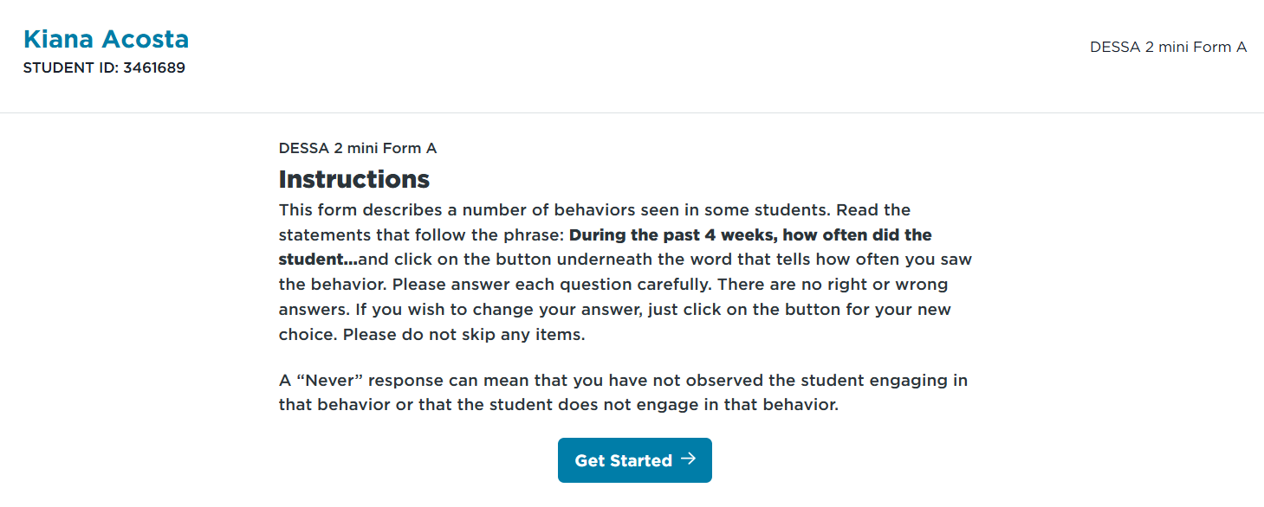
Practice a Rating
Notes:
Talking Points:
First, the directions for each student will read: [read the directions on the screen]
Facilitator Note: Provide paper copies of the DESSA 2 mini screener FORM A - https://info.apertureed.com/en/hc/printable-pdf-dessa-2-mini-and-dessa-2
screen)

Slide 11
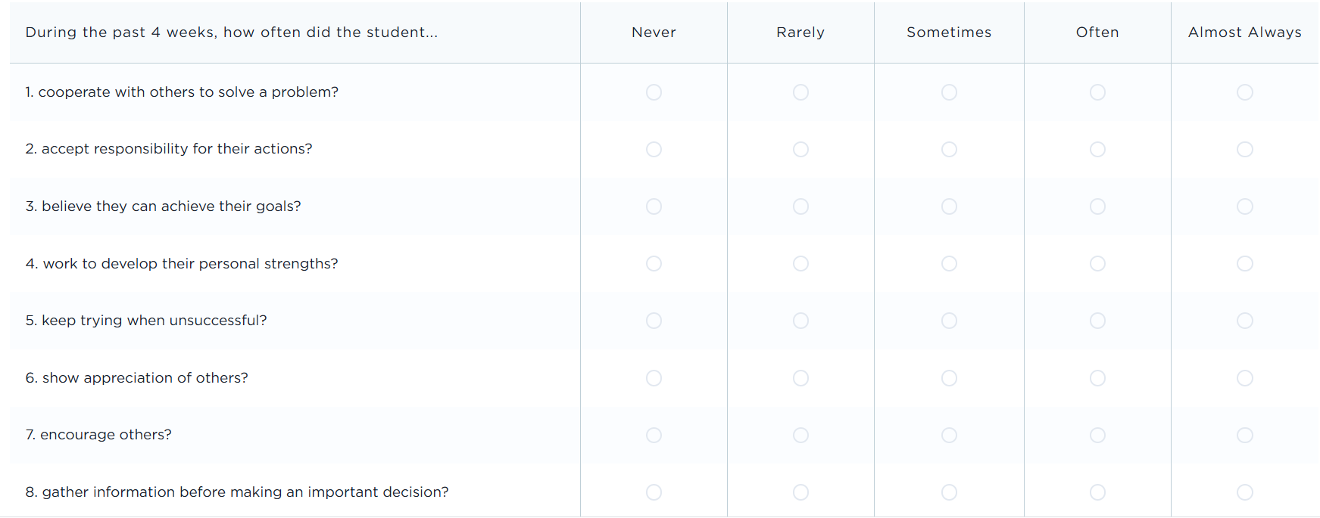
Practice a Rating
Notes:
Talking Points:
Here’s the DESSA mini screener for our practice rating. You also have a copy of this form which you will use to answer the questions. The answer options are: Never, Rarely, Sometimes, Often, and Almost Always.
Facilitator Note: read the items and allow time for attendees to “complete” their rating based on the person they have in mind.” Provide paper copies of the DESSA 2 mini screener FORM A - https://info.apertureed.com/en/hc/printable-pdf-dessa-2-mini-and-dessa-2

Slide 12
Pause:
Any “ah ha!” or additional questions after completing a practice rating?
Notes:
Let’s pause here: are there any “ah ha!” moments or other questions that came up for you while completing this practice rating?

Slide 13
Small Group Activity: Brainstorm Skills
  Contribute to creating a positive learning environment: My student volunteered to hand out scissors and markers to the class so everyone had supplies to work on the activity.
  Listen to others: My student waited until her partner finished speaking and then restated what she heard before giving her own answer during think-pair-share.”
  Do the right thing in a difficult situation: My student returned the game pieces to the shelf even though others were rushing to line up for lunch.
Small Group Directions:
Refer to the DESSA screening form you just completed as an independent practice
Brainstorm with your small group what it can look like for students to demonstrate these skills
Keep in mind, it can look different for different students, in different classrooms, at different times of the day or week or year
Notes:
Facilitation:
Consider: Planning for and facilitating a partner activity where small groups work together to brainstorm what it looks like for students to demonstrate the specific skills on the DESSA mini screener that they just completed independently. This is similar to the first activity of the gallery walk where attendees brainstormed examples of how students demonstrate the different competencies that are measured by the DESSA. Now, they will brainstorm what it looks like for their students to typically demonstrate the skills on the screener.
There are no right or wrong, or absolutes when it comes to these behaviors. The goal is to have educators talking about what they observe and how it can differ based on the student and classroom.
Refer to the examples and directions on the slide and provide the directions listed in the “Talking Points” section below.
Talking Points:
We have one last activity before we move on to the last section of the training, which is an overview of the online DESSA System platform and resources.
In small groups, we are going to talk about the screening we just independently completed and brainstorm what it typically can look like for our students to demonstrate these skills. Keep in mind, it can look different for different students, in different classrooms, at different times of the day or week or year – we are generally describing and brainstorming examples of what it can look like for our students to use these skills – so that we are more confident in completing the ratings when the time comes to collect the data.
Some other DESSA questions are on the screen now with examples of what it can look like for an educator to observe these skills in action. Let’s take a look:
The first one lists the question “How often does the student: contribute to creating a positive learning environment: My student volunteered to hand out scissors and markers to the class so everyone had supplies to work on the activity.”
The next one says: “How often does the student: listen to others: My student waited until her partner finished speaking and then restated what she heard before giving her own answer during think-pair-share.”
The last examples says: “How often does the student: do the right thing in a difficult situation: My student returned the game pieces to the shelf even though others were rushing to line up for lunch.”
Train the Trainer Facilitation:
Consider: Provide directions for how attendees will form small groups and a set a specific amount of time that they will work together on this activity.
After the whole group comes back together, provide time to ask/answer any questions that may have come up and remind attendees that these are skills that they, as educators, can create opportunities for students to demonstrate through different activities throughout the day.

Slide 14
Reflect on Confidence in Rating
How sure are you that your ratings provide an accurate, complete, and fair appraisal of your students’ social and emotional competence? Use the scale of 1-5 below. Consider how well you know your students, any feelings or issues that might have impacted your ratings, and how thoughtfully and carefully you completed the ratings. ​​
Not at all Confident |  | Somewhat Confident | Very Confident
1 | 2 | 3 | 4 | 5
If your rating is a 1-2, you should not use your ratings for decision-making. Spend more time observing your students to get to know them better and address any issues that may have biased your ratings. When you feel confident that you know your students well, connect with leadership staff to complete new rating. |  | If your rating is a 3, you should be very cautious in using your ratings to make important decisions about students and instruction. Consider why you are only somewhat confident and try to address any concerns you identify.​ | If your rating is a 4-5, you can confidently use your data to make next step decisions.​
Notes:
Facilitation:
Use this table and the next slide to check in with the instructional staff who have completed the DESSA by guiding them to reflect on their confidence in ratings.
The table can be used to encourage discussion about how confident instructional staff are in their completed ratings before they begin to use the data to make decisions about their instruction and interventions.
Talking Points:
Start by this discussion by asking instructional staff:
How sure are you that your ratings provide an accurate, complete, and fair appraisal of your students’ social and emotional competence? Use the scale of 1-5 below.
Consider how well you know your students, any feelings or issues that might have impacted your ratings, and how thoughtfully and carefully you completed the ratings. ​​
As listed in the table, if instructional staff select a 1 or 2, indicating they are “Not at all Confident”, then they should not use ratings for decision-making. If they selects a 3, indicating they are “Somewhat Confident” in their rating, they should be cautious in using the rating to make important decisions about a student or their instruction. They should consider why they are only somewhat confident and work together to address any concerns that are identified.
If an instructional staff member selects a 4 or 5, indicating they are “Very Confident” in their rating, they can confidently use the data to make decisions.
Let’s look at the next slides for further steps, if an educator indicates they are less than “Very Confident” in their ratings.

Slide 15
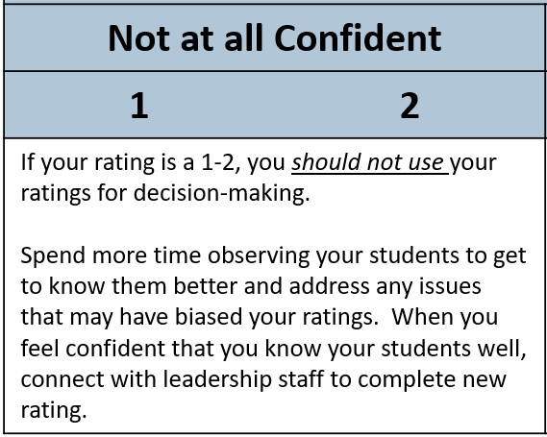
Reflecting on Confidence in Rating
Spend more time observing students
Address any issues that may have impacted ratings
Review DESSA items (skills)
Intentionally create opportunities for students demonstrate skills
Discuss what it typically looks like for students to demonstrate specific skills, based on grade level
Notes:
Talking Points:
If an instructional staff member does indicate that they are less than “Very Confident” in their completed ratings, there are some best practices to return to.
As indicated on the confidence rating tool, if an instructional staff member indicates that they are “Not at All Confident”, they should spend more time observing students and address any issues that may have impacted ratings. When they feel confident that they know students well, they should then connect with leadership staff to ensure they are able to complete a new rating.
In order to increase their rating confidence, a best practice would include reviewing the DESSA items (skills) so that they know what to look for when they go to complete the rating again. PDF versions of the DESSA items can be found in the Support Portal.
Additionally, instructional staff should intentionally create opportunities for the student to demonstrate those skills. This could mean adapting the schedule, environment, or structure of their classroom and considering what it looks like for students to typically demonstrate those skills based on their grade level.
As previously mentioned, communication is key for successful implementation. Be sure to collaborate with relevant team members during this process and work together to ensure confidence in ratings (and therefore, confidence in the results) can increase.

Slide 16
Data-Driven Dialogue
Before reviewing your collected data in more detail throughout this session, take a moment to respond to these reflection prompts:
Sentence starters:
I predict…
I wonder…
My questions/expectations are influenced by…
I am hoping to learn…
Notes:
Facilitation:
Provide this prompt BEFORE staff review collected data
Talking Points:
Before diving into DESSA results, a moment to respond to the reflection prompts below. What do you predict you will see in your data? What wonders or questions does this spark?
Some sentence starters might include:
I predict…
I wonder…
My questions/expectations are influenced by…
I am hoping to learn…
These prompts can also be provided to instructional staff as discussions about analyzing and using DESSA data are facilitated. These prompts allow for educators to both calibrate on their expectations and center on engaging in data-driven dialogue as they work with interdisciplinary team members to support students.

Slide 17
Data-Driven Dialogue
Pause for a moment and consider what you noticed in the data you have analyzed. What patterns or trends did you see? Where you surprised by anything? What alignment do you see with other school data?
Sentence starters:
I observe that…
Some patterns/ trends that I notice…
I can count…
I’m surprised that I see...
This aligns with other school data like…
Notes:
Facilitation:
Provide this prompt AFTER staff review collected data
Talking Points:
Pause for a moment and consider what you noticed in the data you have analyzed. What patterns or trends did you see? Where you surprised by anything? What alignment do you see with other school data?”
Some sentence starters for this reflection could include:
I observe that…
Some patterns or trends that I notice are…
I can count…
I’m surprised that I see…
This aligns to other school data like… (examples include: referrals, benchmark assessments, attendance, evalution referrals)
This process can help to answer some of the questions or concerns that may have come up during your data review and can be used to guide the decision-making steps for supporting students. Educators will want to engage in this process independently, as well as with interdisciplinary teams that are involved in identifying and monitoring students for targeted and individualized supports.

Slide 18


Closing Reflection
How confident do you feel at this point of implementation?
Not confident
Very Confident
Notes:
Facilitation:
Consider: The options for how attendees can respond to this prompt. Since it is a confidence reflection, consider the option for independent reflection and action steps the participant should take if they are on the lower end of the scale.
Talking Points:
Let’s end our time with this closing reflection: what is your individual role when it comes to implementing the DESSA and how confident do you feel within your role at this point of implementation? Use the provided scale 1-5, with one being not very confident through 5 being very confident.
Consider why you answered this question the way that you did. What influenced your response?
As you view this training, consider what supports you may need to feel confident in your role. We encourage you to communicate other team members to ensure you are feeling supported, so that in turn, you can support the instructional staff members as they collect and use DESSA data throughout the school year.

Slide 19
What’s Next
[Insert next steps for the attendees, with timelines included and how/who to ask for support, as needed\
Notes:
[Insert: Next steps for the attendees, with timelines included and how/who to ask for support, as needed

