Slide 1

Analyzing DESSA Data
Educator-Completed Assessments
Notes:
Ταλκινγ Ποιντσ:
Welcome! This DESSA training is the “part 2” of our first year trainings, titled “Analyzing DESSA Data.”
This training will focus on the educator-completed assessments, including both the screening tool and the full DESSA.
Your leadership team has shared with us that your district has implemented the screener, the DESSA mini, for K-12 at this time. We’ll keep that in the forefront but we will touch on the full DESSA as well.

Slide 2
Goals for Today’s Session
By the end of the session, you will be able to:
Access DESSA data within the Educator Portal.
Analyze and interpret data through a multi-tiered system of support (MTSS) lens.
Explore Strategies resources to support students’ social-emotional development using a strengths-based approach.
Notes:
Talking Points:
With that said, by the end of the session, you will be able to:
Access DESSA data within the Educator Portal.
Analyze and interpret data through a multi-tiered system of support (MTSS) lens.
Explore Strategies resources to support students’ social-emotional development using a strengths-based approach.

Slide 3
Meeting Students Where They Are
Is there a need?
What is the need?
What will we do?
Notes:
Talking Points:
Another goal we have for this session, and for implementation overall, is to meet students where they are.
The DESSA helps us understand how our students are developing and using importance skills, and helps us to consider how we can support them in continuing to grow in these competency areas.
These three guiding questions will structure our discussions as we learn how to access and analyze the collected data:
Is there a need? (for support)
What is the need?
And what will we do? (to support students and also staff)

Slide 4
Opening Activity
Strengths-based approach:
How would you describe the first DESSA rating window in one word or phrase?
Notes:
Talking Points:
Before we dive right into content, let’s engage in an Opening Activity. I invite you to enter a response to this question in the chat or feel free to come off mute.
With the strength-based approach in mind, how would you describe the first DESSA rating window in one word or phrase?
We know that a new implementation, like an assessment or curriculum, does take time and can present nuances to work through BUT for this this prompt, I encourage you to think about what went well or what highlights come t o mind.
(Allow time for responses, comment as responses come in)

Slide 5
DESSA Implementation Overview
Pre-Assessment
Post-Assessment
Access, Analyze, and Use Data
End of School Year
Start of
School Year
Ongoing, universal, and data-driven Instruction
Targeted intervention and individualized instruction
Notes:
Talking Points:
Moving on, let’s do a quick recap of the DESSA implementation. Your district leadership provides specific details for this but generally speaking, the DESSA is completed 2-3 times per school year depending on when you get started.
A pre-assessment is completed where all students are screened using the DESSA-mini. It is recommended to that a follow-up DESSA assessment is completed if a student scores within the Need for instruction the DESSA-mini.
A post-assessment following this same process is completed prior to the end of the school year. There is the option for a mid-assessment, as well.
Throughout the school year, ongoing, universal, and data-driven instruction of social and emotional skills is provided to all students, and targeted intervention and/or individualized instruction is provided to students who demonstrate a need for further support in specific skills areas, typically in the small group or individual setting.
At this time, your district should have completed the first rating and you’re at the point of accessing, analzying, and using the results to inform instructional decision-making.

Slide 6
Checking In:
In the chat:
Where are you in your DESSA data analysis process?
1 – Have not accessed results yet
2 – Have reviewed data in the DESSA System
3 – Actively using data to inform instruction, intervention, and other processes (MTSS, PBIS, IEPs, etc.)
Notes:
Talking Points:
So with that in mind, let’s do a check-in question to understand where folks are at with this process.
Again in the chat, add your response to this question and answer options: Where are you in your DESSA data analysis process?
1 – you have not accessed results yet
2 – you have reviewed data in the DESSA System
3 – you are actively using data to inform instruction, intervention, and other processes (such as MTSS, PBIS, IEPS, etc.)
(Allow time for attendees to respond, comment on the types of responses coming in)
There are no “wrong” answers to this check-in question, it’s simply to help us understand where the group is at and we can keep that in mind as we go throughout the session.
It also helps you all, as a staff, have an understanding of how you can lean on and support each other. If you entered a 2 or 3, meaning you are actively using DESSA data in your practices, I encourage you to reach out to others to collaborate, share what you know, and move this implementation forward from your role as well!

Slide 7
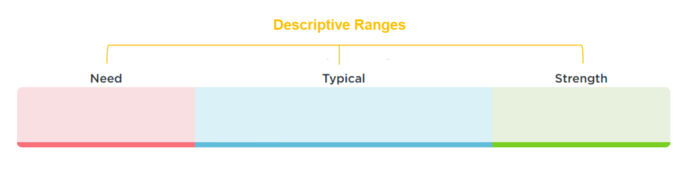
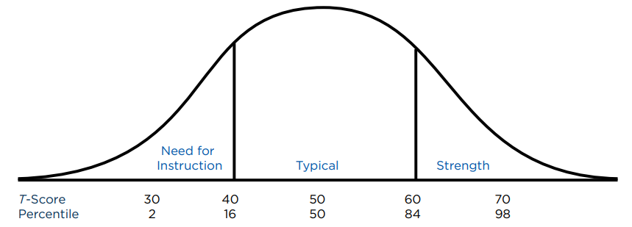
DESSA Results
T-Scores:
28-40
T-Scores:
41-59
T-Scores:
60-72
Notes:
Talking Points:
Our final slide for this overview part of the training is to review the DESSA results.
As you may remember from the first training, the DESSA assessments report results using T-scores. T-scores are categorized into three descriptive ranges, and as strength-based measures, higher T-scores mean a higher level of social and emotional competence.
The t-scores range from 28-72, with a mean of 50 and standard deviation of 10. The mean tells you the average or center of your data, while the standard deviation tells you the typical spread or variability of data points around that mean.
Scores of 60 and above are considered a strength; scores between 41-59 inclusive are considered typical (demonstrating typical patterns of development); and scores of 40 and below indicate a need for instruction.
The term need for instruction was thoughtfully chosen to convey that the student needs support and instruction in this area. That is, it reflects a lack of skill acquisition.
An important practice for reviewing this data and planning for tiered decision-making is to consider both the T-score and Descriptive range results for students. Based on a normal distribution of scores, we can anticipate that the majority of students should be in the Typical range (68%), with about equal amounts of students in both the Strength and Need Instruction (16% for each).

Slide 8
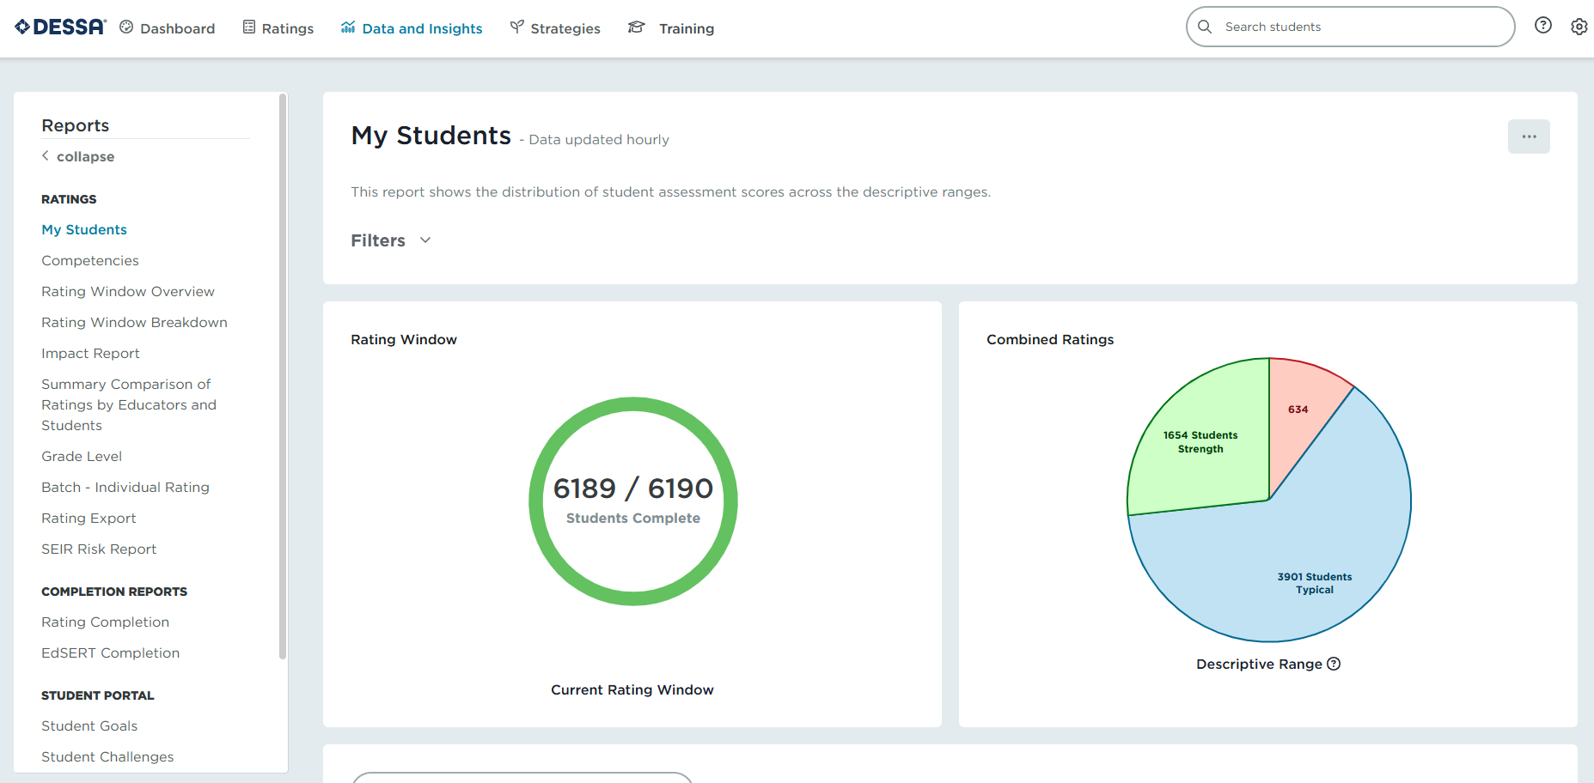
Accessing DESSA Data
To get started, login to your DESSA System Educator Portal
Notes:
Talking Points:
We are going to dive into how to access DESSA data.
To get started, please login to your DESSA System Educator Portal. During this training, you’ll follow along in your Educator Portal and then you’ll have time to view the results for the specific reports that we review together.
(Provide a moment for attendees to login)

Slide 9
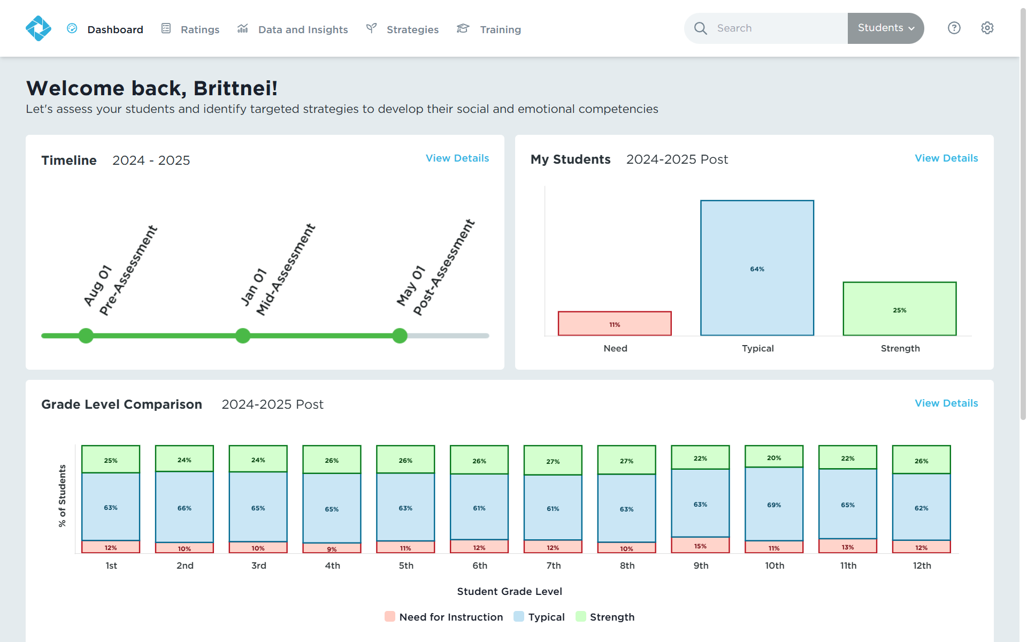
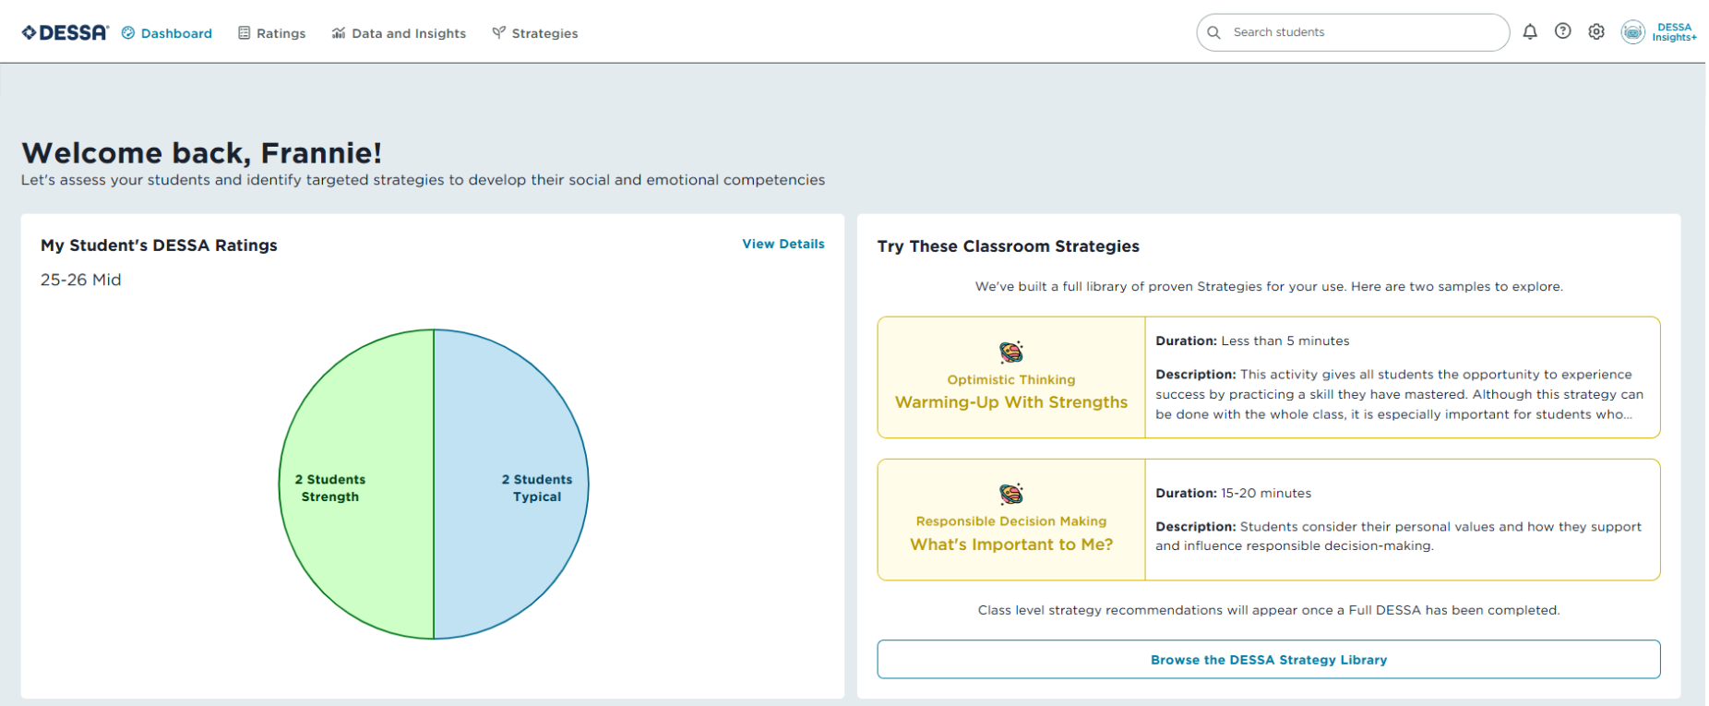
Accessing DESSA Data: Dashboard
Educator Dashboard
Site Leader Dashboard
Notes:
Talking Points:
There are a few starting points for accessing collected data in the DESSA System.
We’ll start by looking at what data is available on the Dashboard when you first login to the Educator Portal.
The data on the dashboard is reflective of the current or most recent rating window and as more readings are completed, the results will be reflected in the bar graph here.
The available data will depend on the user role:
Site Leaders, which are typically administrators, specialists, and other school-based leaders, will have access to data across a site/school. These user roles can see a timeline of the designated rating windows on the left, the distribution of descriptive range results in the bar graph visual on the right, and a grade level comparison of the descriptive range results below.
Educators (Raters): are the staff that complete ratings for their assigned roster of students. On the dashboard, the results for completed ratings are viewable in the pie chart on the left. On the right, there is a preview of classroom strategies resources. If the rater completed any full assessments, the competency t-score results will be available in a table below.

Slide 10
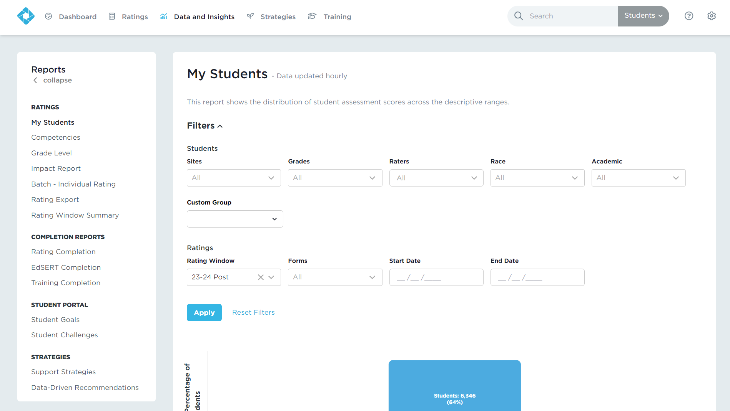
Accessing DESSA Data: Data and Insights
Real-time results
Interactive, filterable charts
Data availability and report options vary based on user type
Notes:
Talking Points:
The main way to access DESSA data is by selecting the Data and Insights tabs, which includes real-time results, interactive charts, and downloadable reports.
Again, data and types of reports available depend on your user access within the system. School leaders, will have more options under this “Results” list than Educators do, which includes both DESSA data reports and implementation reports.
We will go through some main reports together in a just a moment.

Slide 11
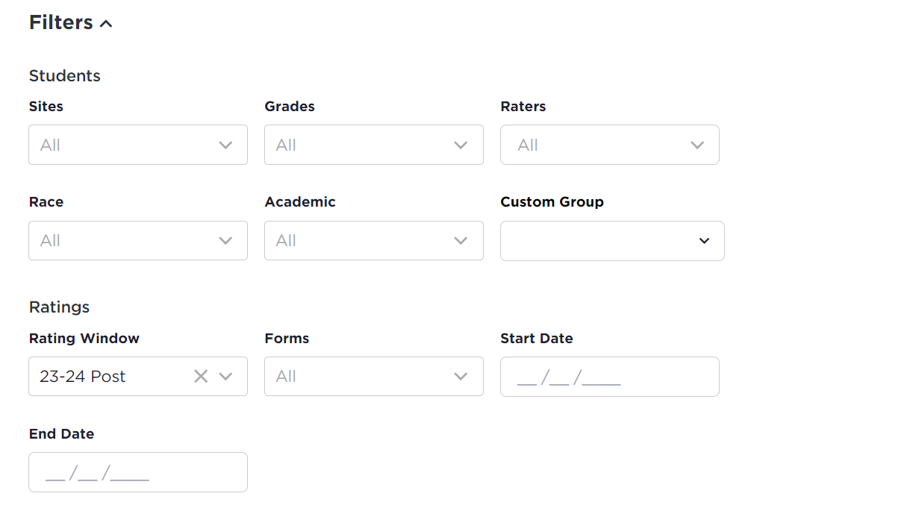
Report Filters
Student Population
Tiered Levels | Demographic Information
Notes:
Talking Points:
On most of the reports, there is a “Filters” option at the top. This feature is collapsed, so use the carrot feature to expand this section.
These filters allow for users to view specific data based on specific rating windows and DESSA assessment type, and by the student population, including by different groups and demographic information.
All users with Program Administrators and Site Leader access to the Educator Portal will be able to filter by grade level and rater, and by the specific site if they have access to more than one school or program.
For the demographic filters under the race and academic drop-down options, this information is available if it has been included during the systems integration process – meaning, you may or may not see options under these filters. Any questions related to these subgroups should be directed to your administration.

Slide 12
Review Results by Report
Directions:
Follow along with the review of the specific report(s)
Then take a few minutes to run the same report in your Educator Portal to view the results
Notes:
Talking Points:
We are going to move into our main section of the training where we review results by report.
How this will work: you will follow along with the slides to review specific reports – we will look at some main reports used, how to generate the report, and how to interrupt the available results.
Then you will have a few minutes to run the same report in your Educator Portal to view the results for your program.
We will repeat this process a few times and then move on to our final section of the training.

Slide 13
Data Reflection
Before reviewing your collected data in more detail throughout this session, take a moment to consider to these reflection prompts about the DESSA results:
I predict…
I wonder…
My questions/expectations are influenced by…
I am hoping to learn…
Notes:
Talking Points:
As we begin to dive in the results, it’s important to reflection on our own potential assumptions and curiosities. Before reviewing your collected data in more details throughout this session, take a moment to consider these reflection prompts about the DESSA results:
I predict…
I wonder…
My questions or expectation are influenced by…
I am hoping to learn…
These types of prompts center us to focusing on the data itself and understanding how it can inform our practices as educators and administrators.

Slide 14

Data and Insights: Frequently Used Reports
Tier 3
My Students
Individual Student Profile
Individual Item Analysis
Tier 2
Competencies
Full DESSA
Custom Groups Filter
Grade Level
My Students
Rating Window Breakdown
Tier 1
Notes:
Talking Points:
Here are frequently used reports that users access. We’ve listed them within the MTSS structured looking at the reports (and the data) from a tiered lens.
At the Tier 1 Universal level, we are looking at the results for collective groups of students, such as school-wide and classroom-wide.
At the Tier 2 level, we are looking at the results for a targeted or specific group of students.
And at the Tier 3, we are looking at the results for individual students.
We’ll look at each of these reports and features in more detail.

Slide 15
Analyzing Tier 1 Data
What are the baseline results?
Are there any groups/reports that differ significantly?
Consider:
How this data can be used to enhance existing programming and instruction?
Notes:
Talking Points:
We are going to look at the Tier 1 reports first.
When analyzing Tier 1 or Universal data for a collective group of students, the goal is to determine:
What are the baseline results?
Are there any groups or reports that differ significantly?
And How can this data be used to enhance existing programming and instruction?

Slide 16
Report:
Rating Window Breakdown
(Site Leader) or
Rating Window Overview
(Rater/Educator)
Tier 1
Notes:
Talking Points:
With that in mind, the first report we are going to generate together is the post-rating window results.
Site Leaders have both of these reports in their Educator Portal; for this training, you would want to look at the Rating Window Breakdown report if you have it available.
Educators will be generating the Rating Window Overview report.

Slide 17
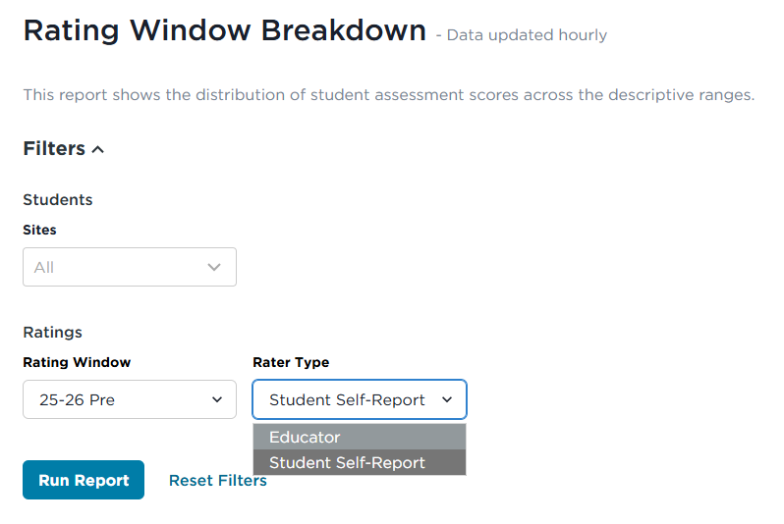
Report: Rating Window Breakdown
Tier 1
Action:
Select the Rating Window Breakdown Report.
Select your desired filters.
Select the Rater Type: Educator (DESSA mini/DESSA)
Run the Report.
1
2
3
Notes:
Talking Points:
Under the Data and Insights tab, locate the Rating Window report that you have access to.
Expand the filters using the carrot button and select any filters that you would like to use to generate these results, such as a specific school or grade level, or rating window.
Click “Run Report” to view the results.

Slide 18
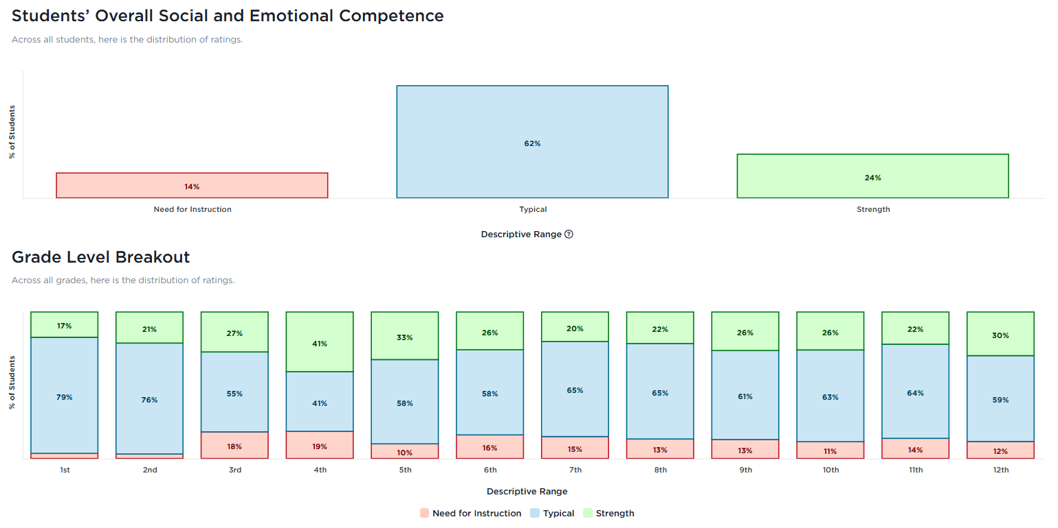
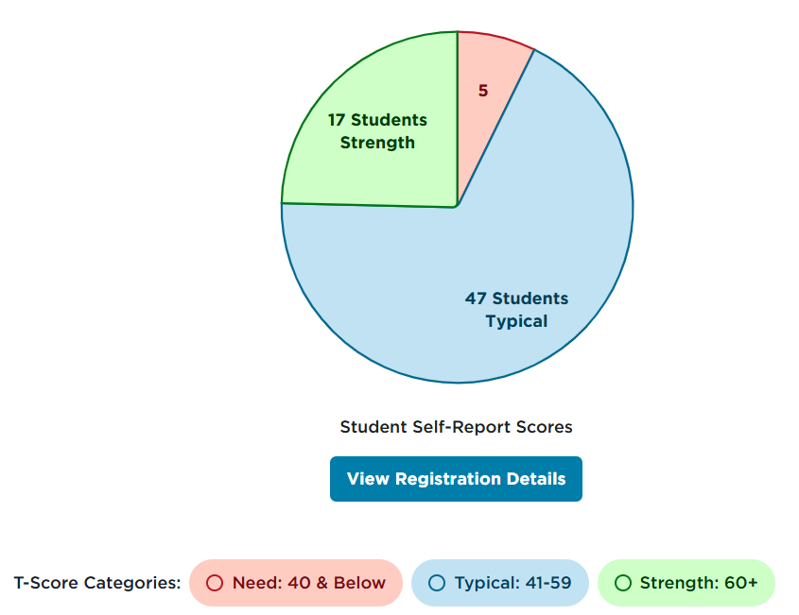
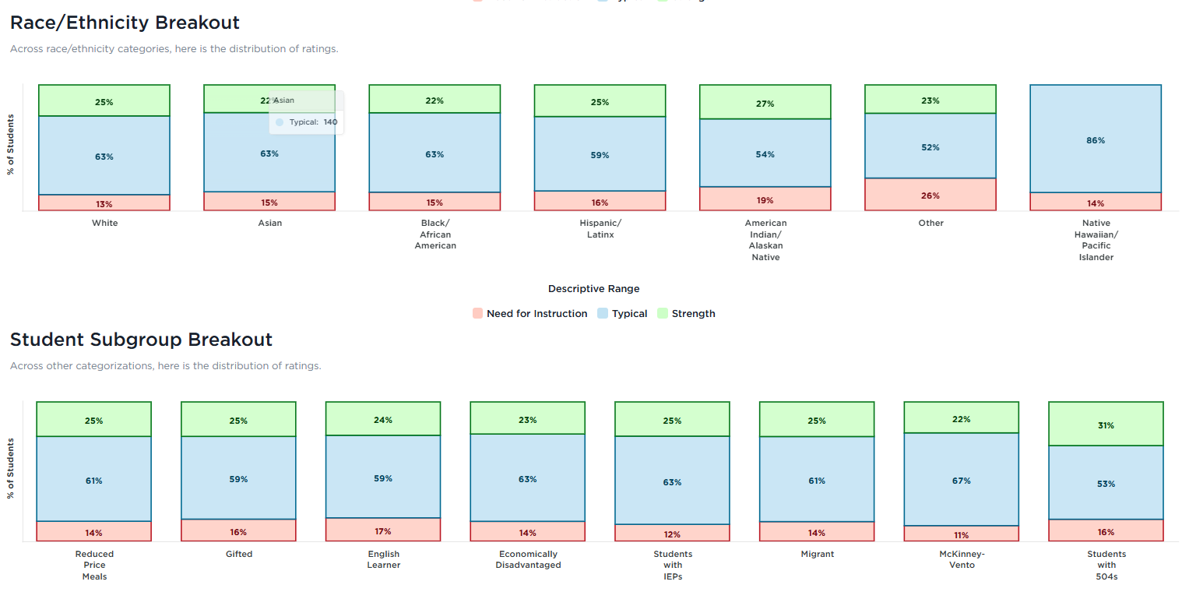
Report: Rating Window Breakdown/Overview
Tier 1
Site Leader View
Educator View
Notes:
Talking Points:
The report will show the overall results for the rating window. You’ll want to review the different visual available, such as the distributions of the descriptive ranges in the pie chart or the comparison of results by grade level.
The quick views of what the report will look like are on this slide for reference.

Slide 19

Results Review: Rating Window Breakdown/Overview
Tier 1
Actions:
Review the available visuals. Review the number of students in each descriptive range.
Use the filters to analyze the results by student population to determine any differences in results across subgroups.
Consider:
How do the results compare the expected norms of: Typical (68%), Strength (16%), and Need for Instruction (16%)?
What might influence these distributions?
Do disaggregated results suggest a need for reflection, discussion, or additional student support?
Direction: Take a few minutes to review the results under the Rating Window Breakdown report in your Educator Portal.
Notes:
Talking Points:
Okay so this is the first time we are going to pause and you will have time to generate this report to view the results in your Educator Portal.
The directions are on the slide for reference and we have a timer to keep us on track.
The actions are to:
Review available visuals once you generate the report and review the number of students in each of the descriptive ranges.
Use the available filters to analzye the results by student population to determine any difference in results across subgroups.
Consider:
How do the results compare the expected norms of: Typical (68%), Strength (16%), and Need for Instruction (16%)?
What might influence these distributions?
Do disaggregated results suggest a need for reflection, discussion, or additional student support?
I’ll start the timer now and we will move on to the next report after that.

Slide 20
Reports:
My Students & Grade Level
Tier 1
Notes:
Talking Points:
The next two reports we will look at from the Tier 1 lens is the My Students report and the Grade Level report.

Slide 21
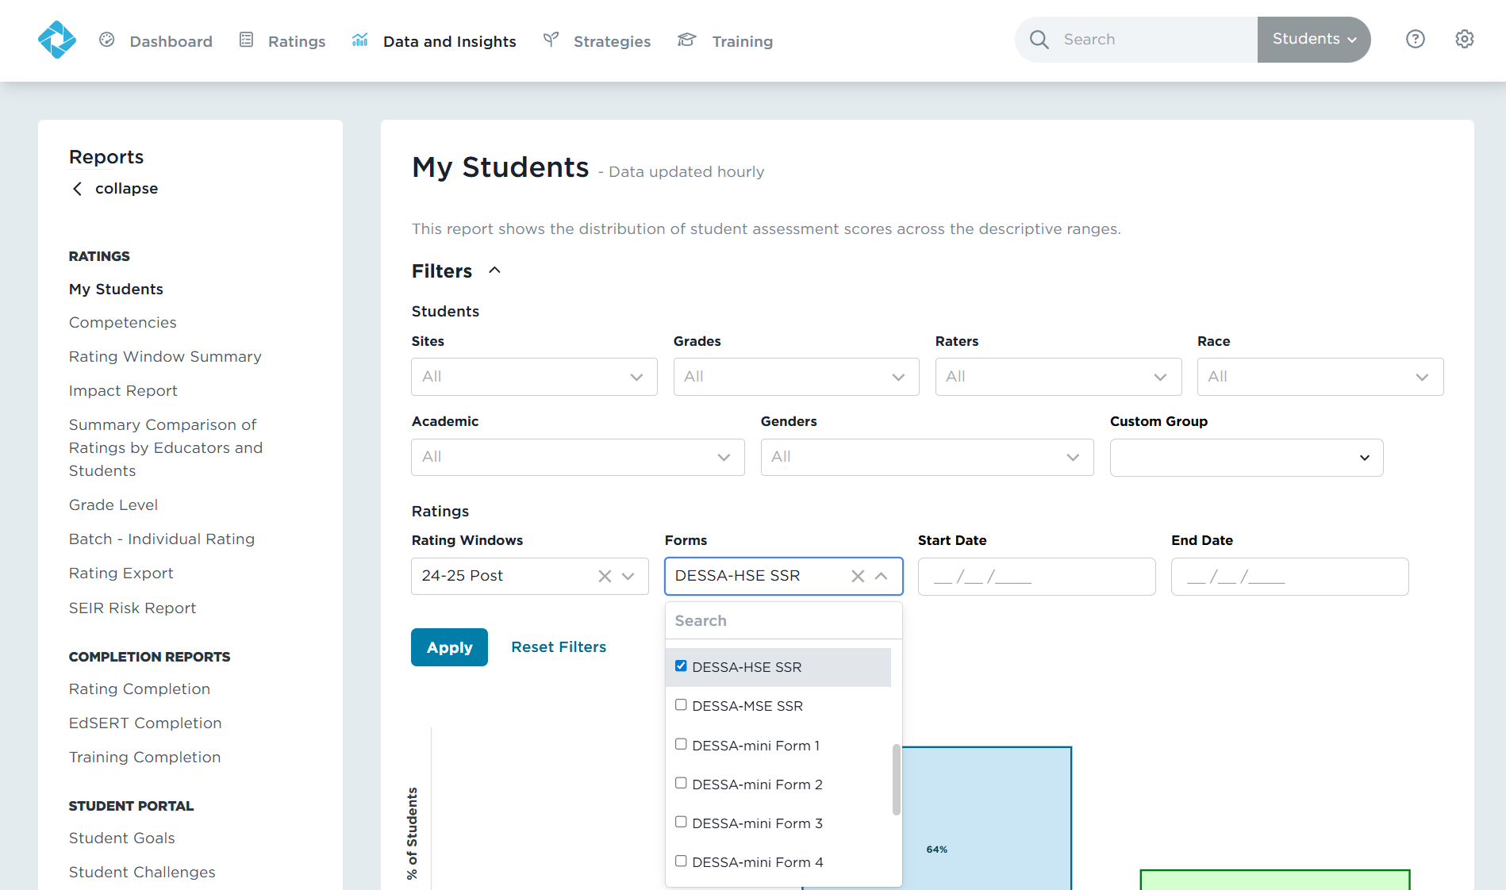
Report: My Students
Tier 1
1
2
3
Action:
Select the
My Students report
Filter for a specific DESSA form
(Optional) Apply any other desired filters
4
5
Notes:
Talking Points:
The My Students report shows the distribution of student assessment scores across the descriptive ranges.
You can use the filters to generate reports for specific sites, classrooms (raters), grades, subgroups, rating forms, etc.
If you don’t select any filters, the report will show all of the results for the most recent rating window.
The list of students is below the pie chart section and each student’s name is hyper linked to their own individual student profile.
You can select the different colored sections of the pie chart to filter for the students within each descriptive range. So if you click on the red section, it will generate the list of students that scored in the Need for Instruction range.

Slide 22
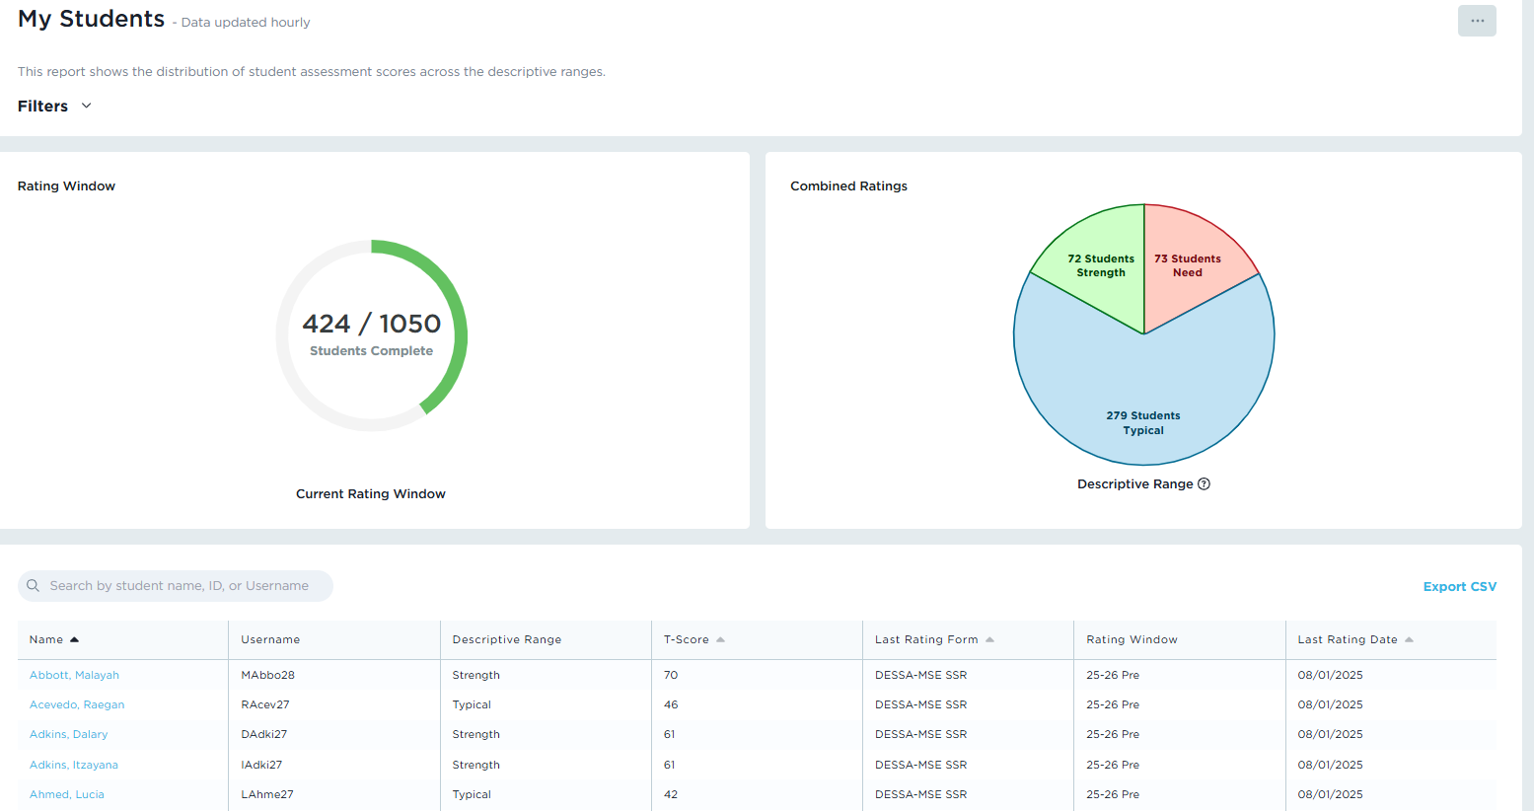
Report: My Students
Tier 1
Action:
Review the distribution of students in the descriptive range bar graph.
Click on the descriptive range sections to generate the list of students within that range (below).
Notes:
Talking Points:
The action here is to review the distribution of students in each range and compare that to the expected norms, as well as consider what might influence those distributions.
For example, from this screenshot, we can see that 64% of the school population are in the “Typical” range, with bookends of students in the “Strength” range (24%) and “Need for Instruction” range (12%). ​
​How do the results across the grade levels compare the expected norms of: Typical (68%), Strength (16%), and Need for Instruction (16%)?
They are pretty similar, in that the majority of students scoring in the Typical range, but with more students in Strength range than in the Need range.
What might influence these distributions? At a high level, this might indicate that the Tier 1 universal supports that are in place are working and that the instruction should continue.
​

Slide 23
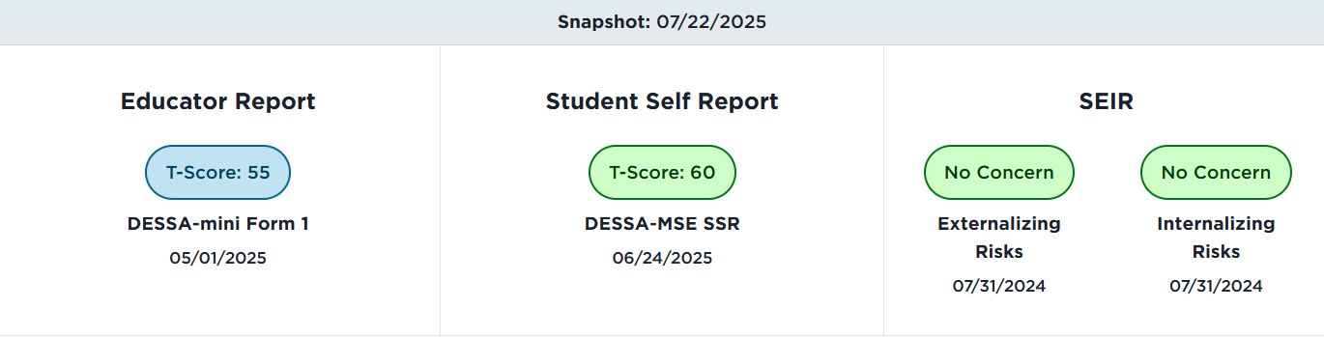
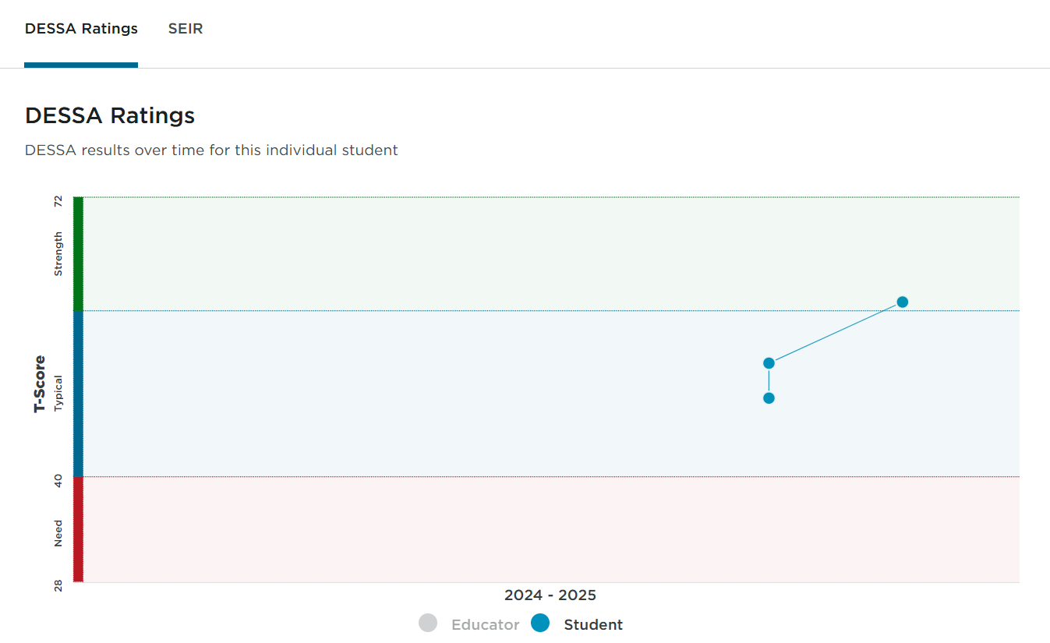
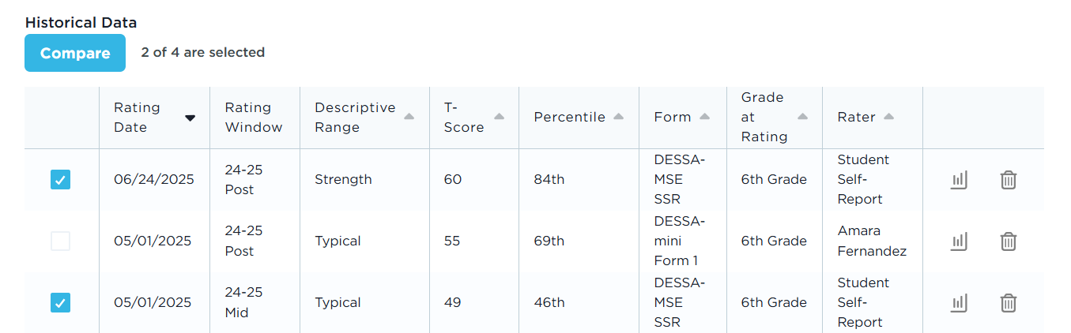
Report: My Students - Individual Student Profile
Individual Student Profile
Historical ratings available to assigned educators
Multiple raters of the same student produce separate data points
Action: View individual assessment details
Notes:
Talking Points:
On this report, the list of students is below your pie chart. Let’s take a quick look here to see what the profile looks like – we will dive in deeper to the individual student results in a little bit.
When you click on an individual student’s name, you will land on the student’s individual student profile.
On this profile, assigned educators can view the historical ratings completed and the results. Data follows the student through their time in the school and/or district, so as long as an educator is assigned to the student.
In this example, the student’s line graph demonstrates their progress between each rating, and we can view those details further by clicking on the specific assessments.
To view the details from an assessment on the list, click on the report icon all the way over to the right side of that row, as circled here on the demo screenshot.

Slide 24
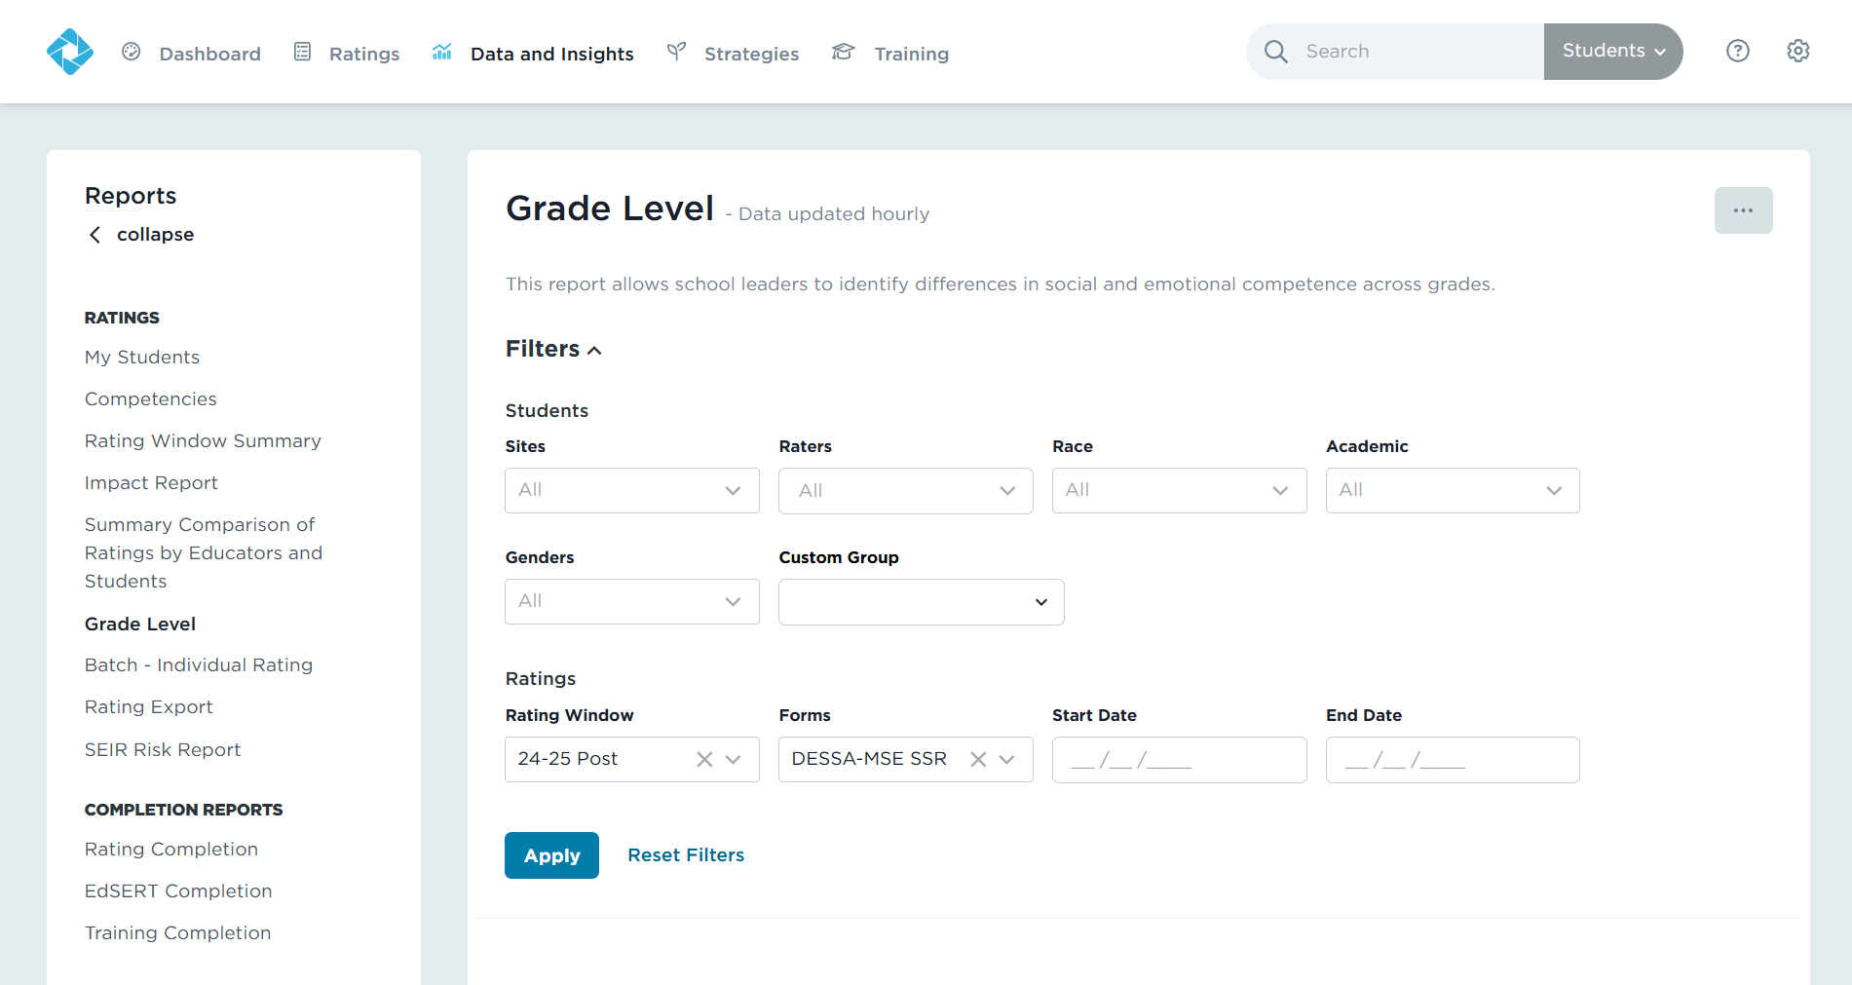
Report: Grade Level
Tier 1
1
Action:
Use the Forms filter to filter for a either the DESSA mini (screener), DESSA 2 (full), or the Student Self-Report (MSE-SSR or HSE-SSR)
3
2
4
5
Notes:
Talking Points:
The other report we will look at together from a Tier 1 lens is the “Grade Level” report.
This report shows the distribution of scores across grade levels.
As usual, select the desired filters, if needed, and generate the report.

Slide 25
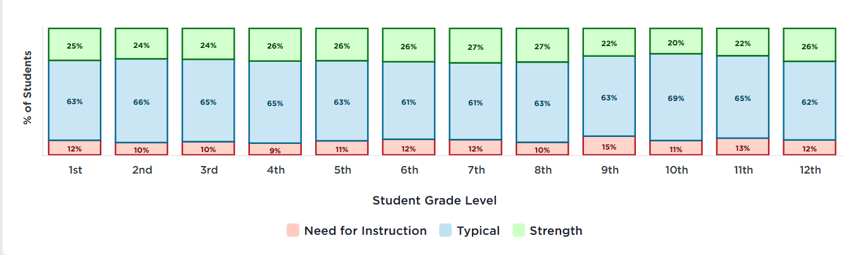
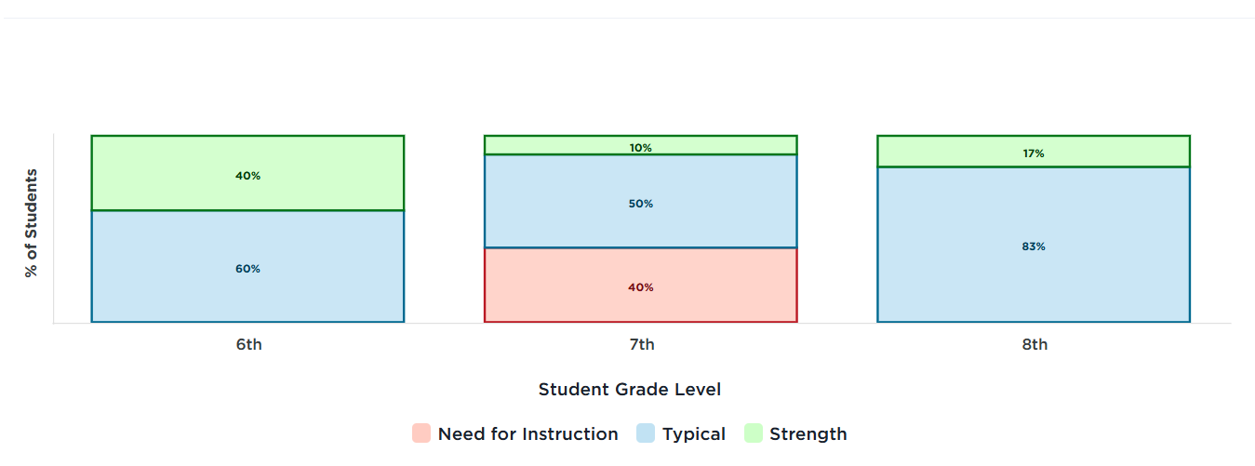
Report: Grade Level
Tier 1
District/Multi-Site View
Single Site View
Notes:
Talking Points:
If you have access to results for multiple grade levels, you can use this report to compare how students are demonstrate skills in different grades.
If you have access to just your class, you’ll only have the grade level for those students. We recommend that administrators and other school leaders share this information with staff and have discussions about what might influence the differences or how to adjust instruction/programming to support students across the campus.

Slide 26
Results Review: My Students and Grade Level Reports
Actions:
Review the results under the My Students and Grade Level reports.
Use the filters to analyze the results by student population to determine any differences in results across subgroups.
Consider:
Are there any groups or grade levels that differ significantly, either in positive or negative ways?
How do the results across the grade levels compare the expected norms of: Typical (68%), Strength (16%), and Need for Instruction (16%)?
What might influence these distributions?
Direction: Take a few minutes to review the results under the My Students and Grade Level reports in your Educator Portal.
Notes:
Talking Points:
It’s time to stop again for you to view the results under the My Students and Grade Level reports.
We will follow the same process – the directions are on the screen and the timer will keep us moving forward.
The actions here are to view the results under these reports, using the filters to analyze results across subgroups to see if there are any differences in results.
During this review, you’re considering:
Are there any groups or grade levels that differ significantly, either in positive or negative ways?
How do the results across the grade levels compare the expected norms of: Typical (68%), Strength (16%), and Need for Instruction (16%)?
What might influence these distributions?

Slide 27
Reports:
Competencies
Tier 2
Notes:
Talking Points:
We are moving into the Tier 2 mindset, looking at the DESSA results for targeted or specific groups of students. Typically, these are students that demonstrate a need for additional support to develop skills.

Slide 28
Analyzing Tier 2 Data
Tier 2
Based on the data, which students would benefit from Tier 2 support?
Which competency areas can be targeted during small group instruction?
Consider:
What additional info will educators need to make decisions about support?
Notes:
Talking Points:
When analyzing Tier 2 data, the goal is to determine:
Based on the data, which students would benefit from Tier 2 support? This support may look like additional, repeated, and/or differentiated instruction, typically in a small group setting where the intervention targets specific skills – based on the DESSA data.
Also, which competency areas can be targeted during small group instruction? The individual competency area results are available using the full DESSA assessment. If you school has not yet completed full assessments yet, further discussions about how to target specific skills would include additional data and information. The screening tool, the DESSA mini, does not provide individual competency area results. That said, the screening tool can be used to form groups of students by using students’ T-scores.
Finally, consider what additional information will educators need to make decisions about support? The DESSA should be included in the existing systems and practices for reviewing student’s progress and needs – it is one of the data points of many used to make decisions. Teams should consider things like attendance data, behavior incidences, out of school contexts, whether the student qualifies for additional/special ed services, etc.

Slide 29
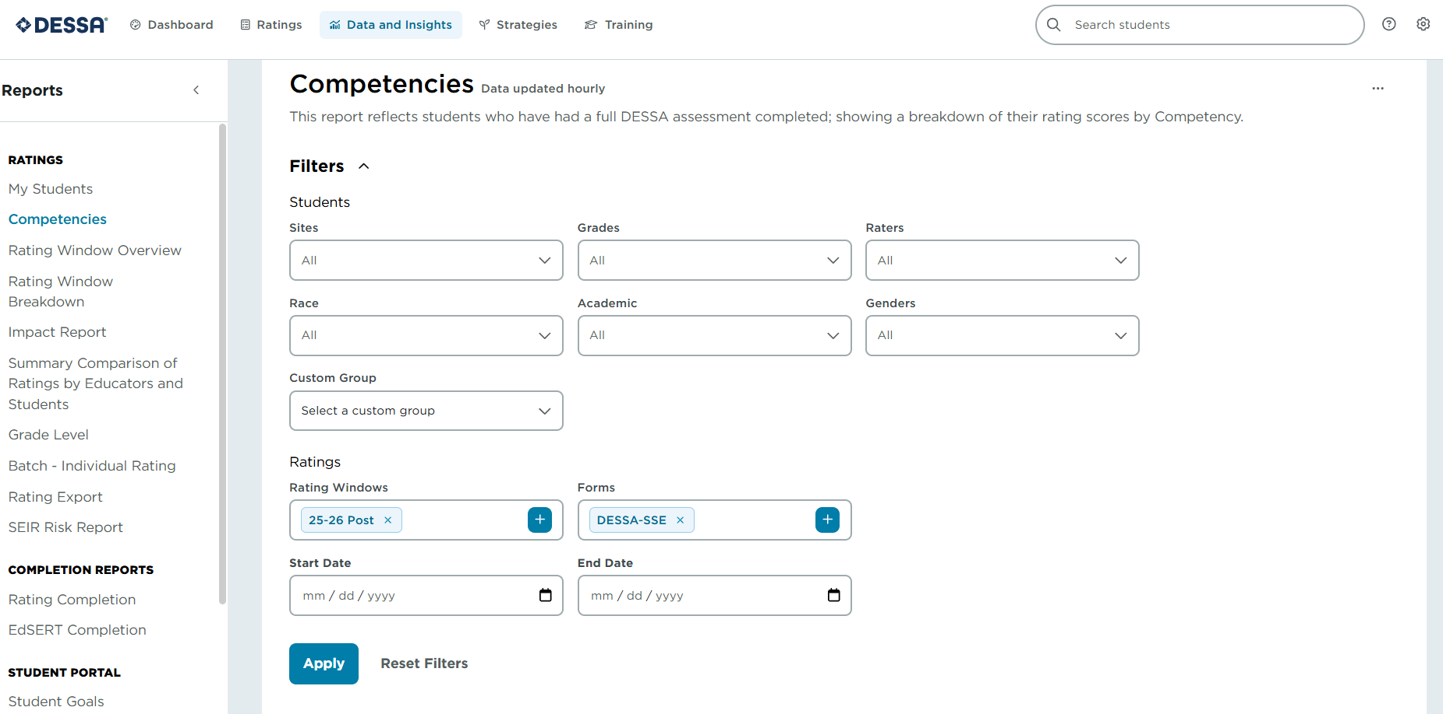
Report: Competencies Report
Tier 2
1
3
Action:
Select the
Competencies report.
Apply any desired filters.
2
4
5
Notes:
Talking Points:
For the Tier 2 lens, we will look at the Competencies Report. This report shows the results for the individual competency areas measured by the DESSA. In other words, you will get to view the specific results by skill area- Self-Awareness, Self-Management, Optimisitic Thinking, etc.
This report is only available when a full DESSA is completed. (The screening data gives us the overview score and the full DESSA gives us the full details)
This is a useful report in evaluating which universal strategies would be most impactful to implement at the Tier 1 level and which skills to target within the Tier 2 small group setting.
The Competencies report also includes the filter options we’ve seen before; remember to expand those options to filter for the data your’d like to view.

Slide 30
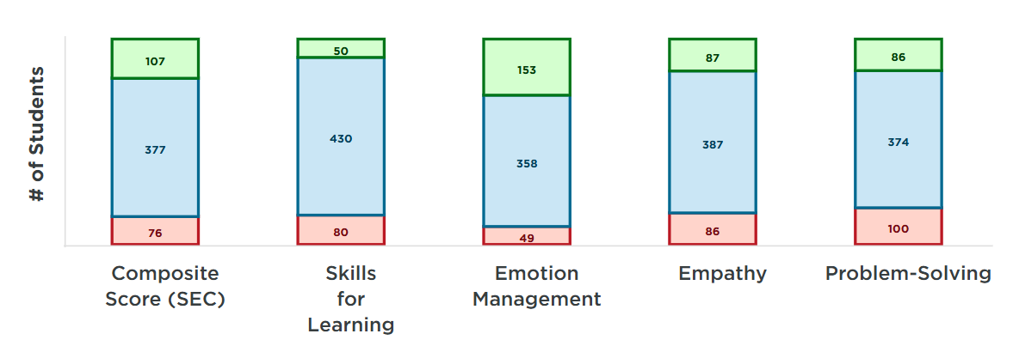
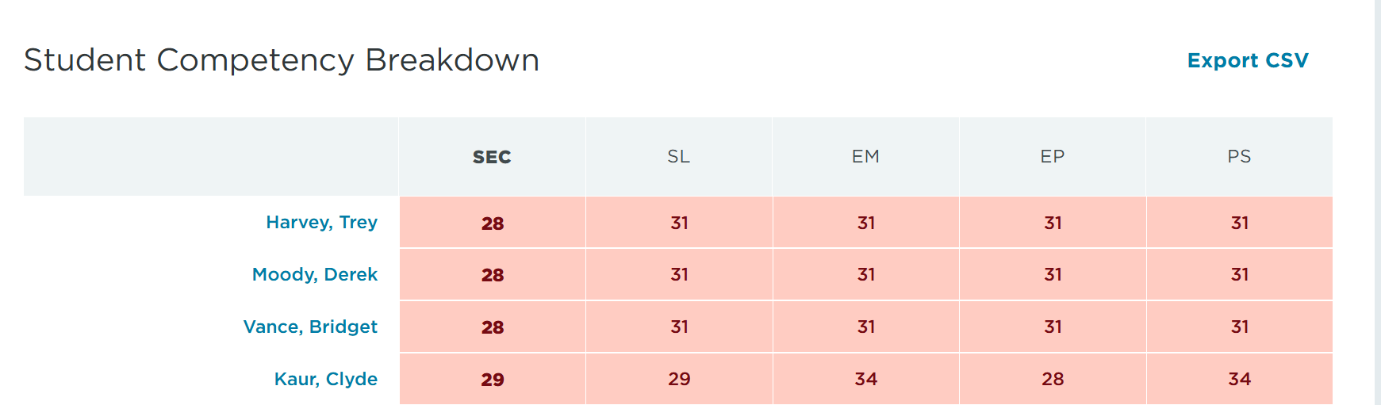
Report: Competencies
Tier 2
Action:
Review the
results for completed DESSA assessments based on the filters set
Action:
Consider students’ overlapping areas of strength and need
Notes:
Talking Points:
Once you’ve clicked apply for the filters set for the Competencies report, the first action in analyzing the data is to intentionally review results.
In this descriptive bar graph image, we see the collective results for the students with a full DESSA completed.
We can see the overlapping areas of strength and need, and this can drive tiered intervention to target specific skill areas based on the group of students’ collective need
If you scroll down under the bar graph, the student roster is viewable with the competency area t-scores listed.
When planning for targeted, small-group support, the educator would want to consider which areas of the collective strength the students demonstrate as well.
This could be a time to consider creating a Custom group under the Filter feature to easily pull the results for this group and monitor their progress. Let’s take a closer look at this feature.

Slide 31
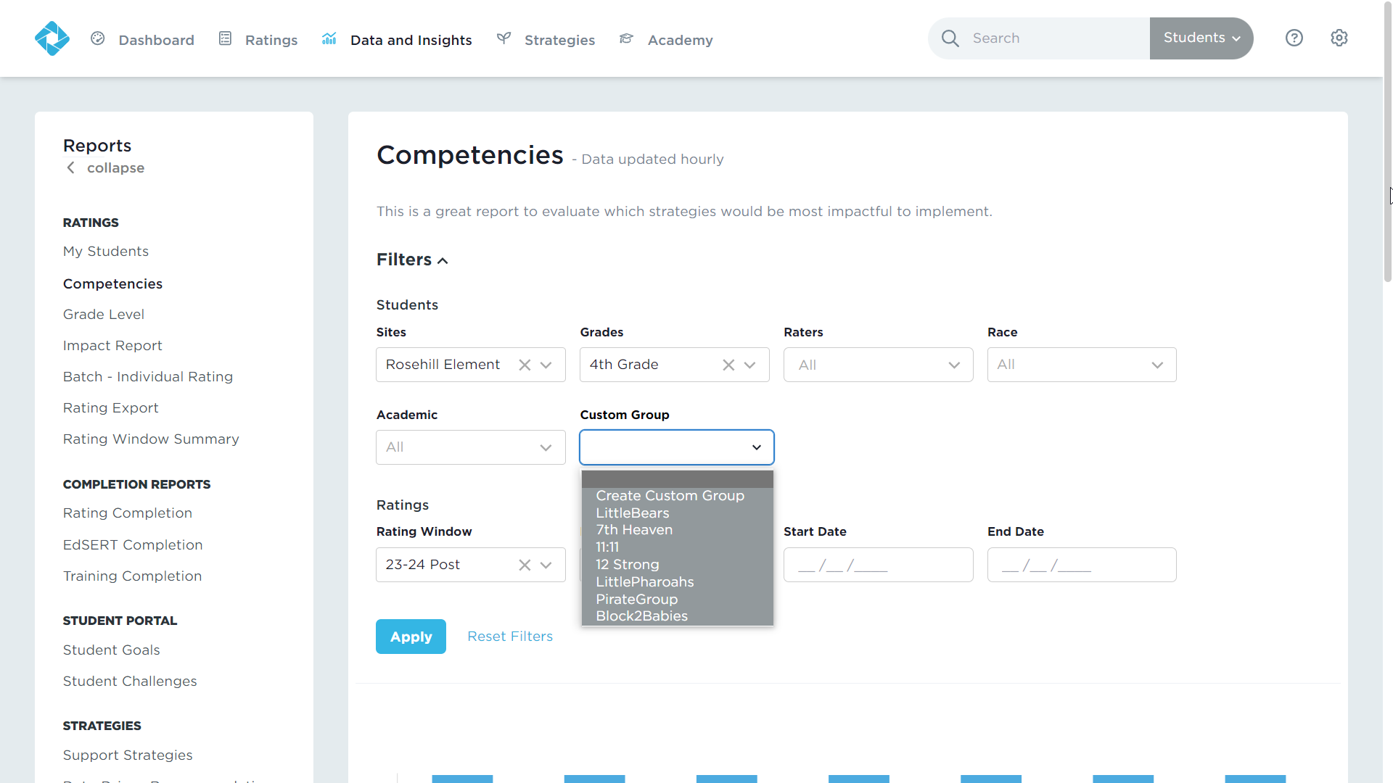
Filter Feature: Custom Groups
Tier 2
Action:
Click into the Custom Group Filter
Notes:
Talking Points:
The Custom Group filter is located under the “Filters” section on most reports. This will allow you to filter to a predefined set of students on all interactive reports to support targeted planning and monitoring of skill development.
You can add specific students to a group and name it as appropriate, and then always be able to pull the data for just that group of students by selecting that filter when generating a report.
For example, this feature is commonly used to view results for an intervention group of students.

Slide 32
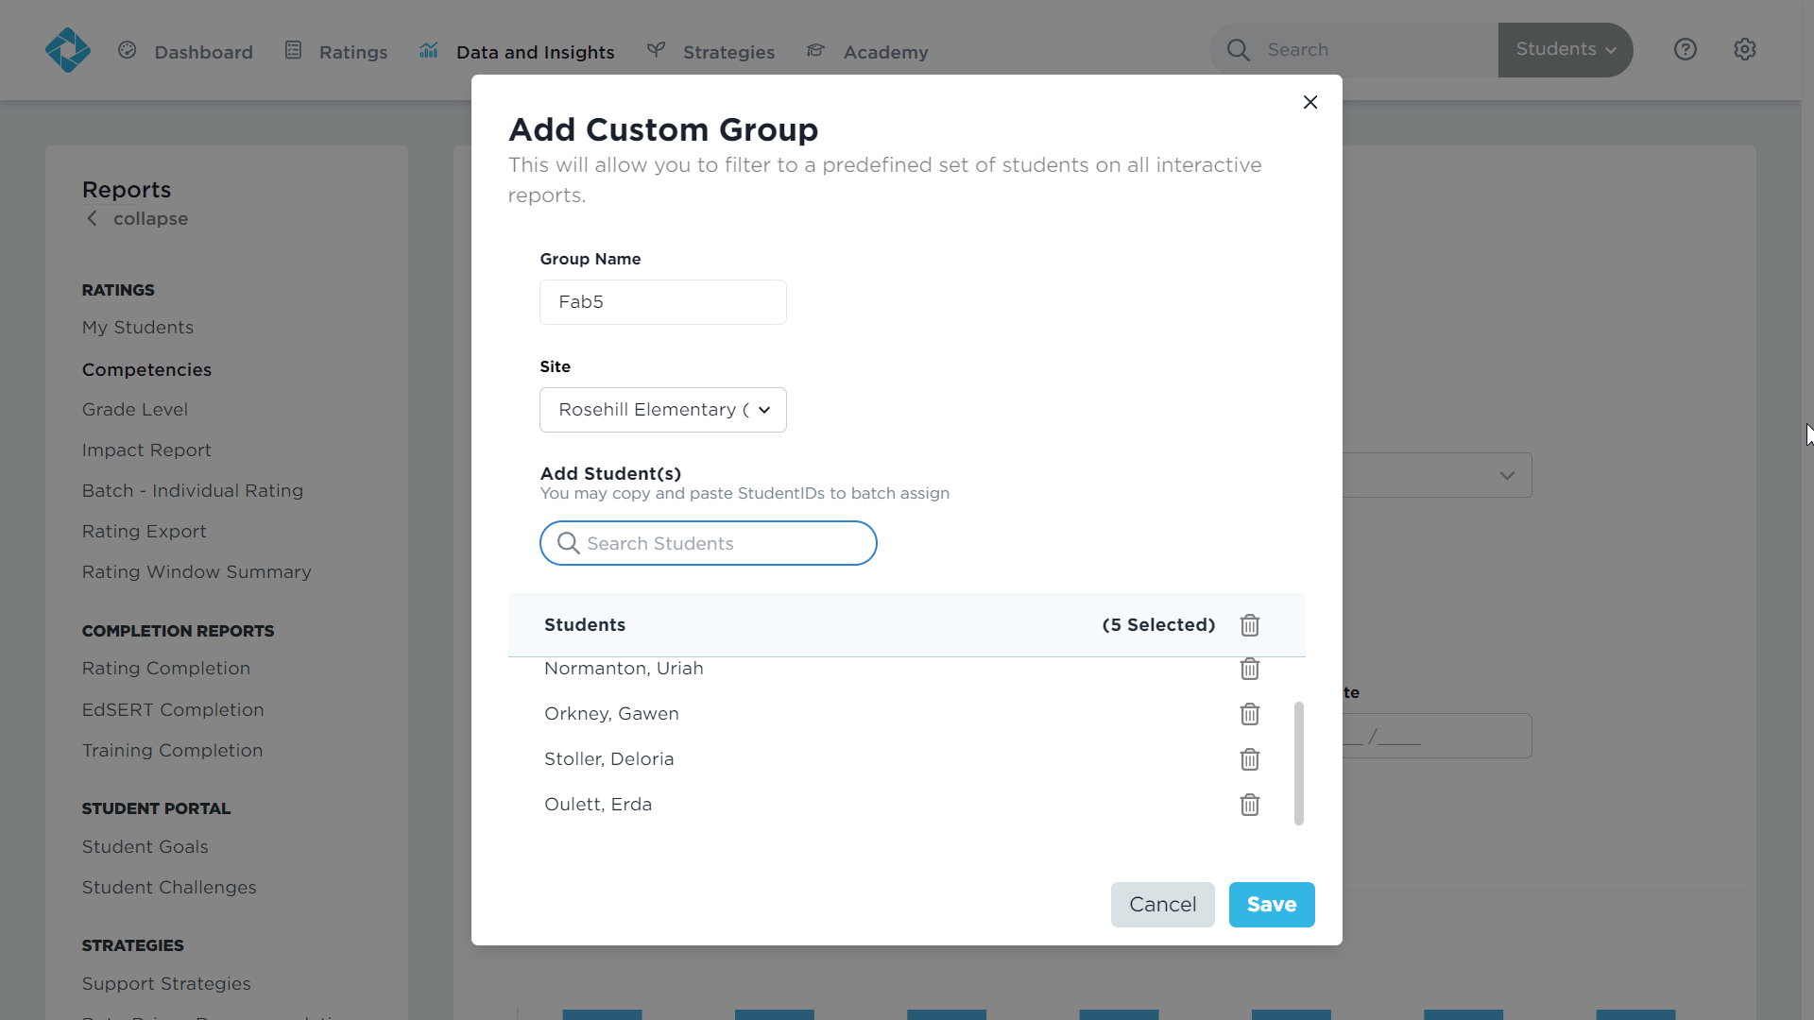
Filter Feature: Custom Groups
Tier 2
Action:
Name the group.
Action:
Add students by searching their names.
Notes:
Talking Points:
You can create these custom groups by following the prompts in the DESSA System. Simply create a new group, add a name for the group, then search and add students, click save.
You can adjust the group at any time but adding or removing students, as needed.
In just a moment, you’ll get a chance to look at this feature in your Educator Portal when we pause for our next independent review.

Slide 33
Results Review: Competencies and Custom Groups
Actions:
Review the results under the Competencies report and/or create/view Custom Groups.
Consider:
Which students would benefit from additional support or intervention?
What are the results for students who already receive additional supports/services?
What competencies could be targeted during intervention?
Direction: Take a few minutes to review the results under the Competencies report and Custom Group Filter in your Educator Portal.
Notes:
Talking Points:
It’s time for our next “pause” to review your own data. In the Educator Portal, if you have results available from the full DESSA, you’ll use this time to review the results under the Competencies report.
If you screening data only, you can use this time now to continue reviewing results and explore the custom group feature. This can be a good time to look closer at students t-scores and consider which students may benefit from further instruction based on their results, even without the individual competency area results.
As you explore the results for this section, consider:
Which students would benefit from additional support or intervention?
What are the results for students who already receive additional supports/services?
What competencies could be targeted during intervention?

Slide 34
Questions?
Up Next:
(Optional) Break
Notes:
Talking Points:
We have some time here for any questions that may have come up during the first part of our training.
(allow time for questions/answers)
We do have an optional break coming up before we look at individual student (Tier 3) data in the DESSA System.

Slide 35

Break – 5 minutes
Notes:
Talking Points:
We have the option for a break now if the collective group would like to pause. If you would like to take a break, please add a “yes” into the chat and if would prefer to keep going with our content, please add a “no” into the chat.
(Allow time for attendees to add response in the chat and proceed accordingly.)
If the group does not take a break, encourage attendees to take a break as they need to and they will have access to the recording of the training.

Slide 36
Reports:
Individual Student Profile
Tier 3
Notes:
Talking Points:
We have one report and practice section, focusing on the Tier 3 lens. We are going to be looking at individual results by viewing the Individual Student Profile within the DESSA System.

Slide 37
Analyzing Tier 3 Data
Tier 3
What additional data, information, and context is necessary to make decisions about supporting a student?
What are the individual competency results for a specific student?
Which competency area(s) can be targeted skills instruction?
Review:
Descriptive range
T-score
Start with Strengths:
Build on these skills
Integrate:
DESSA data into existing systems of student support
Notes:
Talking Points:
At a high level, the process for analyzing individual student results includes:
Analyzing the individual competency results for a specific student by looking at both the descriptive range category and noting where the t-score lies within that range.
Based on the results, identify which competency area(s) can be targeted for individualized instruction. Aligning with the strength-based approach to these measures, start by reviewing the areas of strength and consider how to support the student in building on those skills.
And ensuring that additional data, information, and context is included during the decision-making process about student support. An efficient way to do this is to integrate the DESSA data into existing systems of student support, such as the MTSS framework.

Slide 38
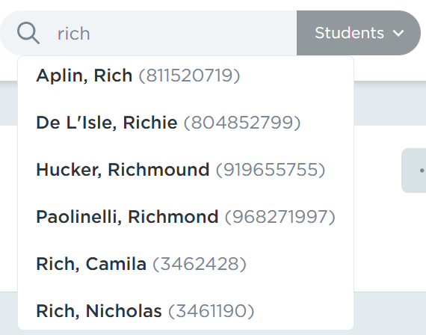

Locating an Individual Student
Tier 3
Use the search bar and enter the student’s First or Last name, or student ID number.
Notes:
Talking Points:
There are different ways to locate individual students within the Educator Portal, including by using the search bar or by reviewing other reports. You can search for students by their first or last name, or student ID number.
You can also click on a student’s hyperlinked name where it shows up on any of the reports to access their Individual Student Profile.

Slide 39
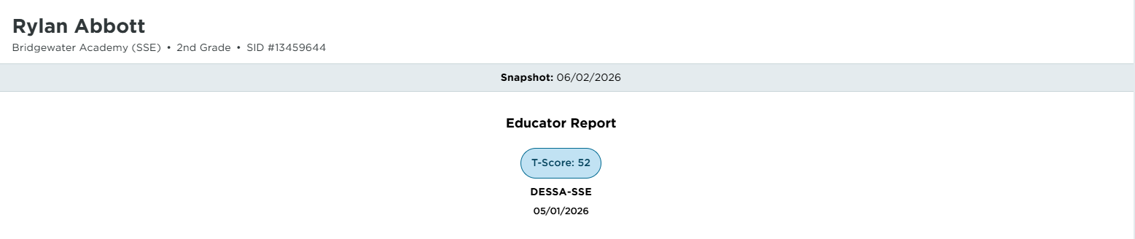
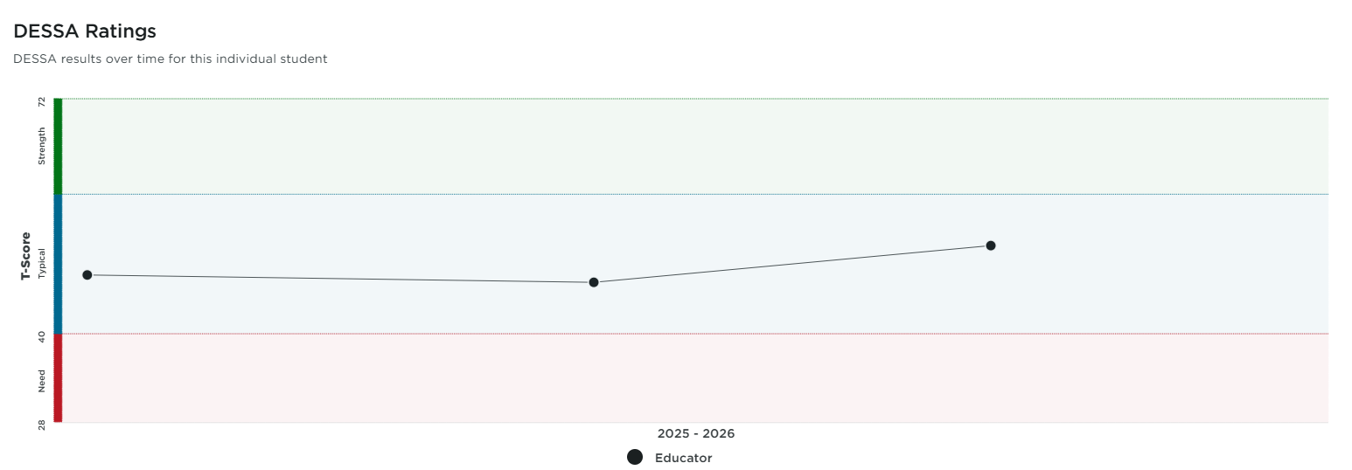
Individual
Student
Profile
Notes:
Talking Points:
An Individual Student Profile page include the details about all assessments completed for the student.
In this example, we can see the student’s information at the top of the page, which will always reflect the student’s current grade level. It will provide a snapshot of the name and results of the most recent assessments completed.
Below that, the DESSA Ratings chart will display the student’s DESSA results over time. In this example, the student has three data points, or three assessments completed, with all scores in the Typical range, indicating slight growth within that range over time.

Slide 40
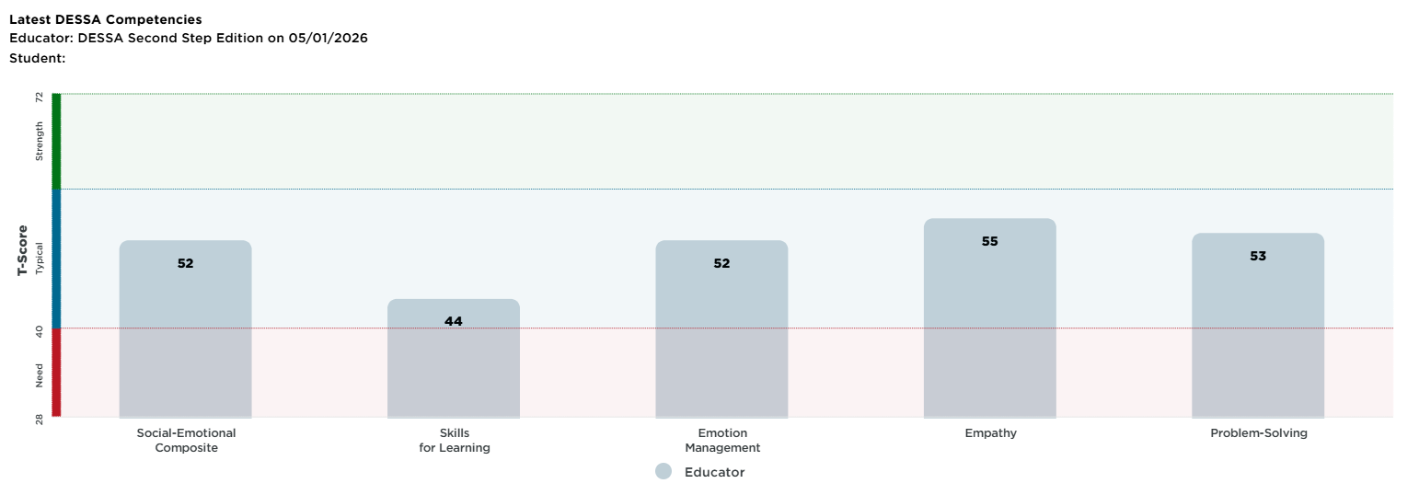
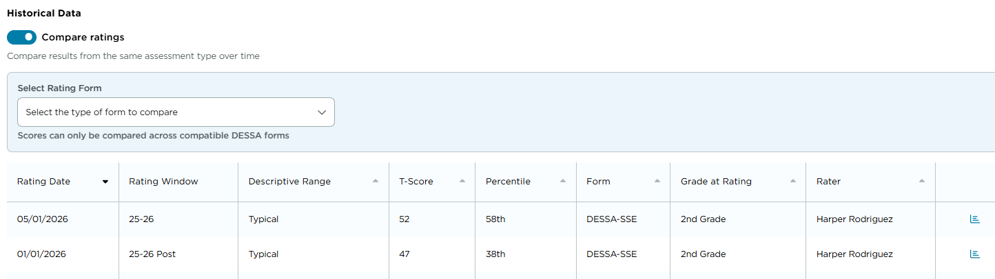
Individual
Student
Profile
Notes:
Talking Points:
Below that, the competency area results for the most recent full DESSA assessment are viewable (if available).
The list of Historical Data table underneath these charts provides the details for each assessment that has been completed for the student.
To view the results for a specific assessment, select the chart icon on the far right of the line for the selected assessment.

Slide 41
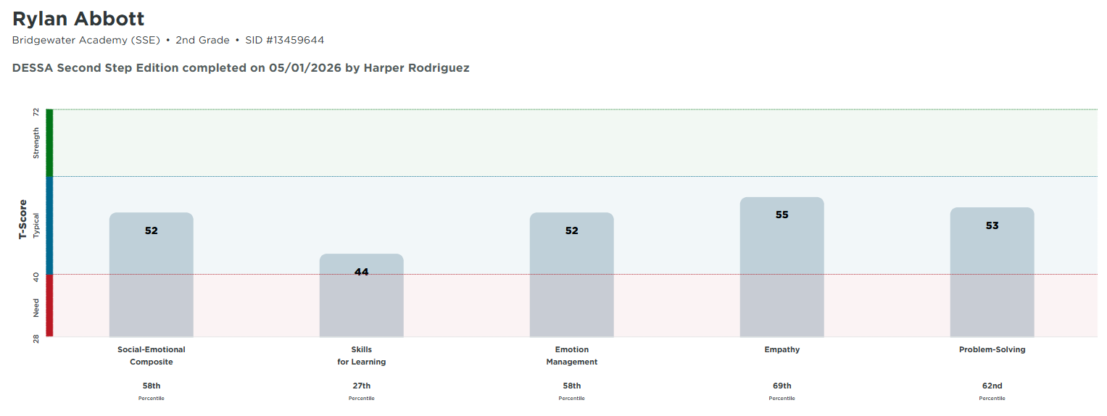
Individual
Student
Profile
Notes:
Talking Points:
If you click on a report icon, the results will be displayed on the bar graph with the t-scores for each competency area.
As a best practice aligned to the strength-based approach of the DESSA, it’s important to note both areas of strength and need for the student. In this example, the student’s highest t-score on the Second Step version of the assessment is in the Empathy competency and the student’s lowest t-score is in Skills for Learning.

Slide 42
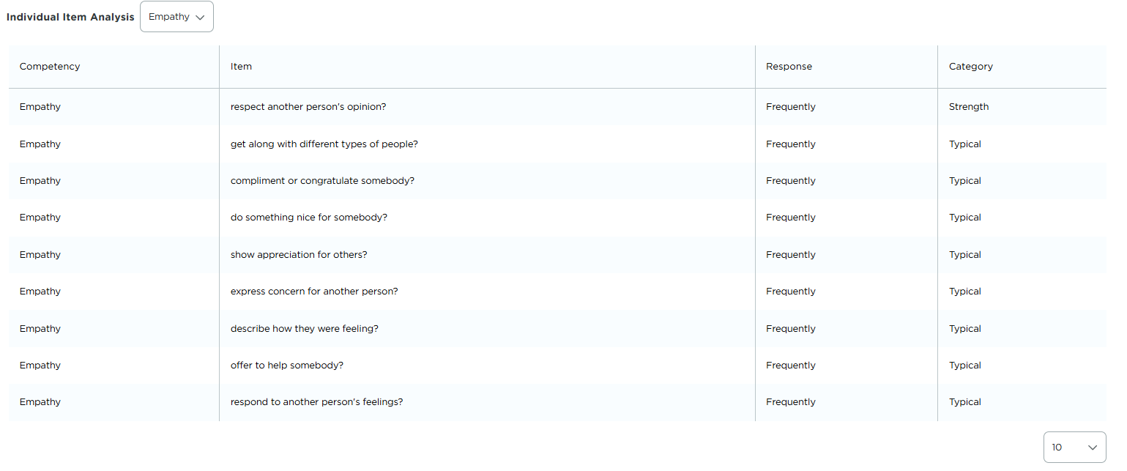
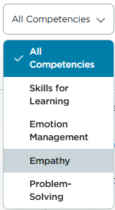
Individual
Item Analysis
Notes:
Talking Points:
The results of the selected assessment will populate with the competencies bar graph and the Individual Item Analysis.
The Individual Item Analysis allows for the educators to filter the items (questions/answers) by competency using the drop-down filter. The questions that were included on the assessment for measuring that competency area will appear, along with the frequency response selected by the rater and the corresponding descriptive range results.
From a strength-based lens, it’s important to review the skills listed under the competencies that student demonstrates strengths in. For this example, the student had a highest t-score in Empathy, so the educator viewing this report would then filter for the Empathy questions and consider how these skills can continue to be supported in the learning environment and how to use these skills to support growth in other areas.
Based on your role, how would YOU support this student in continuing to use these Empathy skills throughout the day?

Slide 43
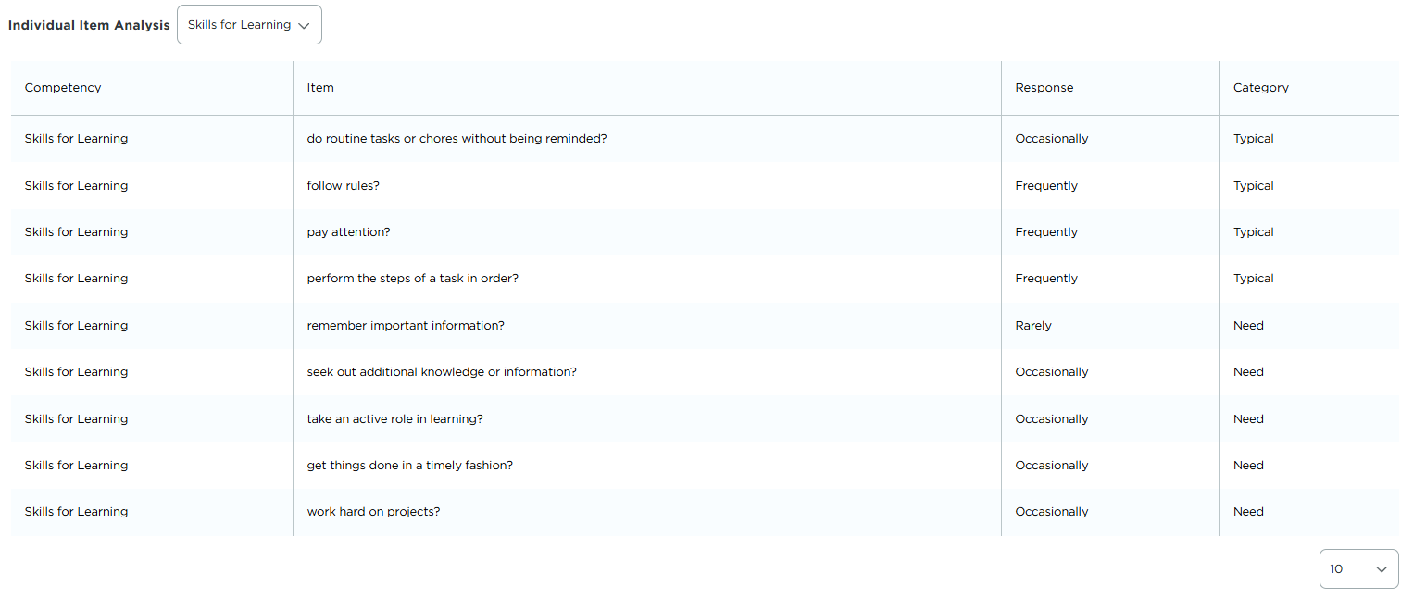
Individual
Item Analysis
Notes:
Talking Points:
Next, select a competency area in which the student demonstrated a lower score, indicating a need for additional support. For the example student we have been using in this section, the lowest competency area was in Skills for Learning.
Filtering for this competency on the dropdown feature, we can see the questions and responses that were answered by the rater, half of which scored within the Need category.
Educators can use this report feature to identify the specific skills that can be targeted for individualized and differentiated instruction, as well as determining how to adjust their approach to the learning environment to support the student. These skills can be taught and reinforced informally, through everyday activities and interventions, and they can also be used to create goals for Tier 3 interventions and supports being provided.

Slide 44
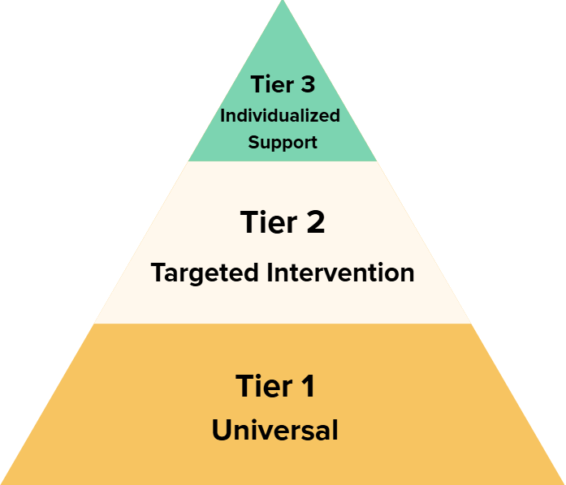
Reminders:
Tier 3 Supports are aligned and layered to Tier 1 and Tier 2 practices.
Decision-making for student support includes a variety of data and information:
DESSA results
Attendance patterns
Academic performance
Out-of-school context
If the student is receiving special education services and if so, what services they are receiving
Notes:
Talking Points:
It’s important to remember that the results of the DESSA should be included in addition to other data points, information, and context. The DESSA is added to the existing processes for identifying students who need additional supports and/or individualized interventions; it is not used as the sole data point in this process.
Additionally, Tier 3 supports should be aligned and layered onto universal Tier 1 as well as Tier 2 practices. Students who are identified to receive individualized instruction or intervention should also continue to participate in the universal and targeted supports provided to students in Tier 1 and 2.

Slide 45
Results Review: Individual Student Profile
Actions:
Review the available results for an individual student on their Individual Student Profile.
Consider:
Where does the student’s t-score(s) lie within the descriptive range?
Which area(s) does the student demonstrate a strength?
What individual skills can be targeted at different tiered levels?
What additional context/data is necessary to include for this student?
Direction: Take a few minutes to review the results for an individual student within your Educator Portal.
Notes:
Talking Points:
This will be out last “pause” for the data reports. It’s time now to review the available results for an individual student within your Educator Portal.
Locate a student and spend the next few minutes looking through their Individual Student Profile.
Consider:
Where does the student’s t-score(s) lie within the descriptive range?
Which area(s) does the student demonstrate a strength?
What individual skills can be targeted at different tiered levels?
What additional context/data is necessary to include for this student?

Slide 46
Data-Driven
Instruction & Intervention Resources
DESSA Insights+ (Educators/Raters)
Foundational Practices, Strategies, and Tier 2 Intervention Programs
Data-Driven Recommendations Report
Notes:
Talking Points:
We are moving to our last section of this training, which is reviewing the available Data-driven instruction and intervention resources within the Educator Portal.
We will review the DESSA Insights+ AI feature that is available to educator/rater level users, as well as the Strategies and Tier 2 Interventions, and the Data-Driven Recommendations report (available to all users).
All of these resources are available within the Educator Portal and they can be used to plan for and provide direct instruction of the skills that are measured by the DESSA.

Slide 47

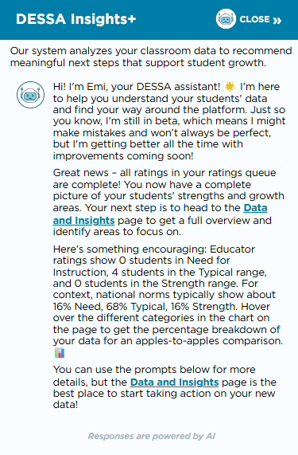
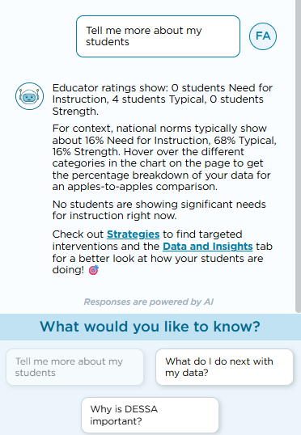
DESSA Insights+
AI-powered widget available on the Educator platform, top right corner
Simplifies data into brief, clear summaries
Provides next step suggestions
If you have Site Leader access, navigate to the Settings cog (upper right corner), select Staff from the left side list. Select an educator user to impersonate
Notes:
Talking Points:
DESSA Insights+ is an AI-powered widget that is available on the educator or rater dashboard. It’s purpose is to surface concise insights and provides intelligent navigation support within the platform based on the collected data.
Some Key Benefits of DESSA Insights+:
Reduces Data Overload: Simplifies data into brief, clear summaries teachers can quickly understand
Supports Informed Action: Adds a “so what” layer to data—guiding teachers on what steps to take next
Improves Navigation: Helps teachers move more efficiently to the most relevant parts of the platform to support student needs.

Slide 48


Strategies Tab: Foundational Practices
Select from the Foundational Practices Set
Begin with 1-2 practices to implement schoolwide
Set an implementation goal.
Share successes, challenges, and any needed supports.
Reflect and adjust as needed.
Select additional practices when ready and repeat these steps.
Notes:
Talking Points:
The instructional materials that we will review together are all located under the Strategies tab in the Educator Portla.
The first set of resources are the Foundational Practices, which are PDF materials that include best practices for creating supportive learning environments where students can learn about and practice social and emotional skills.
An environment with routines and predictability that recognizes students’ strengths promotes a sense of safety. Within a safe environment, students will be more likely to learn, to engage, and to continue to develop their social and emotional skills.
Resilience doesn’t just come from individuals alone – it is shaped by the environments we create and these Foundational Practices outline how to consistently implement these things in the classroom and across the school campus. Any staff member can implement them too!

Slide 49
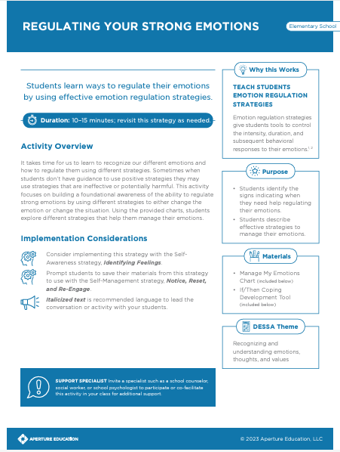
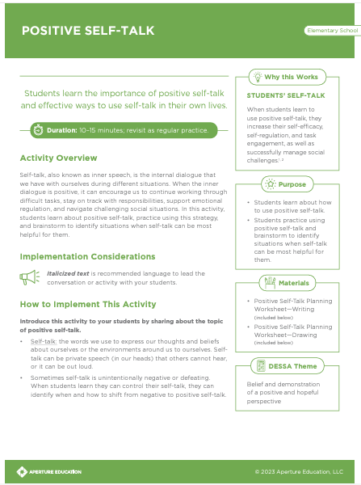
Strategies Tab: Strategies
Select lessons from our strategies that promote well-being
  Begin with 1-2 strategies
  Lessons take between 10-40 minutes.
  Consistency is important.
Set an implementation goal.
Share successes, challenges, and any needed supports.
Reflect and adjust as needed.
Notes:
Talking Points:
The Strategies resources are the next group of materials under the Strategies tab.
These lessons and activities are research-based, DESSA-aligned and provide direct instruction skills in the 6 competencies areas. Designed for Tier I (Universal) instruction, each strategy includes quick facilitation activities and options for extension activities so that educators have flexibility in how and when they incorporate wellbeing objectives into the school day!
Each Strategy is available as a downloadable PDF and includes suggested language, an activity and materials-needed list, teaching tips, and step-by-step implementation instructions all designed to ensure that incorporating wellbeing into the classroom is effortless.

Slide 50
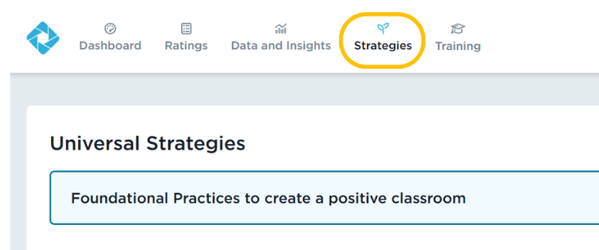
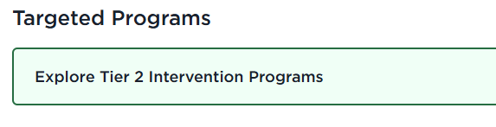
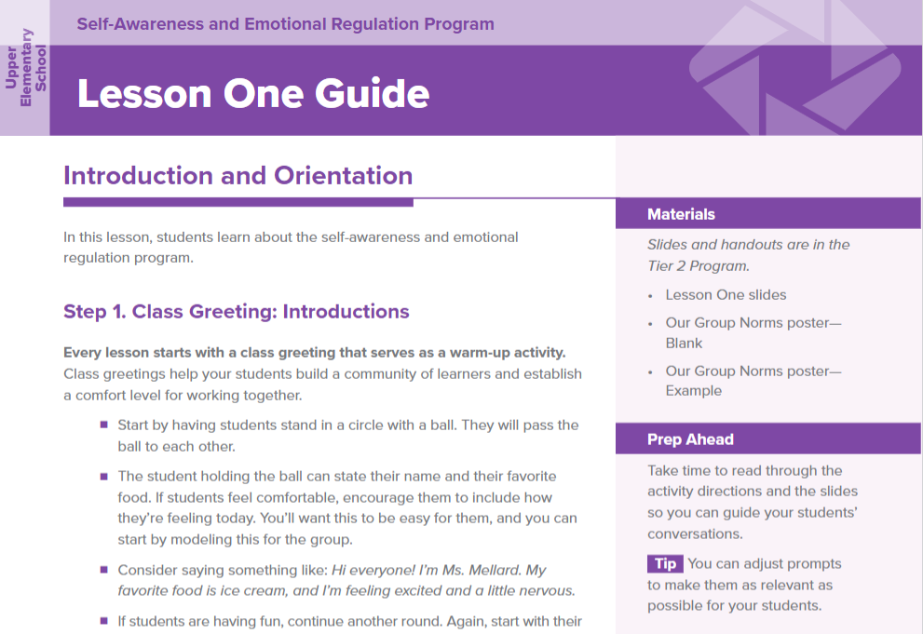
Strategies Tab: Tier 2 Intervention Programs
Sequenced, intensive lessons to develop student resilience skills with a focus on:​
Self-Awareness and Emotional Regulation
Social Awareness and Behavior Regulation
Social and Emotional Skill Development integrated with Academic Intervention
Responsible Decision Making
Relationship Skills
Notes:
Talking Points
The Tier 2 Intervention Programs consist of five multi-week programs designed for targeted, small group instruction for students who need intensive skill building.
Lessons within the Tier 2 Intervention Programs are designed to be delivered in a scope and sequence that builds skills through repeated practice and active engagement.
All of the intervention programs are available within the DESSA System, also under the Strategies tab.
The programs are grouped by grade bands: Early Elementary, Upper Elementary, Middle School, and High School.

Slide 51
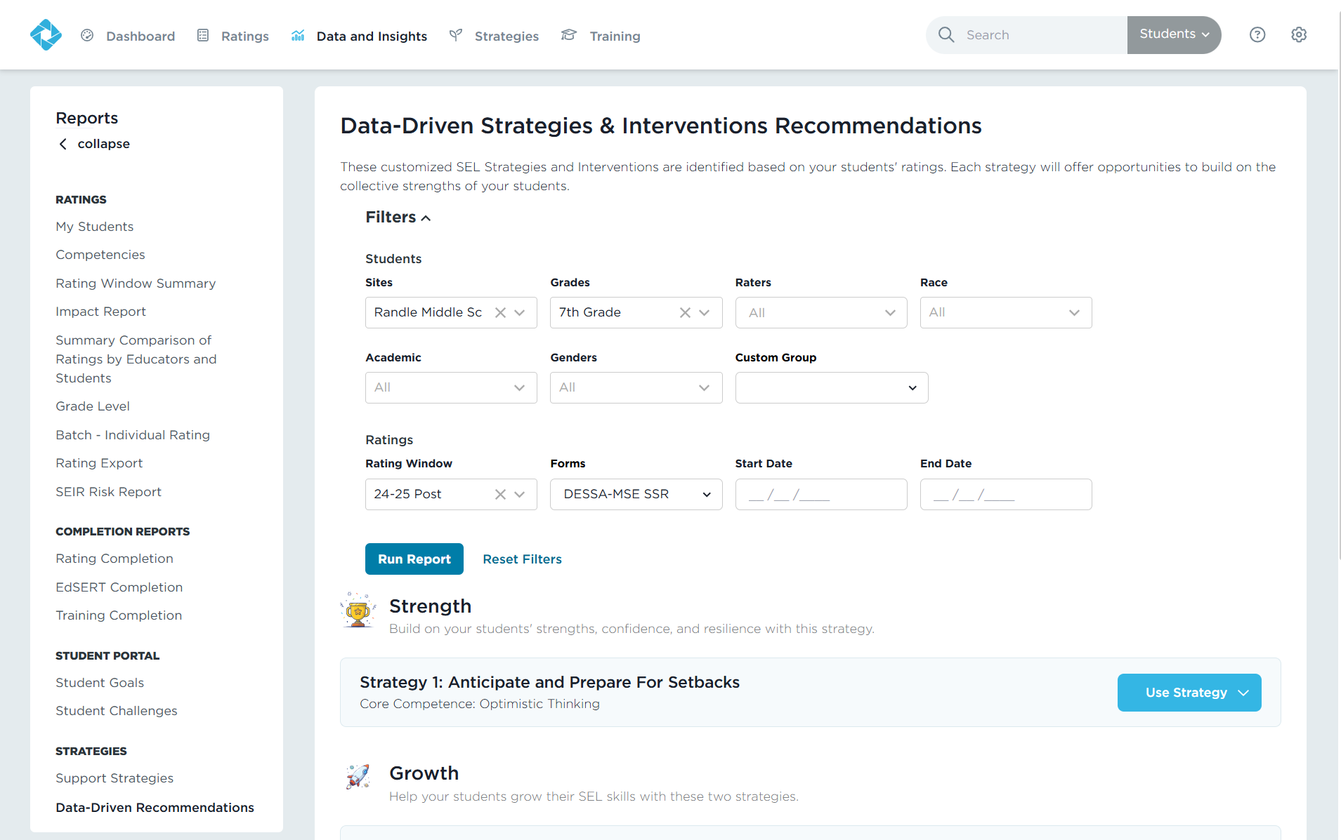
Report: Data-Driven Recommendations
1
Action:
Click Data and Insights
Select the Data-Driven Recommendations report
Apply any desired filters
Run the report
3
4
2
Notes:
Talking Points
You can go through the different Strategies lessons and Tier 2 Intervention Programs and select which ones you want to use in your classroom, but there is also a report built into the DESSA System that does exactly that.
The Data-Driven Recommendations report provides recommended Strategies and Tier 2 Intervention lessons based on the DESSA results.
This takes the “guess work” out of what to do with your data and how to select the lessons and strategies that would support your students growth.
Select this report from the under the Data and Insights tab, and add any desired filters, then run the report.

Slide 52
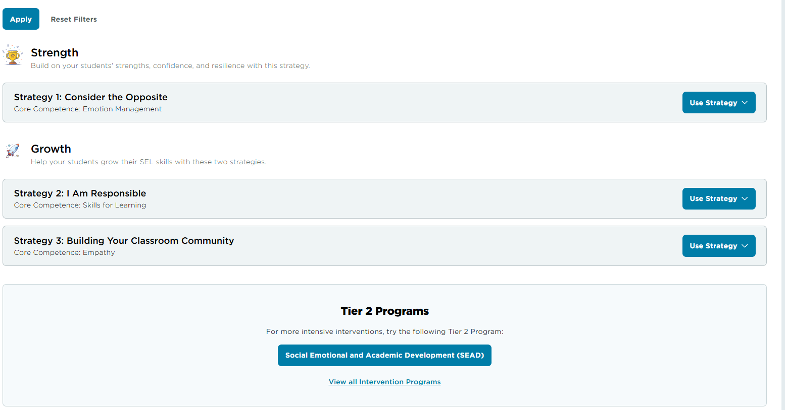
Report: Data-Driven Recommendations
Action:
Review the filtered group’s area of Strength and Growth.
Scroll down to see the recommended Tier 2 Program.
Notes:
Talking Points
Based on the results that were filtered for, this report will provide several different recommendations.
First, starting with strengths, a Strategies resource will be recommended for a competency area of collective strength. In this example, the data indicated a strength in Optimistic Thinking, so a Strategy activity titled “Anticipate and Prepare for Setbacks” is recommended. Building on student’s existing skills and supporting their continued growth helps them to make progress in other skill areas.
Then two Strategies for areas of growth are recommended for competency areas in which the data indicated a need for support. In this example, lessons in areas of Relationship Skills and Responsible Decision Making are recommended for the educator to implement.
After these materials are used, you can go back to the Strategies tab to view more resources within those recommended competency areas.
Additionally, a specific Tier 2 Intervention Program is recommended, again based on the data results. This example shows that the program focusing on Relationship Skills is recommended.

Slide 53
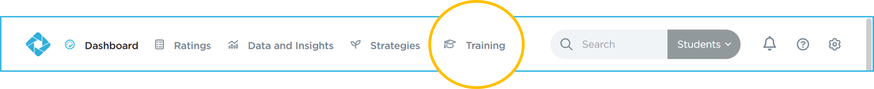
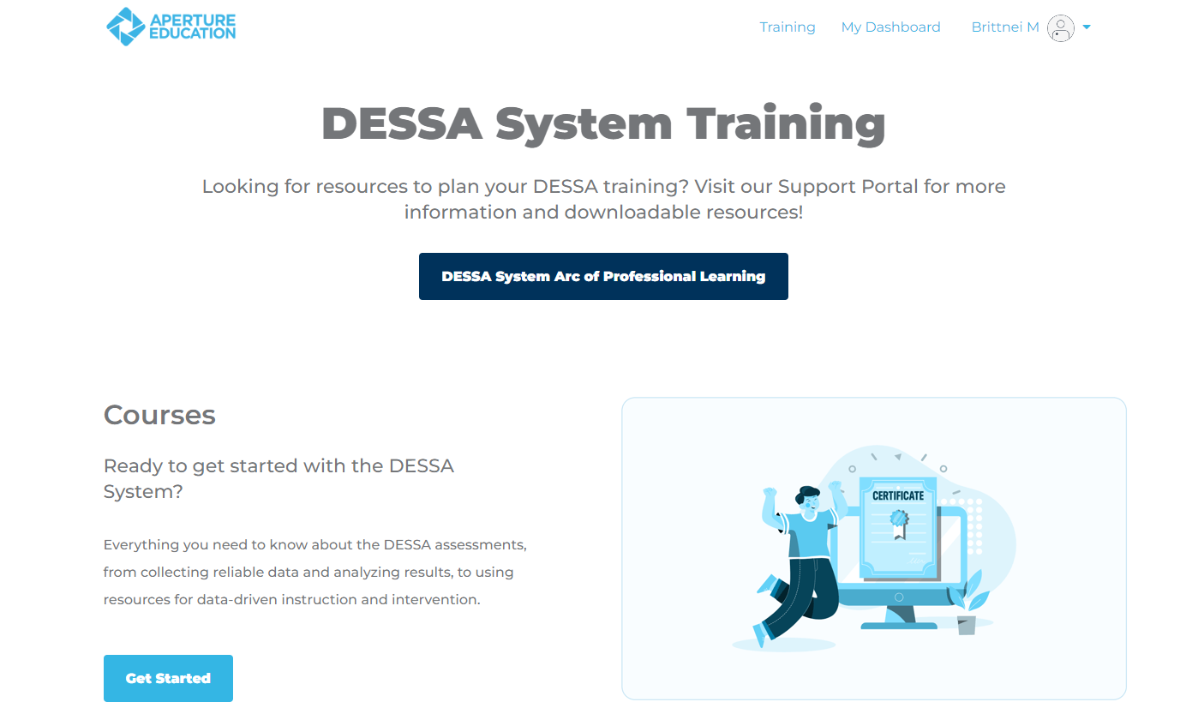
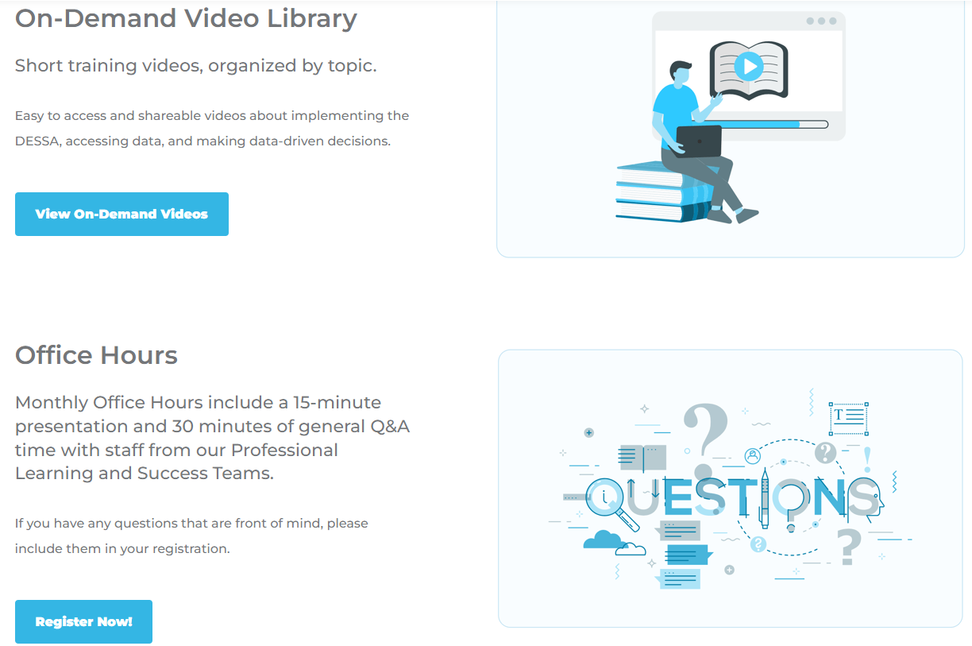
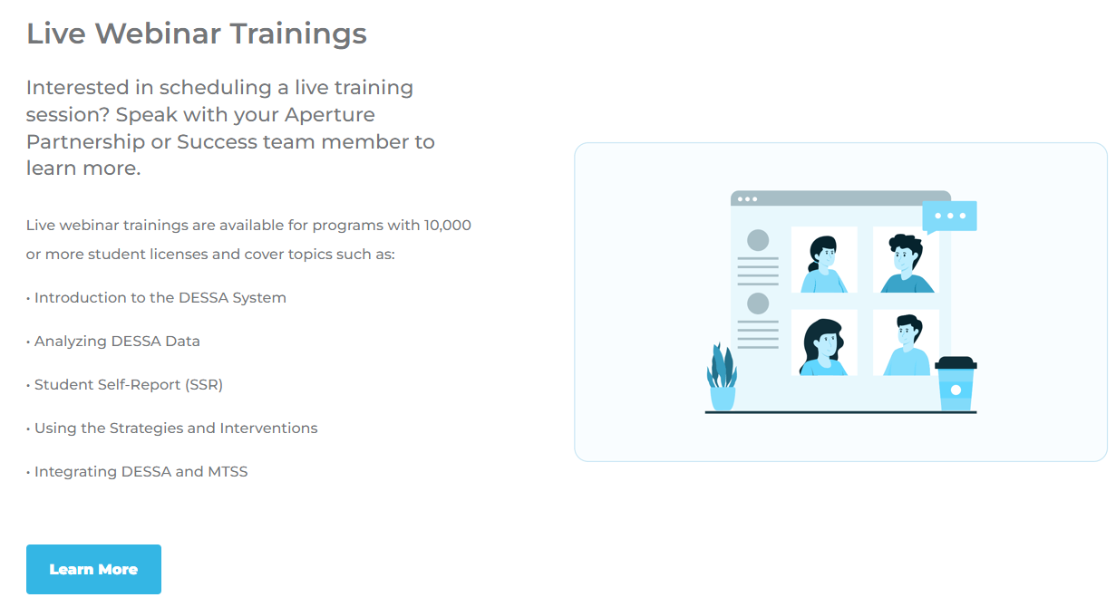
Training and Support Portal
Support Portal
Notes:
Talking Points:
There are a couple other areas and resources to highlight that can help you in your data analysis process after this training.
In your Educator Portal, you have access to both the Training tab and the Support Portal.
The training tab allows you to choose more learning options, such as self-paced courses for individuals who are new to the DESSA or those who just need a refresher, and an extensive On-demand Video library that has short videos on a lot of topics related to DESSA implementation. You can also register for monthly office hours with our DESSA team under the Training tab.
Additionally, the Educator Portal has an extensive Support Portal, a knowledge base complete with articles, resources, templates, and information for all-things DESSA implementation. This is where you can access other training materials to facilitate with your staff, if needed. To access the Support Portal, click on the circle with a question mark in it, always located in the top right side of the Educator Portal. The Support Portal is open 24/7, offering resources to help guide users through the DESSA system.
We also have more options for live trainings! Check out our list of webinar and on-site training options listed in the DESSA Arc of Professional Learning resources (in the support portal). Administrators can reach out to their DESSA contact for these options. https://info.apertureed.com/en/hc/dessa-system-arc-of-professional-learning

Slide 54
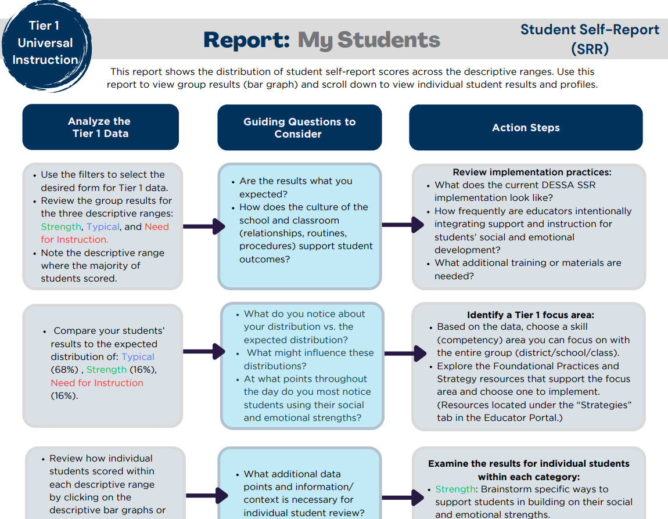
Resource:
Analyzing Tiered Data - Reports Guide
Located in the Support Portal
Notes:
Talking Points:
Speaking of the Support Portal, there are two specific resources to highlight for your data-driven practices.
The first one is our most commonly used resource, the Analyzing Tiered Data- Reports Guide. This resource provides step-by-step directions for accessing data by generating specific reports, guiding questions to consider, and suggested actions.
This report is the PDF version of the training that we did today, so it’s something you can take along with you to use as you work and collaborate with your teams to embed DESSA data into your existing structures of student support. I’ll drop the link in the chat now but you can also search for it within the Support Portal.
https://info.apertureed.com/en/hc/analyzing-tiered-data-report-guides

Slide 55
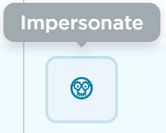
Explore the Data-Driven Resources
Actions:
Generate the Data-Driven Recommendations Report based on filters set
Explore the resources under the Strategies tab
Check out the Training tab and the Support Portal for additional resources
Engage with the DESSA Insights+ feature
  Impersonate an educator user, if needed:
    Settings cog → Admin → Staff → Select an Educator and click on the “Impersonate” icon to view their profile
Notes:
Talking Points
This is our last “pause” to review in your Educator Portal, this time looking at the different data-driven resources.
Take this time to generate the Data-driven recommendations report, explore the resources under the Strategies tab, check out the training tab and the Support Portal for additional resources, or engage with the DESSA Insights+ feature.
If you are an administrator or staff member with the Site Leader level user account, you can view an educator’s profile to see this feature in action. To impersonate a rater’s account, go to:
Settings cog → Admin → Staff → Select an Educator and click on the “Impersonate” icon to view their profile (these directions are on the screen)

Slide 56
Optimistic Closure
Strengths-based approach:
What is a main take-away for you today?
Notes:
Talking Points:
We have covered A LOT in this session and hopefully you are now feeling more prepared to take your data-analysis training offline to dive into the results and resources more.
Our Optimistic Closure prompt is: from a strengths-based approach, what is a main take-away for you today?
We know there often questions at this stage of implementation as you move in to using the collected data and that might even present some challenges to work through with a new implementation. But for today, what’s your main takeaway that excites you about using the DESSA?

