Slide 1
Getting Started with the DESSA Student Self-Report (SSR)
Notes:
Note to the Educator:
This student-facing resource is designed to support the overall implementation of the DESSA Student Self-Report (SSR) for middle and high school grades.
It includes foundational information to share with students, embedded opportunities for student engagement, step-by-step directions for accessing the Student Portal features, and additional resources.
Suggestions:
Prior to facilitation, preview the slide deck and adjust it for your students, as needed. Connect with your site-based administrator for implementation details that can be shared with students.
Visit the Aperture Education Support Portal for more information and to submit a support request: https://selcompass.zendesk.com/hc/en-us

Slide 2



What are we doing today?
You will reflect on your social and emotional skills to learn about your strengths and areas you may want to develop further (growth opportunities).
Why is it valuable?
These skills can support you academically, but can also support your personal wellbeing and relationships. These skills also support college, career, and workforce readiness!
Notes:
Note to the Educator:
The purpose of this slide is to introduce the topic of measuring social and emotional skills and highlight why this process is important.
Suggestions:
Connect with your district, school, or program administrator for specific implementation details that may be relevant to share with students.
Consider aligning existing initiatives to the DESSA SSR, such as:
PBIS
MTSS
College, career, and workforce readiness or Portrait of a Graduate programming
Share an SEL Skill you use in your role, and/or a skill you are working on

Slide 3
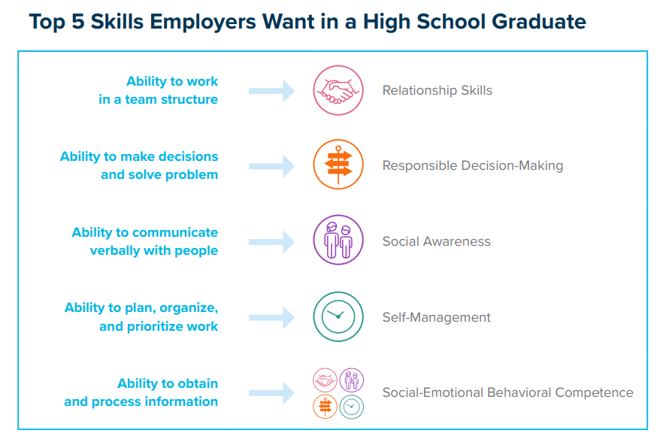
Top 5 Skills Employers Want in a High School Graduate
Notes:
Note to the Educator:
The purpose of this slide is to highlight how SEL skills support students with career readiness

Slide 4

Video: Student Portal Overview
Notes:
Slide Purpose: To review a Student Portal overview video.
Talking points:
Let’s take a look at an overview of the Student Portal! We’ll be sure to expand on these details following the short video. Students will see this video when they log into their Student Portal for the first time.
Click to play the video or access this link: https://www.youtube.com/watch?v=EWt1YMYDLLs

Slide 5
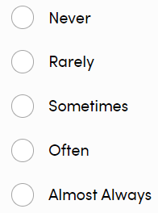
What will the questions look like?
Grades 6-12 | 50 questions
Answer Selection Options
Do your best to rate yourself.
I set goals for myself.
I show appreciation for others.
I feel comfortable being myself in different situations.
Notes:
Slide Purpose: To provide example questions asked on the SSR.
Talking points:
As a reminder, the questions asked on the SSR are strength based. Here we have a few examples. The sentence stem will always begin with “Do your best to rate yourself.”
The answer options include never, rarely, sometimes, often, and almost always. If you have students who may need support in identifying the difference, this may be a piece you can visit as a whole class.

Slide 6
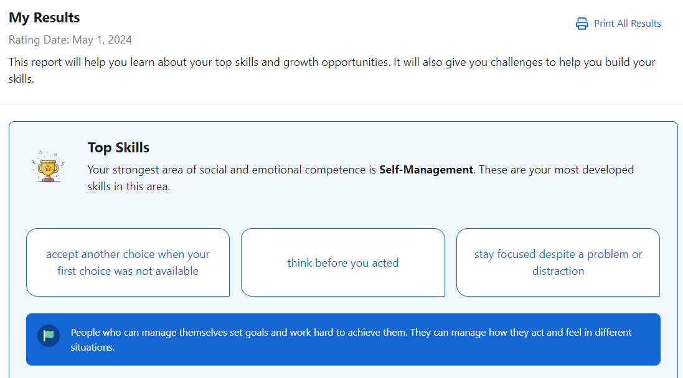
What will my results look like?
First, you’ll learn…
Your Top Skill
Specific ways you shine with this skill
Why this skill is important
Notes:
Note to the Educator:
Share with students that they will have access to their results in real time after they complete the DESSA SSR in the Student Portal.
Share with students who else will be able to see their results, such as their assigned educator, counselors, administrators, etc. Connect with your administrator for site-specific implementation details, as needed.

Slide 7
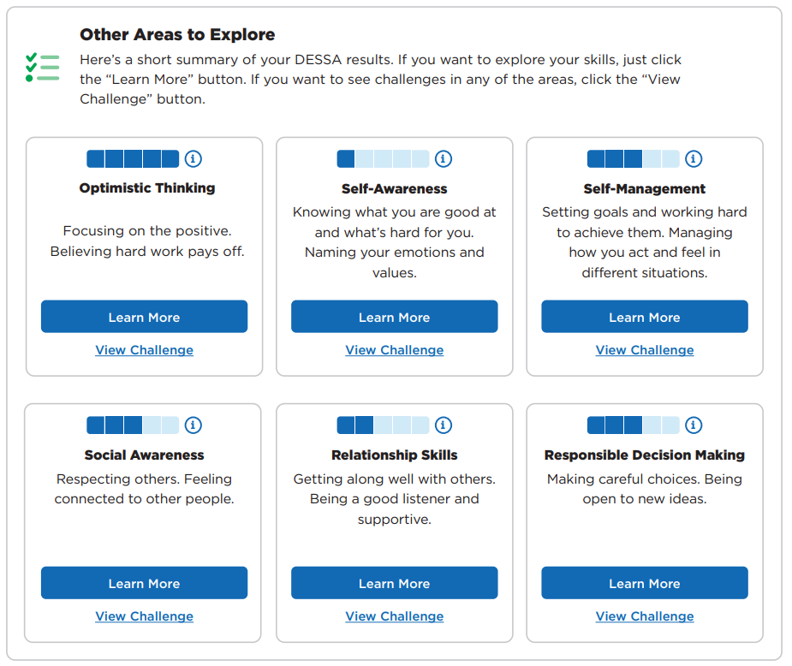
What will my results look like?
Then, you’ll be able to explore your skills in other competencies
Notes:
Note to the Educator:
Share with students that they will have access to their results in real time after they complete the DESSA SSR in the Student Portal.
Share with students who else will be able to see their results, such as their assigned educator, counselors, administrators, etc. Connect with your administrator for site-specific implementation details, as needed.

Slide 8
Let’s Get Started!
Notes:
Note to the Educator:
This student-facing resource is designed to support the overall implementation of the DESSA Student Self-Report (SSR) for middle and high school grades.
It includes foundational information to share with students, embedded opportunities for student engagement, step-by-step directions for accessing the Student Portal features, and additional resources.
Suggestions:
Prior to facilitation, preview the slide deck and adjust it for your students, as needed. Connect with your site-based administrator for implementation details that can be shared with students.
Visit the Aperture Education Support Portal for more information and to submit a support request: https://selcompass.zendesk.com/hc/en-us
Review the Support Portal Article: How to Talk to Your Students about Their SSR Data: https://selcompass.zendesk.com/hc/en-us/articles/16362862103565-Talking-to-Students-About-Their-SSR-Data AND Responding to Student Self-Report Data: https://selcompass.zendesk.com/hc/en-us/articles/7150556819469-Responding-to-DESSA-Student-Self-Report-Data

Slide 9

First time log into your Student Portal without
Single Sign On (SSO)
Option 1: Login using the website link
Direct the students to go to: https://student.apertureed.com/login
Select First Time User? Register Now
Make sure you have your Username and ID (your teacher will give it to you)
Enter your username
Enter you Student ID
Create a password
Re-enter the password
Complete registration and login
Option 2: Use Your Individual QR Code
Your teacher may give you a specific individual QR code to scan. Your specific QR code will have your individual Student Username and ID filled in, and you can create your own password and login.
Teachers and/or Site Leaders: To access to students' unique Usernames within the DESSA System, review the DESSA Student Self Report: Student Registration Guidance resource for instructions on how to access and distribute this information. After registering, students can go to the student login page and enter their credentials to access their Student Portal dashboard.

Slide 10
Log into your Student Portal- with ClassLink Single Sign On (SSO)
From the ClassLink Launch Pad, you can select the DESSA Student App to be automatically logged in and taken directly to the DESSA Student Portal, ready to begin using the system.
Notes:
Teacher Note: The ClassLink SSO does not require students to register for the first time login process. Students can access the DESSA Student App the first time they login and every subsequent login.

Slide 11
Log into your Student Portal- with Clever
Single Sign On (SSO)
You will select the DESSA Student app from your Clever home page. If this is your first time logging in, you may be prompted to complete a one-time registration process or you will be logged into the Student Portal directly.
If Prompted To Register: Enter your DESSA Username and Student ID. Your teacher will give you your username and ID for this process.
Teachers and/Or Site Leaders: Review the DESSA Student Self Report: Student Registration Guidance for instructions on how to access and distribute this information. After registering, students can simply select the DESSA Student app from Clever to be immediately logged in to the DESSA Student Portal.

Slide 12
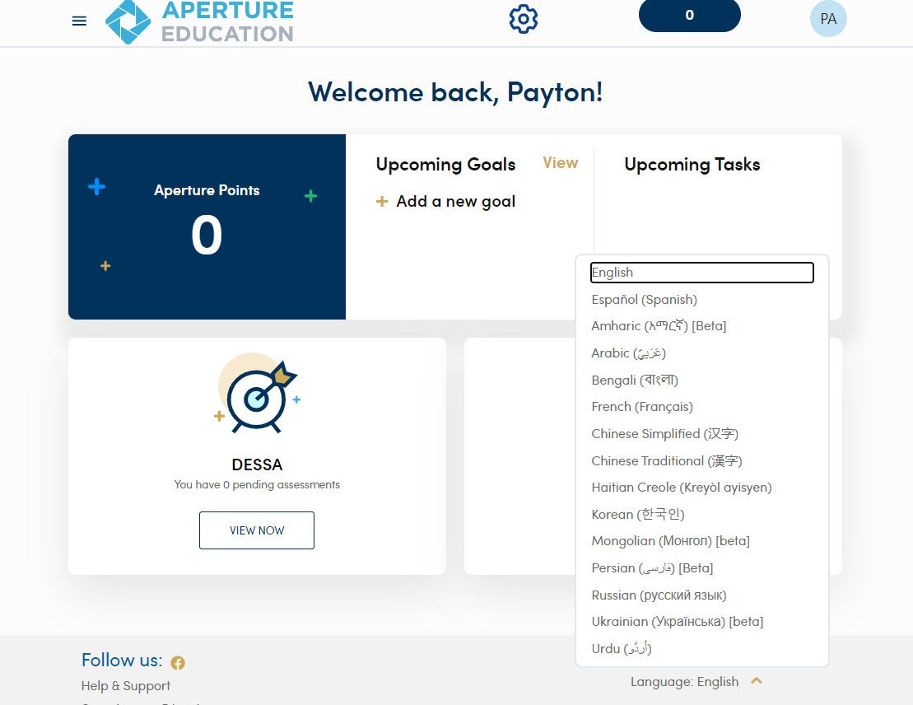
Completing the DESSA
After logging in:
Select your language in the Student Portal.
Notes:
Note to the Educator:
Activity Purpose: Students complete the DESSA in their Student Portal.
Review Step 2 of completing the DESSA.

Slide 13
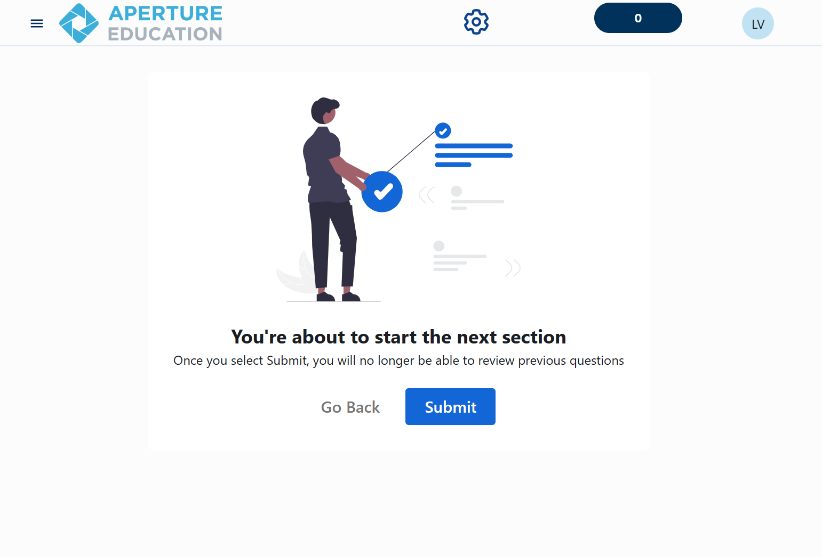
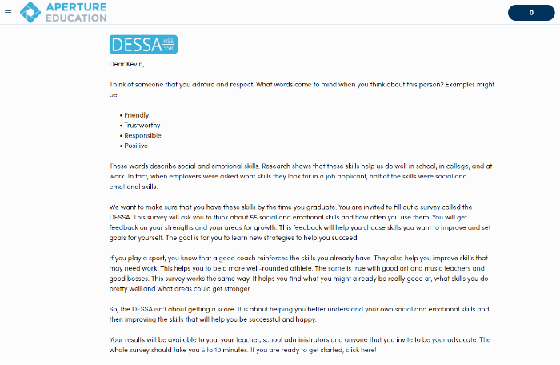
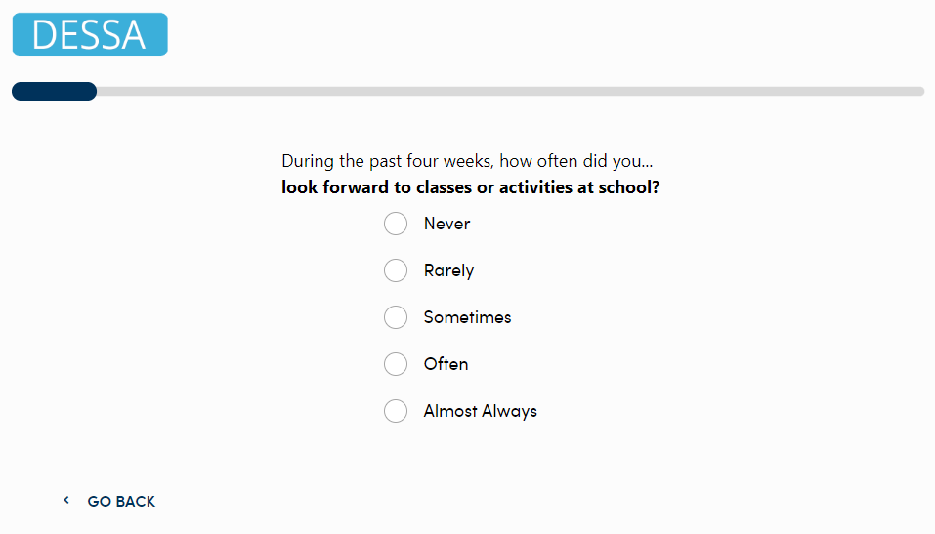
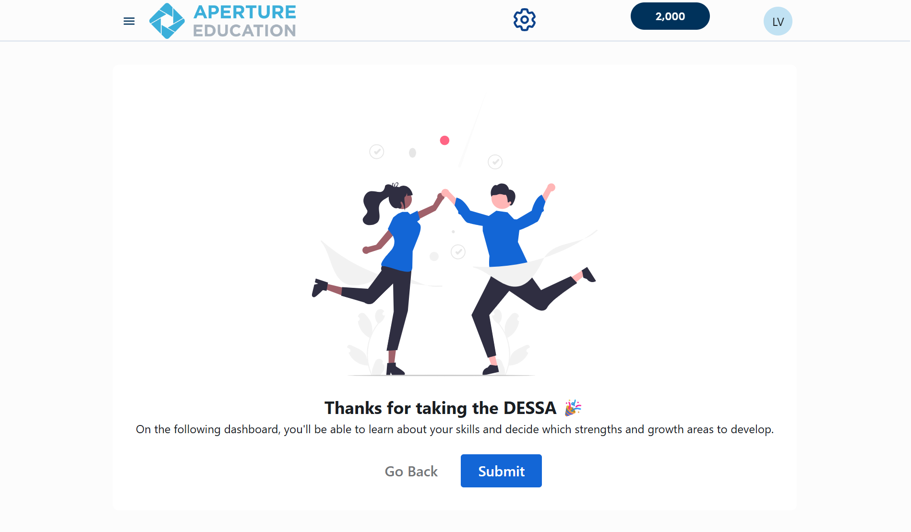
Completing the Student Self-Report
First:
Read the Welcome Letter about what the DESSA is and its purpose.
View the video and then click Begin at the bottom of the page.
Then:
Answer the DESSA SSR questions.
To return to a previous question, click Go Back at the bottom of the screen.
You may be prompted to complete a second section of questions. When finished, click the Submit button.

Slide 14
After the Student Self-Report is Completed
Notes:
Note to the Educator:
This student-facing resource is designed to support the overall implementation of the DESSA Student Self-Report (SSR) for middle and high school grades.
It includes foundational information to share with students, embedded opportunities for student engagement, step-by-step directions for accessing the Student Portal features, and additional resources.
Suggestions:
Prior to facilitation, preview the slide deck and adjust it for your students, as needed. Connect with your site-based administrator for implementation details that can be shared with students.
Visit the Aperture Education Support Portal for more information and to submit a support request: https://selcompass.zendesk.com/hc/en-us

Slide 15
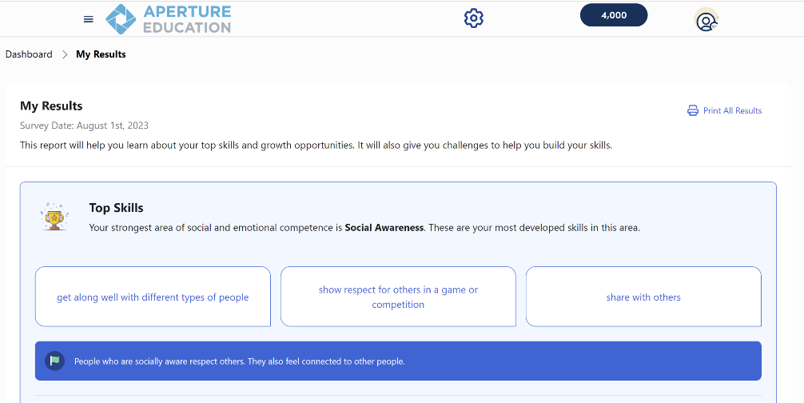
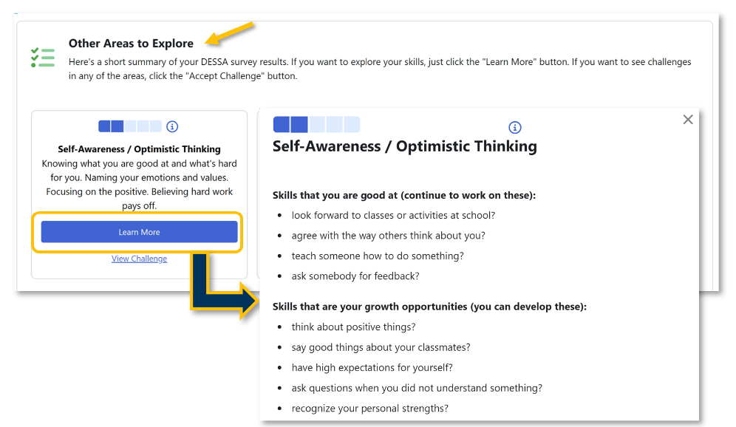
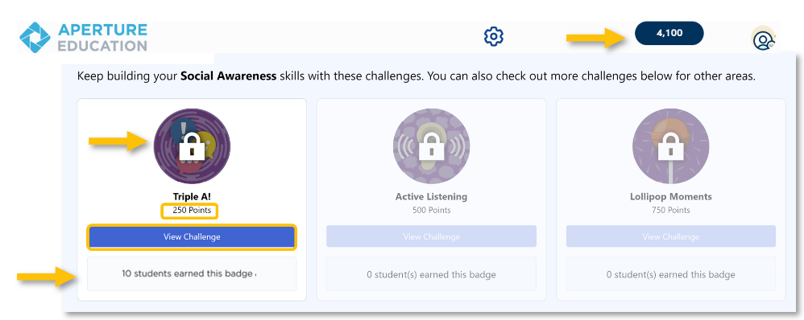
My Results
First:
Review your Top Skill
Then:
Scroll down to view results and learn more about each social and emotional competency (skill).
Next:
Keep building your strengths with suggested challenges.
Unlock a new badge and earn points with every challenge you complete.

Slide 16
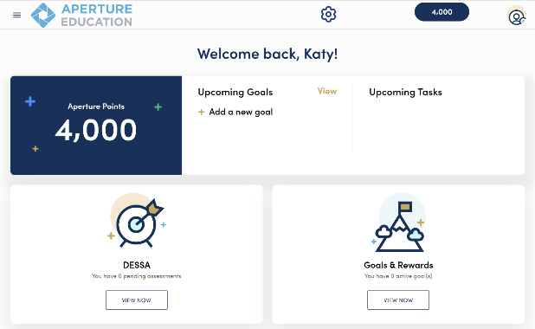
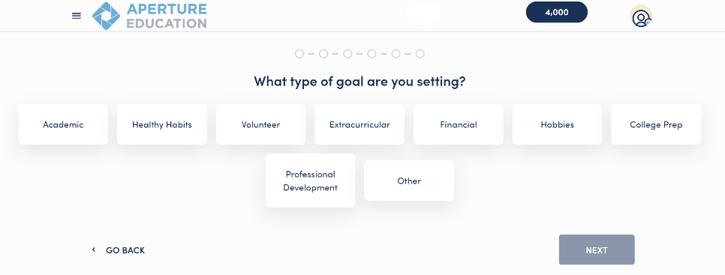
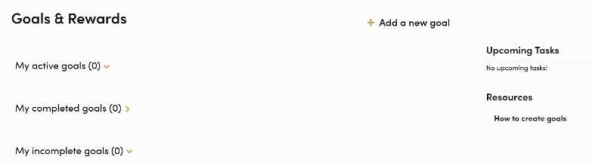
Set Personal SMART Goals
Select the “Goals & Rewards” section on the Dashboard.
Select “Add a new goal.”
Use the self-guided prompts to help create a personal goal that is relevant to you.
Earn points for submitting and completing your goals!
Notes:
Note to the Educator:
Remind students that they also have the option to set personal SMART goals within the Student Portal.
Students can access this feature by selecting the “Goals and Rewards” section of the dashboard and then selecting “Add a new goal.”

